Slide 1
Instructional Practices| Unit 6: Instructional Alignment| Lesson 6.06
Sequencing the Content of a Lesson
This work is licensed under a Creative Commons Attribution-Noncommercial-Share Alike 4.0 International License.

Slide 2
TEKS Standards & Objectives
TEKS 3B, 6A, 6C, 6F
The student will:
Describe and explain how a lesson is intentionally structured to build student understanding
Identify and evaluate how learning is sequenced within a single lesson to build understanding

Slide 3
Bellringer
Look at the list of skills below and place them in order from the skill that is taught first to the skill that is taught last.
Writing an essay
Drawing a line
Writing a complete sentence
Drawing a circle
Writing the letter C
Writing a simple word
Writing a paragraph

Slide 4
Vocabulary
Sequencing: Organizing concepts in an order that starts simply and build in complexity.

Slide 5
Example of Sequencing in a Lesson
Activity | Skills/Concepts
Warm-up | Producing short vowel sounds for i, a, and o
Sound Riddles | Repeat, identify, and produce words with /b/
Minimal Pairs | Recognizing the difference between the /b/ sound and /p/ sound
Rhyming Words | Identifying rhyming words with /b/ and /p/
Spelling /b/ | Teacher models how to write B, students practice writing B
Student Chaining | Students make new words from old words by chaining one letter in the word. All the words use the short vowels o, a, and i and the /b/ and /p/ sounds.

Slide 6
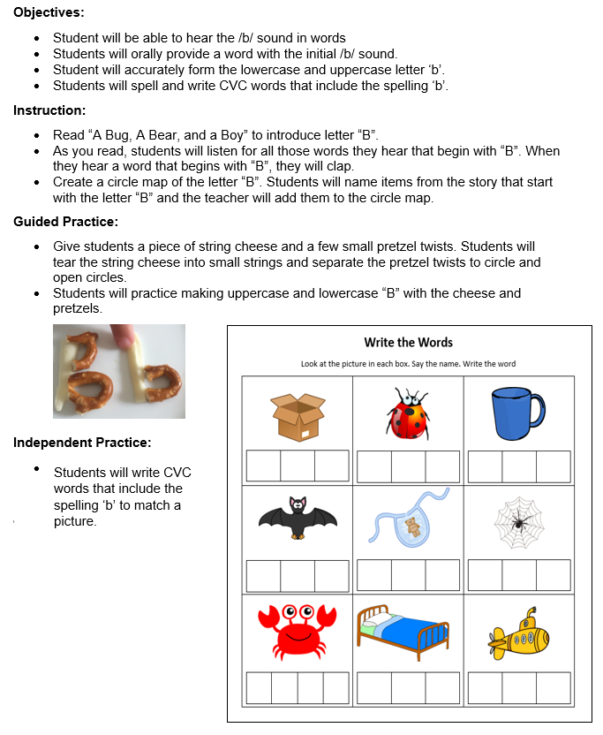
Activities Students will Engage With
Read through the activities the students will engage in during the lesson.

Slide 7
Non-Example of Sequencing in a Lesson
Activity | Skills/Concepts
Story | Listen for words that begin with ‘b’ and clap
Circle Map | Students name items from the story that started with letter ‘b’ – teacher adds to the circle map
Letter ‘b’ with string cheese and pretzels | Students make upper- and lowercase ‘b’ with string cheese and pretzels
CVC Worksheet | Students write CVC words with initial and final ‘b’

Slide 8
Exit Ticket
Look at the following lesson sequence and determine if the learning is structured to build student understanding.
If not, make suggestions for how the teacher could better sequence the instruction.
What do you notice about how the learning is sequenced? What could the teacher do to better sequence the instruction and build student understanding?
Respond to the following questions:
How does intentionally sequencing the concepts and skills in a lesson support student learning?
How does the sequencing of a lesson relate to the Science of Learning?
What might be the impact of a lesson where the learning is not sequenced?
Standard | 2.5A - determine the value of a collection of coins up to one dollar
Objectives | Demonstrate understanding of coin values Create coin combinations that are equal to one dollar
Activity | Skills/Concepts
The Coin Counting Book | The teacher introduces counting money by reading the Coin Counting Book by Rozanne Lanczak Williams
Review of Coin Values | Teacher holds up a picture of a coin and students tell the value
Guided Practice | Each student is assigned a specific coin to represent. Students stand up and group with other students to make a dollar
Independent Practice | Students draw and label four different coin combinations to make a dollar

