Slide 1
Instructional Practices| Unit 6: Instructional Alignment| Lesson 6.09
Scaffolding a Lesson | Modeling, Part II
This work is licensed under a Creative Commons Attribution-Noncommercial-Share Alike 4.0 International License.

Slide 2
TEKS Standards & Objectives
TEKS 3B, 6A, 6C, 6F
The student will:
Define and describe characteristics of effective modeling
Identify and apply examples of modeling within a lesson
Evaluate the modeling within a lesson based on characteristics of effective modeling

Slide 3
Bellringer
Look at each lesson example below and determine if it is an example of the “I do”, “We do”, or “You do” portion of the lesson. Write if it is “I do”, “we do”, or “you do” beside the example number.

Slide 4
Vocabulary
Modeling: An instructional strategy where the teacher demonstrates how to perform a skill while describing each step with a rationale.

Slide 5
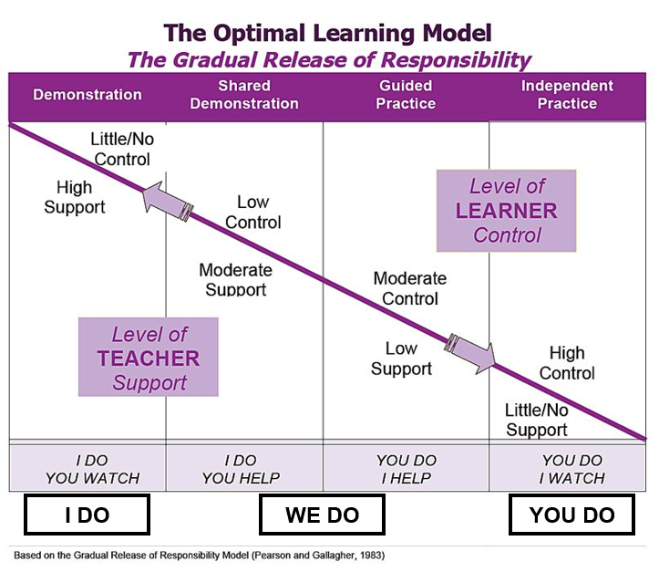
Gradual Release of Responsibility

Slide 6
Success Criteria for Successful Modeling
  Break down the skill into learnable steps
  Visually demonstrate the steps as students watch
  Think Aloud = Verbally explain what the student is seeing as you model
  Make important connections between the steps
  Check for student understanding along the way and re-model steps as necessary
  Ensure pacing is just the right speed
  Allow opportunities for students to ask questions and get clarification

Slide 7
Video: (17:05-21:40)
https://drive.google.com/file/d/1lHi5hQwbWuIhCER7G3hNn8DHZkA-zwGO/view?usp=sharing

Slide 8
Exit Ticket
Review the scenario below to determine whether it meets the characteristics of effective modeling. If the criteria are not met, provide a suggestion for improvement.
A 1st grade teacher is teaching her students how to solve addition problems by making a bar model. The teacher introduces the following word problem:
Tom has 5 books in a box. He puts 3 more books in the box. How many books are in the box?
The teacher does a think aloud for the following question: What do we need to find? She explains that we need to find how many books are in the box. She then asks students to think about what information from the word problem they need to use. The teacher underlines important information in the word problem, such as 5 books and 3 more books. The teacher then draws a bar model to show students how to put the information they found in the word problem into a bar model. Last, the teacher wrote the equation 5 + 3 = 8.
How does teacher modeling help build student understanding and mastery of the standard?

