Slide 1
Instructional Practices| Unit 7: High Leverage Teaching Practices| Lesson 7.06
Worked Examples
This work is licensed under a Creative Commons Attribution-Noncommercial-Share Alike 4.0 International License.

Slide 2
TEKS Standards & Objectives
TEKS 4B, 6D
The student will:
Describe worked examples
Compare and contrast worked examples and modeling as a strategy
Define, practice, and reflect on strategies for providing worked examples for students

Slide 3
Bellringer
Describe each of the key practices in an effective model and explain why they help learning.

Slide 4
Vocabulary
Worked Examples: Step-by-step demonstrations of how to perform a task or solve a problem.

Slide 5
Benefits of Worked Examples
Helpful when students have little to no prior knowledge of the skill to be learned - demonstrates the process to students step-by-step so students learn what they need to do and what success looks like.
They focus on the process rather than the answer. This allows the brain to utilize all the power of the working memory to applying information, thus reducing the cognitive load.

Slide 6
Criteria for Effective Worked Examples
Focuses on the process: Removing the need to find a solution reduces cognitive load for students, especially when the information is new.
Provides steps and Rationale: Shows expert thinking and highlights key important details. The rationale is important to highlight so students know not just what to do by why it is important to the process.
Increases in complexity: Examples move from basic to more challenging. This helps the learner to transition from using the example as a reference to mimic to thinking more deeply and understanding the process. It is important that all problems are appropriately challenging; challenging enough to push the students but not too much that they become frustrated with the process.

Slide 7
Example
Mr. Brooks, a high school algebra teacher is teaching students how to solve for an unknown variable. He began by using the example below. He walked the students through the example providing the explanations of each step listed.
8x + 3 = 17 + x | The goal is to figure out what x must be.
8x + 3 – (x) = 17 + x – (x) 7x + 3 = 17 | Subtract x from both sides to remove x from the right side. The goal is to get the x’s on only one side of the equation.
7x + 3 – (3) = 17 – (3) 7x = 14 | Subtract 3 from both sides to further isolate the x. We need to get x by itself on one side of the equation.
7x /7 = 14/7 X = 2 | Divide both sides by 7 to solve for the value of x

Slide 8
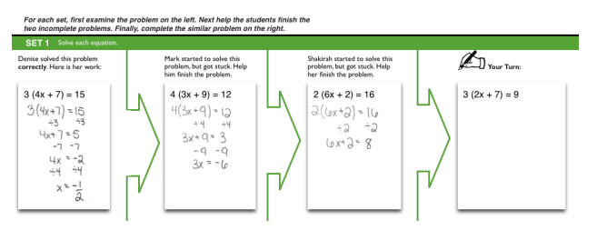
Example (Continued)
He then moved to a practice set where he walked the students through the examples below as a class before asking the students to solve the last problem independently.

Slide 9
Non-Example
Mr. Jones, a science teacher, is teaching students how to convert one unit of measure to another in the metric system. The students are new to the concept of converting units. He stared by demonstrating how to convert kilograms to grams using the problem below:
4.8 kilograms | The goal is to convert kilograms to grams
4.8 kg x 1000 g 1 1 kg | To convert kg to grams multiply by 1000.
4.8 x 1000 = 4800 | You get 4,800 g

Slide 10
Non-Example (Continued)
He then gave the students time to practice their conversions by completing the following practice problems:
Express the following mass in units of grams.
5.89 kg = _______ g
3 kg = _______ g
0.18 kg = ______ g
4.20 kg = _______ g
6.5 kg = ______ g
Express the following mass in units of kg.
12,240 g = _______ kg
15 g = _______ kg
565 g = _______ kg
4,000 g = ______ kg
3, 920 g = ______kg

Slide 11
Exit Ticket
What is a worked example? How is it the same or different from the strategy of modeling?
Look at the scenario provided on your Exit Ticket for a worked example. Does this worked example meet the criteria to be effective? Provide evidence for your decision based on the chart of criteria.

