Slide 1
Instructional Practices| Unit 7: High Leverage Teaching Practices| Lesson 7.09
Questioning | Using Questioning Strategies to Support Student Learning
This work is licensed under a Creative Commons Attribution-Noncommercial-Share Alike 4.0 International License.

Slide 2
TEKS Standards & Objectives
TEKS 3B, 14F
The student will:
Identify the different types of questions teachers can ask with their purpose in the classroom
Analyze questions from a lesson for evidence of high-quality questioning strategies

Slide 3
Bellringer
What do you remember about the characteristics of effective questions?
How does the use of meaningful questions lead to cognitive engagement and student understanding?
How do teachers use questioning to inform their instruction?

Slide 4
Vocabulary
Bloom’s Taxonomy | A model used to classify thinking into levels of rigor.
Lower-Level Questions | Questions that require students to recall or restate information that is relatively easy to give
Higher-Level Questions | Questions that require students to think deeply and critically about a topic
Closed Questions | Questions that have a limited number of acceptable answers
Open Questions | Questions that have many acceptable answers and that promote deeper thinking and building of connections

Slide 5
Why Questioning is Important
Encourages extended student response
Engages students in effective class discussions
Fosters student involvement
Facilitates a positive, active learning environment
Helps teachers to challenge students and learn more about how they think.
Helps teachers to understand what students know/don’t know

Slide 6
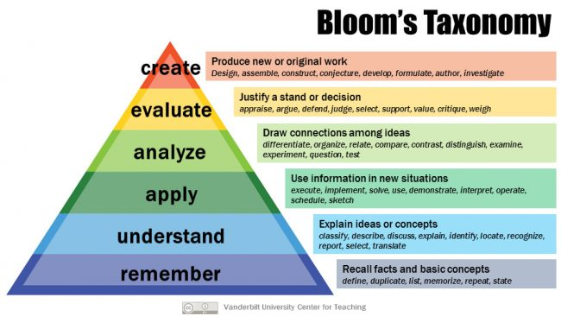
Bloom’s Taxonomy

Slide 7
Lower-Level Questions
Questions that require students to recall or restate information that is relatively easy to give
Level of Blooms | Remember, Understand, Apply
Purpose | Review or summarize content Assess comprehension Check student understanding Determine student strengths & weaknesses
Examples | Define theme. What are the three branches of government?
Non-Examples | What second theme could be added to this story, and how would you change the story to support the additional theme? What is the function of each of the three branches of government and how do they compare?

Slide 8
Higher-Level Questions
Questions that require students to go beyond simple information and think deeply and critically about a topic
Level of Blooms | Analyze, Evaluate, Create
Purpose | Encourages students to think more deeply and critically about the content Develops & engages students in problem solving Encourages discussions Requires students to apply, not just recall prior knowledge and understanding to respond
Examples | Why do you agree or disagree with the theme of this story? Think of a time in history when the system of checks and balances was challenged. What was the result?
Non-Examples | What is the theme of the story? What are the three branches of government?

Slide 9
Closed Questions
Questions that have a limited number of acceptable answers and are useful to check students’ understanding
Level of Blooms | Can be used at both lower & higher-level questioning
Purpose | Questions where there is a limited number of acceptable answers Doesn’t require students to elaborate on their responses Beneficial in helping to retrieve core knowledge & facts
Examples | Who was the first person to walk on the moon? How do the hairs on a gecko’s toes work together to help it carry so much weight? What is the meaning of “tear” as it is used in the text? (higher level)
Non-Examples | What benefits have come from space exploration? Why do you think the pilot was/wasn’t fit to do the job?

Slide 10
Open Questions
Questions that have many acceptable answers and that promote deeper thinking and building of connections
Level of Blooms | Can be used at both lower & higher-level questioning
Purpose | Questions where there are many acceptable answers, many of which might not be anticipated by teacher Promotes higher order thinking and building of connections
Examples | How are the main character’s actions important to the plot of the story? How can we use the features of a gecko to help us develop modern medicine practices? How would you describe a metamorphic rock? (lower-level)
Non-Examples | What is the main character’s name in the story? What does a gecko have on its toes to help it carry up to 200 pounds?

Slide 11
Guided Practice
A 3rd grade teacher is planning instruction for a science lesson with the following objectives:
  Students will define land
  Students will observe land areas and describe their natural features.
The teacher plans to use an inflatable globe model of Earth. Students will pass the globe around the classroom and point to an area they think shows land. The teacher wants to ask questions during the activity and after the activity to gauge students understanding of land and find out how students decided which parts of the globe were land.

Slide 12
Guided Practice: Question Drafts
  What is this an example of?
  Is this an example of land?
  How did you decide which parts of the globe were land?
  What information do you think a globe gives us about land?
  Why is it difficult to describe land using only a globe?
  What other tools could you use to help you describe land?
  How would you describe land?

Slide 13
Exit Ticket
Draw a line to match each question type with the corresponding definition.
Analyze the questions (on your Exit Ticket) about a story to determine if they are low/high level and open/closed and explain your reasoning.

