Slide 1
Instructional Practices| Unit 7: High Leverage Teaching Practices| Lesson 7.10
Questioning | Engaging Students in the Questioning Process
This work is licensed under a Creative Commons Attribution-Noncommercial-Share Alike 4.0 International License.

Slide 2
TEKS Standards & Objectives
TEKS 3B, 14E
The student will:
Explain why it is important for students to generate questions in the classroom
Identify, practice, and reflect on strategies for supporting students in developing questions in the classroom

Slide 3
Bellringer
Studies have shown that 4-year-olds ask as many as 200-300 questions a day. Between the ages of 2-5, kids ask on average 40,000 questions!
Why do you think it is important for students to ask questions?

Slide 4
Vocabulary
Student Generated Questions | Questions developed by students to help demonstrate their understanding of the content being taught and direct their own learning to understanding more about the content.
Question-Answer-Relationship (QAR) | A strategy to help students understand the relationship between a question and its answer.
Right There Questions | Explicit questions whose answers can be found in the text. Often the words used in the question are the same words found in the text.
Think and Search Questions | Explicit questions whose answers are gathered from several parts of the text and put together to make meaning.
Author and Me | The answer to the question cannot be found directly in the text. The learner must combine information provided in the text with their own prior knowledge to create a response.
On My Own | The answer to the question cannot be found directly in the text. These questions require the learner to use their background or prior knowledge to answer the question.

Slide 5
A teacher can help students develop questions by:
Modeling explicitly how to ask good questions
Providing structured ways for students to ask questions
Setting expectations that asking questions is the norm in the classroom.

Slide 6
Right There Questions
Definition | Explicit questions whose answers can be found in the text. Often the words used in the question are the same words found in the text.
Question Starts With | Who What When Where How
Example | Where did the story take place?
High or Low Level | Low Level
Open or Closed | Closed

Slide 7
Think and Search
Definition | Explicit questions whose answers are gathered from several parts of the text and put together to make meaning.
Question Starts With | How did…? Summarize Describe Compare What caused…?
Example | Why was Baby Bear upset?
High or Low Level | Low Level
Open or Closed | Closed

Slide 8
Author & Me
Definition | The answer to the question cannot be found directly in the text. The learner must combine information provided in the text with their own prior knowledge to create a response.
Question Starts With | Predict what will happen Why did the author…? What is the main idea?
Example | What kind of person is Goldilocks?
High or Low Level | High Level
Open or Closed | Open

Slide 9
On My Own
Definition | The answer to the question cannot be found directly in the text. These questions require the learner to use their background or prior knowledge to answer the question.
Question Starts With | What is your opinion about…? How would you feel…? What would you do…?
Example | Goldilocks sat in Baby Bear’s chair and broke it. Write about a time you broke or damaged something that did not belong to you.
High or Low Level | High Level
Open or Closed | Open

Slide 10
Roly-Poly Pill Bugs
Question | Type of Question | Reasoning
Why are pill bugs nicknamed “roly-poly”? | Right there | The answer can be found directly in the text.

Slide 11
Roly-Poly Pill Bugs
Question | Type of Question | Reasoning
Which statement from the article is an opinion? a. This bug is scared of you, not the other way around. b. A pill bug molts about five times until it is full-grown. c. Pill bugs aren't just nice bugs; they are interesting ones. d. One of their favorite hang-outs is under damp flower pots | On My Own | The answer cannot be found directly in the text. Students must use their own prior knowledge to answer the question.

Slide 12
Roly-Poly Pill Bugs
Question | Type of Question | Reasoning
In what ways is the pill bug similar to other creatures? | Think and Search | The answers are found directly in the text but are gathered from several parts of the text and put together to make meaning.

Slide 13
Roly-Poly Pill Bugs
Question | Type of Question | Reasoning
Where would you be least likely to find a pill bug? | Author and Me | These questions are based on information provided in the text, but the student is required to relate it to their own experience. Although the answer does not lie directly in the text, the student must have read it to answer the question.

Slide 14
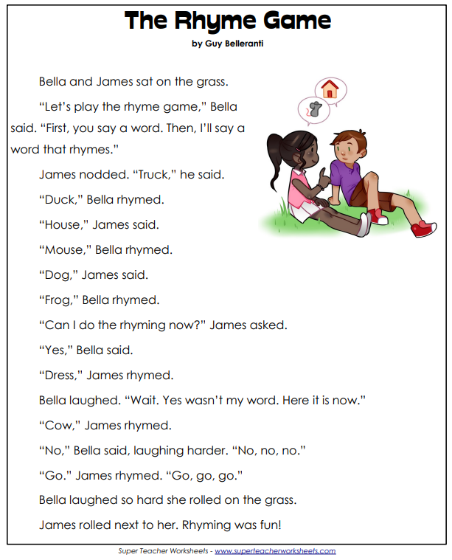
Exit Ticket
Read the following passage and examine the corresponding questions to determine if each question is Right There, Think and Search, Author and Me or On My Own. (See graphic organizer on Exit Ticket)
How did the QAR strategy help you to develop deeper questions?

