Slide 1
Instructional Practices| Unit 7: High Leverage Teaching Practices| Lesson 7.11
Metacognition
This work is licensed under a Creative Commons Attribution-Noncommercial-Share Alike 4.0 International License.

Slide 2
TEKS Standards & Objectives
TEKS 4B
The student will:
Define metacognition and explain how metacognitive strategies support student learning
Identify and describe the impact of metacognitive strategies
Practice think-alouds to make thinking visible

Slide 3
Bellringer
Have you ever talked to yourself as you were working through a problem? Why might it be beneficial for someone to verbalize their thinking as they are solving problems?

Slide 4
Vocabulary
Metacognition | Thinking about your thinking
Think-aloud | A strategy used to verbalize one’s thinking in order to make it explicit

Slide 5
Introduction to Metacognition
Metacognition: Thinking about ones thinking
Benefits of Metacognition:
Improves student learning
Enhances:
  control over learning and
  personal ability to self-regulate our thinking and motivation

Slide 6
Metacognitive Strategies
  Planning how to approach new tasks or new information (What’s my purpose or goal? Where should I start? What obstacles might I encounter and how can I plan to avoid them?)
  Identifying and planning for challenges (What might be hard for me? What are some strategies for moving forward?)
  Consulting prior knowledge (What do I know about this already? How can I use what I know to make predictions?)
  Evaluating your progress (Where am I in the process? How am I doing? Am I on track?)
  Monitoring comprehension (Am I understanding? Where might I be getting stuck? What do I need to do to get unstuck?)
  Using images (What does this image add to my understanding of the text? How might I visualize what is being said?)

Slide 7
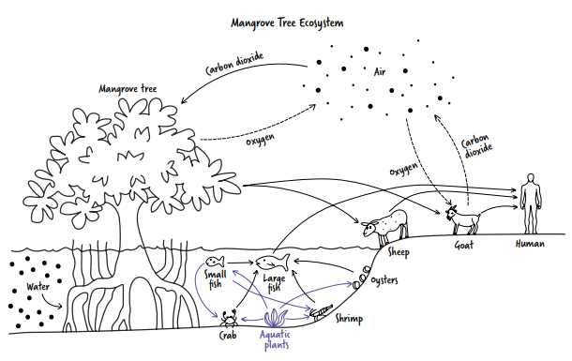
Teacher Model: Think Aloud

Slide 8
Exit Ticket
Define metacognition. How does metacognition support learning?
Reflect on your experience practicing the read aloud. Was it easy or difficult to make your thinking visible? How does making your thinking visible help you or your partner to better understand the content?

