Slide 1
Instructional Practices| Unit 8: Planning for Diverse Learners| Lesson 8.01
Intro to Universal Design for Learning | Part I
This work is licensed under a Creative Commons Attribution-Noncommercial-Share Alike 4.0 International License.

Slide 2
TEKS Standards & Objectives
TEKS 3B, 7A, 7D, 10A, 10B
The student will:
Define Universal Design for Learning and explain its purpose

Slide 3
Bellringer
The coach of a high-school girls’ basketball team is buying shoes for the team. Since the average shoe size of a 16-year-old is a women’s 8.5, she buys everyone the same size. Provide three reasons why this isn’t a good idea.

Slide 4
Vocabulary
Universal Design for Learning (UDL): An educational framework to guide the development of flexible learning environments that can accommodate individual learning differences through engagement, representation, and expression. UDL minimizes barriers and maximizes learning for all students.

Slide 5
Ted Talk
The Myth of Average: Todd Rose at TEDx Sonoma County

Slide 6
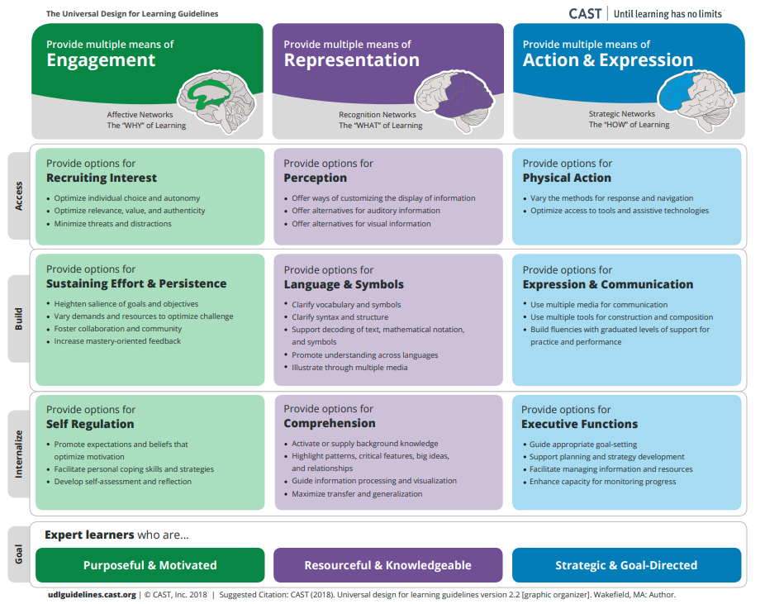
Universal Design for Learning

Slide 7
Exit Ticket
What is the impact of designing for the average?
Which of the following are instructional practices can teachers use to provide a flexible learning environment?
What does it mean to “design to the edges”?

