Slide 1
Instructional Practices| Unit 8: Planning for Diverse Learners| Lesson 8.02
Intro to Universal Design for Learning | Part II
This work is licensed under a Creative Commons Attribution-Noncommercial-Share Alike 4.0 International License.

Slide 2
TEKS Standards & Objectives
TEKS 3B, 7A, 7D, 10A, 10B
The student will:
Define Universal Design for Learning and explain its purpose

Slide 3
Bellringer
Complete the Learner Sketch Tool learning profile self-assessment. Make a list of your strengths and challenges based on the results.
https://learnersketch.org/

Slide 4
Vocabulary
Universal Design for Learning (UDL) | An educational framework to guide the development of flexible learning environments that can accommodate individual learning differences through engagement, representation, and expression. UDL minimizes barriers and maximizes learning for all students.
UDL Guidelines | A set of strategies that can be applied to any subject or grade level to ensure that all learners can access and participate in meaningful, challenging learning opportunities. (CAST, 2022)
Multiple Means of Engagement | Providing various ways of engaging with material to stimulate interest and motivation for learning
Multiple Means of Representation | Presenting information and content in different ways to support learning for all students
Multiple Means of Action & Expression | Offering options for ways students can demonstrate their learning and express what they know
Assistive Technologies | Any form of device, technology, or equipment that helps students with disabilities participate, communicate, and learn.

Slide 5
Ted Talk
The Myth of Average: Todd Rose at TEDx Sonoma County

Slide 6
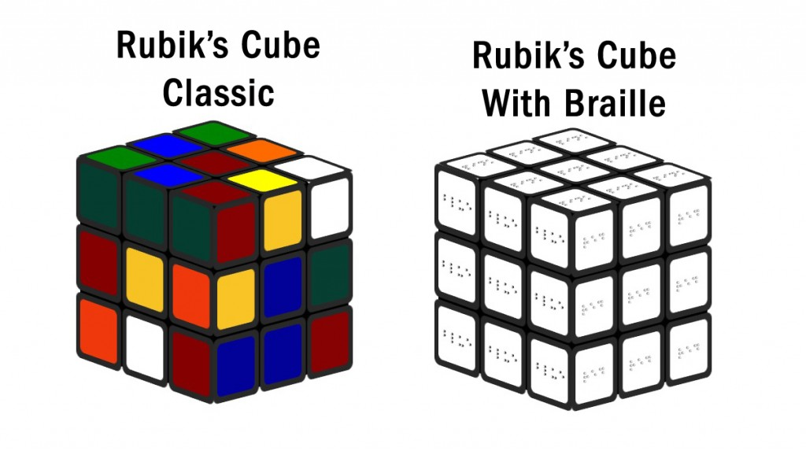
Rubik’s Cube

Slide 7
Rubik’s Cube with Braille

Slide 8
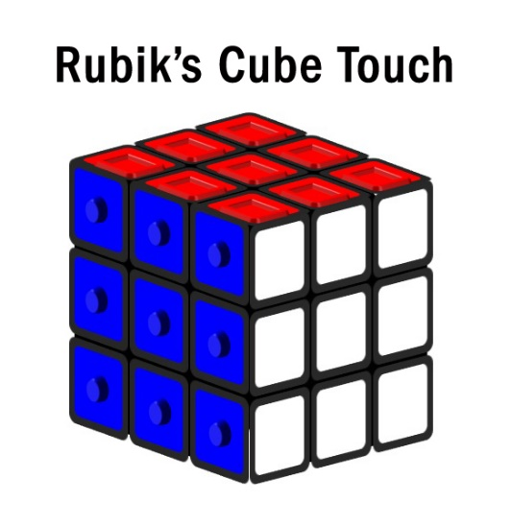
Rubik’s Cube Touch

Slide 9
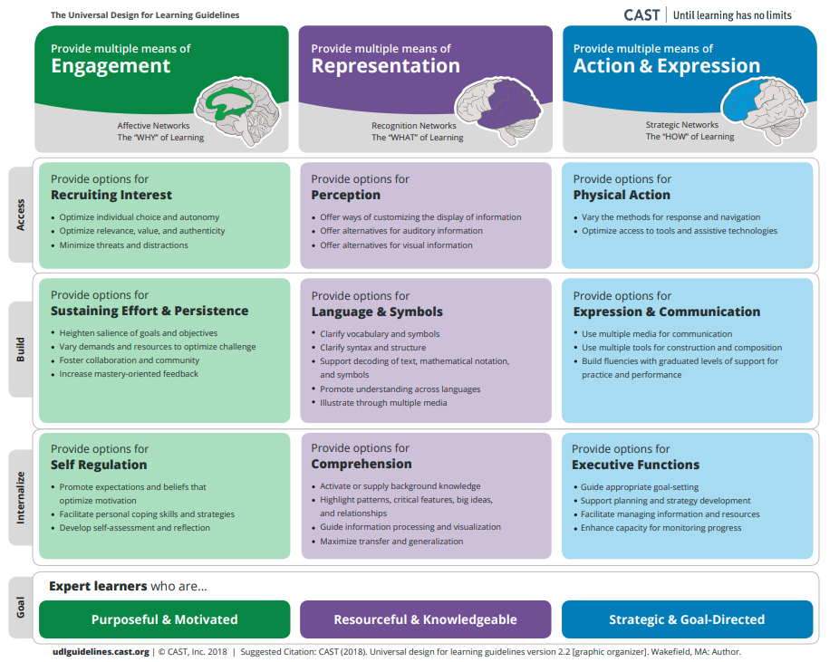
Universal Design for Learning
Guidelines for UDL
Multiple Means of Engagement
Multiple Means of Representation
Multiple Means of Action and Expression

Slide 10
Exit Ticket
Match the following terms to the correct definition on your Exit Ticket.
Universal Design for Learning (UDL)
UDL Guidelines
Multiple Means of Engagement
Multiple Means of Representation
Multiple Means of Action & Expression

