Slide 1
Instructional Practices| Unit 8: Planning for Diverse Learners| Lesson 8.03
Multiple Means of Engagement
This work is licensed under a Creative Commons Attribution-Noncommercial-Share Alike 4.0 International License.

Slide 2
TEKS Standards & Objectives
TEKS 3B, 7A, 7D
The student will:
Define student engagement and explain why it is essential to student learning
Define and explain why multiple means of engagement are necessary
Identify guidelines to recruit student interest
Analyze a lesson to evaluate its use of recruiting student interests

Slide 3
Bellringer
Complete the following true/false statements and be ready to explain the reasoning for your choice.
Every student should complete the same work.
There is one form of engagement that will work for every student.
Culture, personal relevance, and background knowledge influences a student’s engagement.
All students should have the same resources and tools to complete a task.
Students need a safe and supportive environment where they feel safe to learn and take risks.
All students like working in groups.

Slide 4
Vocabulary
Student Engagement | The level of attention, interest, and motivation students exhibit in the learning process
Multiple Means of Engagement | Providing various ways of engaging with material to stimulate interest and motivation for learning
Learning Menu | A type of graphic organizer that allows students a menu or choice of learning activities

Slide 5
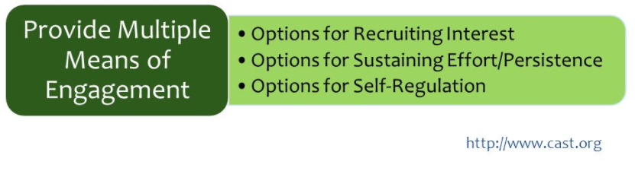
Multiple Means of Engagement

Slide 6
Guideline: Recruiting Interest
Recruiting Interest
Guideline | Examples | Nonexamples
Allow students choice in how they might reach a learning target | Provide choice boards (also called menu options and playlists) Offer choice in how students work Use examples aligned to student hobbies | Ask all students to complete a research project on the same topic Require all students to work independently on a task

Slide 7
Guideline: Recruiting Interest
Recruiting Interest
Guideline | Examples | Nonexamples
Provide opportunities for students to engage in learning experiences that are relevant and valuable to their goals and individual interests | Connect content to something relatable to students. Incorporate a variety of materials and resources. Provide a clear purpose for why the content matters in the real-world. | Provide materials that are not personalized to students’ lives Give assignments with no clear purpose

Slide 8
Guideline: Recruiting Interest
Recruiting Interest
Guideline | Examples | Nonexamples
Create a supportive environment where students feel safe to learn and take risks. | Set clear expectations and class routines. Use timers, cues, etc. for activities and transitions Provide choice in the sequence or pace for completing tasks. | Allow a chaotic and unorganized learning environment Require all students to work at the same pace and complete assignments in the same order

Slide 9
Video: 4th Grade Bilingual ELA
Video Example

Slide 10
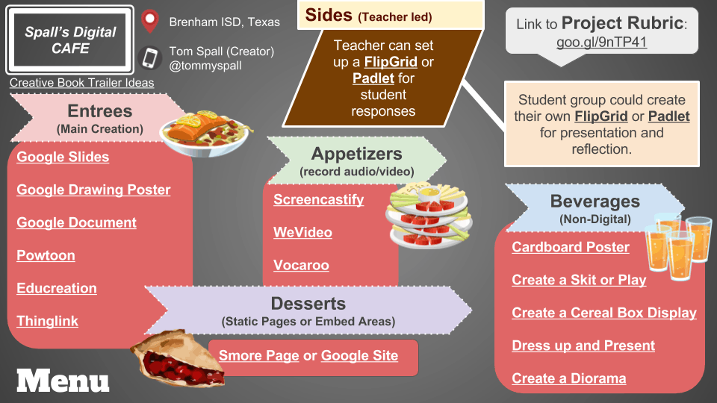
Learning Menu

Slide 11
Exit Ticket
Reflect on the learning goal: Identify ways a teacher can spark excitement and curiosity for learning and explain how those specific strategies can be used in the classroom.
What parts of today’s lesson were most engaging to you?
What parts of today’s lesson most impacted your learning?
Read the scenarios on your Exit Ticket and determine which is more likely to foster student engagement. Explain your reasoning and tell why the use of multiple forms of engagement is important to student learning.
Which scenario is more likely to foster student engagement and why? Explain your reasoning.
Why is the use of multiple forms of engagement important to student learning?

