Slide 1
Instructional Practices| Unit 8: Planning for Diverse Learners| Lesson 8.04
Sustaining Effort and Persistence
This work is licensed under a Creative Commons Attribution-Noncommercial-Share Alike 4.0 International License.

Slide 2
TEKS Standards & Objectives
TEKS 3B, 7A, 7D
The student will:
Identify guidelines for sustaining effort/persistence
Practice and reflect on strategies for sustaining effort/persistence

Slide 3
Bellringer
Describe a time you were given a difficult learning task. Choose one of the following prompts for reflection:
How was the task structured to support your success in completing the difficult task? To what extent were you successful? How did you feel at the end of the task?
What supports were missing from the task that led to a lack of success? How did you feel at the end of the task?

Slide 4
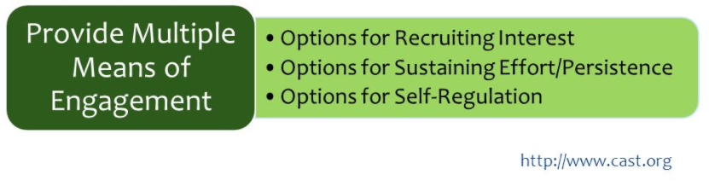
Multiple Means of Engagement

Slide 5
Guideline: Sustaining Effort & Persistence
Sustaining Effort & Persistence
Guideline | Examples | Nonexamples
Explain the importance of goals and objectives | Display the goal in different ways Provide frequent reminders of the learning target and explain why it matters | Forget to post goals or reference goals throughout the lesson Forget to explain the importance of the goal

Slide 6
Guideline: Sustaining Effort & Persistence
Sustaining Effort & Persistence
Guideline | Examples | Nonexamples
Provide flexibility with tools and resources to challenge and motivate learners | Differentiate the level of rigor of a task Provide students with a range of tools and resources to use. | Ask all students to complete the exact same assignment Provide the same materials and resources to all students

Slide 7
Guideline: Sustaining Effort & Persistence
Sustaining Effort & Persistence
Guideline | Examples | Nonexamples
Foster collaboration and community through flexible grouping | Establish clear goals, roles, and responsibilities for cooperative learning groups Allow students to engage in peer-tutoring | Require students to always complete assignments independently Require students to always work with the same person

Slide 8
Guideline: Sustaining Effort & Persistence
Sustaining Effort & Persistence
Guideline | Examples | Nonexamples
Provide feedback that guides students toward mastery | Provide frequent, timely, specific, and actionable feedback Focus feedback on effort and improvement over performance | Provide only written feedback on an assignment Provide feedback that focuses solely on student performance

Slide 9
Exit Ticket
Which of the Multiple Means of Sustaining Effort and Persistence helped you most as a learner? Explain your answer.
Why is it important to use various strategies to help students sustain effort and persistence throughout a lesson?

