Slide 1
Instructional Practices| Unit 8: Planning for Diverse Learners| Lesson 8.05
Self Regulation
This work is licensed under a Creative Commons Attribution-Noncommercial-Share Alike 4.0 International License.

Slide 2
TEKS Standards & Objectives
TEKS 3B, 7A, 7D
The student will:
Describe and explain the importance of strategies to promote self-regulation in the classroom
Define one-on-one conferences and characteristics of one-on-one conferences
Practice and reflect on one-on-one student conferences
Evaluate scenarios to determine effective use of one-on-one conferences

Slide 3
Vocabulary
Multiple Means of Engagement | Providing various ways of engaging with material to stimulate interest and motivation for learning
One-on-one conference | A conversation between a teacher and an individual student focused on the student’s learning progress.

Slide 4
Bellringer
Consider what you have already learned about multiple means of engagement related to options for recruiting interest and options for sustaining effort/persistence. Today’s lesson will focus on options for self-regulation. Based on where you are in your learning, complete the first two columns of the KWL chart on your student guide.

Slide 5
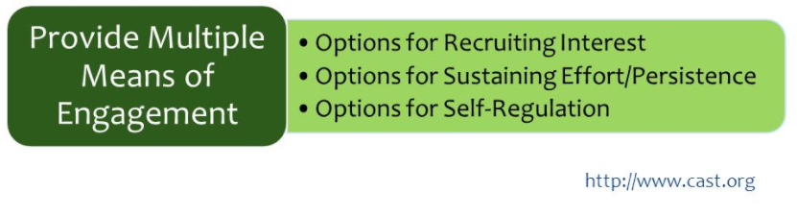
Multiple Means of Engagement

Slide 6
Guideline: Sustaining Effort & Persistence
Self Regulation
Guideline | Examples | Nonexamples
Support learners in setting personal goals that are attainable and that motivate them to take ownership of their learning. | Offer activities that encourage self-reflection and identification of personal goals Model the process of goal setting. | Provide all students with the same goal Require students to set goals at the beginning of the year but do not return to them

Slide 7
Guideline: Sustaining Effort & Persistence
Self Regulation
Guideline | Examples | Nonexamples
Provide models, scaffolds, and feedback to help learners develop personal coping skills and strategies. | Model how to manage frustration and seek external support Use real life situations to demonstrate coping skills | Ignore students’ feelings or tell them to “get over it” Send students to the principal when frustration leads to an outburst

Slide 8
Guideline: Sustaining Effort & Persistence
Self Regulation
Guideline | Examples | Nonexamples
Support learners in developing an awareness of their progress toward goals and how to learn from their mistakes. | Provide charts or tools to help students track progress Engage in activities that allow students to self-assess and receive feedback | Provide a progress report in the middle of the quarter Ask students to track grades in gradebook

Slide 9
One on One Conferences
A conversation between a teacher and an individual student focused on the student’s learning progress.
Criteria for one-on-one student conferences:
  Are brief
  Include attention to the students’ emotions about learning
  Provide scaffolded opportunity for student reflection on their own learning progress
  Focus on the student’s strengths and opportunities for growth
  Include goal-setting
  End with next steps

Slide 10
Exit Ticket
Return to your KWL chart. Complete the final column with information about self-regulation you learned today.
Which of the scenarios (on your Exit Ticket) provides a better example of a one-on-one conference? Explain your answer.
Based on your experience in the role play, what is one goal you have for improving your facilitation of one-on-one conferences?

