Slide 1
Instructional Practices| Unit 8: Planning for Diverse Learners| Lesson 8.07
Multiple Means of Representation and Options for Perception
This work is licensed under a Creative Commons Attribution-Noncommercial-Share Alike 4.0 International License.

Slide 2
TEKS Standards & Objectives
TEKS 3B, 7A, 7D, 10A, 10B
The student will:
Identify strategies for providing multiple means of representation
Brainstorm options for providing multiple means of representation

Slide 3
Vocabulary
Multiple Means of Representation | Presenting information and content in different ways to support learning for all students.
Perception | A way of understanding or interpreting information
Modality | A form of sensory perception

Slide 4
Bellringer
A second-grade science teacher uses pictures and music to introduce new vocabulary related to the learning objective. She reads each word aloud and has the students practice their pronunciation. During the lesson, students watch a video, read or listen to an article on their iPads, and play a game that matches pictures, vocabulary, and real-world scenarios related to the objective.
How might this approach to introducing new vocabulary benefit students?

Slide 5

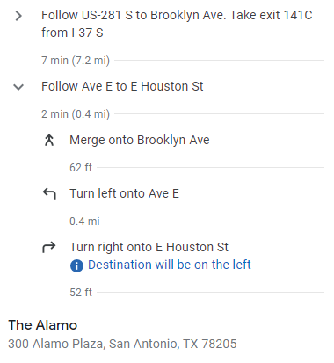

Introduction to Multiple Means of Representation

Slide 6
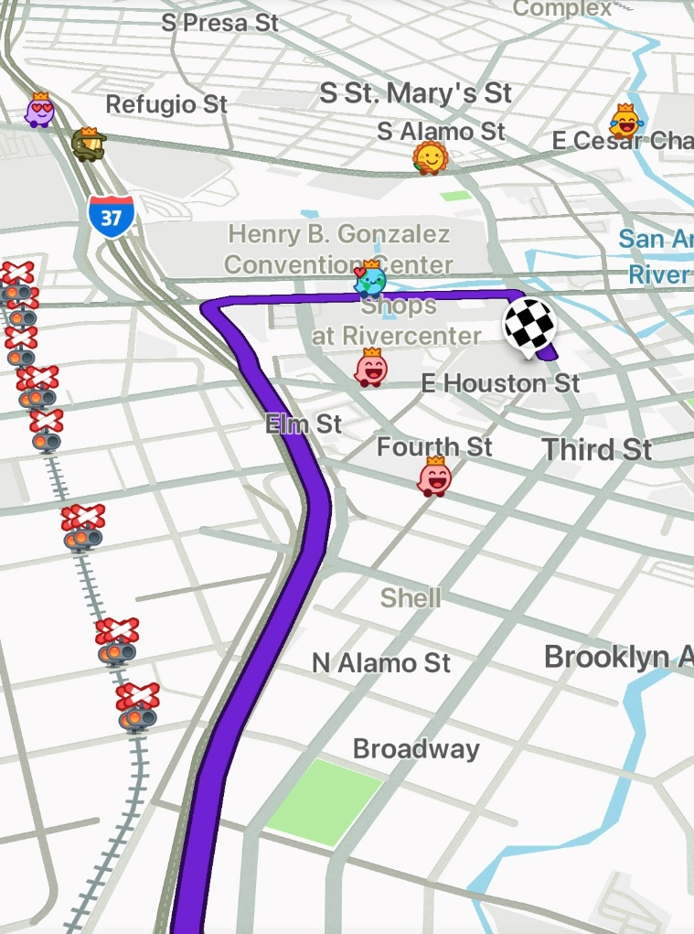
Introduction to Multiple Means of Representation

Slide 7
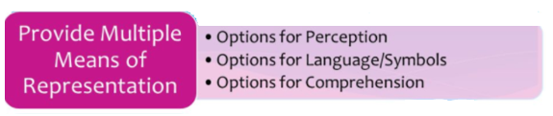
Multiple Means of Representation

Slide 8
Video: UDLA Representation Perception
https://www.youtube.com/watch?v=AK5xMZYnf24

Slide 9
Guideline: Perception
Perception
Guideline | Examples | Nonexamples
Offer options for customizing the display of information | Provide materials that allow students to modify the size of texts and graphics, colors, and layout Provide materials that allow students to change the rate of speech or sound and vary the pace and sequence of information | Provide all students with the same written text to read. Require students to read an eBook without a read-aloud function or options to modify the size of the font.

Slide 10
Guideline: Perception
Perception
Guideline | Examples | Nonexamples
Offer alternatives for auditory information | Show visuals Provide closed captioning Provide written transcripts from videos Offer tactile alternatives for sound effects | Present information through a lecture Share videos without closed captioning or written transcripts

Slide 11
Guideline: Perception
Perception
Guideline | Examples | Nonexamples
Offer alternatives for visual information | Use audio Provide descriptions for images and graphics Provide tactile resources | Present a graph without a description of what the graph is about. Share picture of a globe without access to a tactile representation of a globe.

Slide 12








How to Present Information to Students
Sound
PowerPoint or Lecture
Video
eBooks
Closed Captioning
Books
Graphs, Charts, Diagrams
Magazines

Slide 13
Video: 4th Grade Bilingual ELA
Video Example

Slide 14
Exit Ticket
A PE teacher demonstrates how to effectively complete a free throw in basketball while explaining his process out loud.
What modalities were used in the lesson?
How might the teacher add two additional modalities to the lesson?

