Slide 1
Instructional Practices| Unit 8: Planning for Diverse Learners| Lesson 8.09
Comprehension
This work is licensed under a Creative Commons Attribution-Noncommercial-Share Alike 4.0 International License.

Slide 2
TEKS Standards & Objectives
TEKS 3B, 7A, 7D, 10A, 10B
The student will:
Identify and discuss strategies for comprehension
Engage and reflect on strategies for multiple means of representation

Slide 3
Vocabulary (1/2)
Multiple Means of Representation | Presenting information and content in different ways to support learning for all students.
Graphic Organizer | Visual tool to help students organize information
Annotations | A brief note or comment added by the reader to a text or graphic to record thinking at a specific moment in the text
Transfer | The ability to apply learned information to a new context without help

Slide 4
Vocabulary (2/2)
Generalization | An understanding that learning does not apply only to one context
Rehearsal | Reciting new information over and over
Schema | Frames of understanding
Mnemonic Device | A memory technique or aid that improves the ability of a person to remember something through patterns of letters, numbers, or associations

Slide 5
Bellringer
Describe a time you were given a difficult learning task. Choose one of the following prompts for reflection:
How was the task structured to support your success in completing the difficult task? To what extent were you successful? How did you feel at the end of the task?
What supports were missing from the task that led to a lack of success? How did you feel at the end of the task?

Slide 6
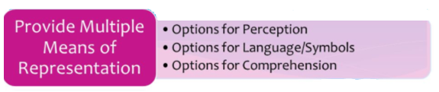
Multiple Means of Representation

Slide 7
Video: UDLA Representation Comprehension
UDL A Representation Comprehension - YouTube

Slide 8
Guideline: Comprehension
Comprehension
Guideline | Examples | Nonexamples
Activate background knowledge | Use KWL charts or concepts maps Make cross-curricular connections | Provide new content without connecting to prior learning

Slide 9
Guideline: Comprehension
Comprehension
Guideline | Examples | Nonexamples
Highlight patterns, critical features, big ideas, and relationships | Use multiple examples and nonexample Provide tips and tools for organizing information such as color coding, graphic organizers, and annotations | Ask students to take notes on a blank piece of paper Ask students to read a text without assigning a purpose or providing supports for capturing main ideas

Slide 10
Guideline: Comprehension
Comprehension
Guideline | Examples | Nonexamples
Guide information processing and visualization | Give explicit prompts for each step in a process Chunk information into smaller elements | Introduce a new problem and ask students to solve without guidance Walk students through solving a problem without pausing at after each step.

Slide 11
Guideline: Comprehension
Comprehension
Guideline | Examples | Nonexamples
Maximize transfer and generalization | Incorporate explicit opportunities for review and practice Provide opportunities to apply learning to new situations, such as scenario-based problems Prompt the use of mnemonic devices | Leave old learning behind as new units and lessons are introduced. Ask students to practice similar problems to support memorization of the steps

Slide 12
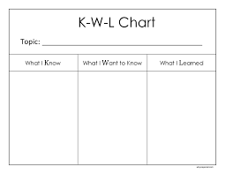
KWL SChart
KWL Chart – used to activate prior knowledge
Before beginning a new topic, at the beginning of a lesson to review the previous day’s lesson, at a transition from one topic to another related topic

Slide 13
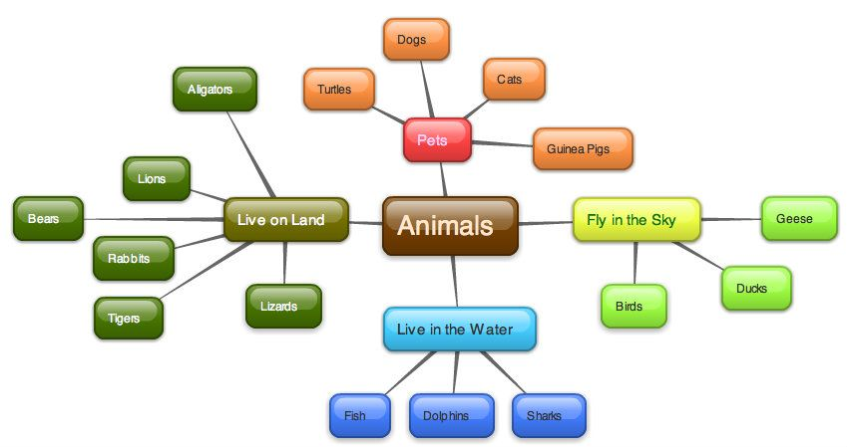
Concept Map
Concept Map – to make connections between ideas and concepts
Before beginning a new lesson to see what students already know, during or at the end of a lesson to provide opportunities for students to process readings, discussions, activities, etc.

Slide 14
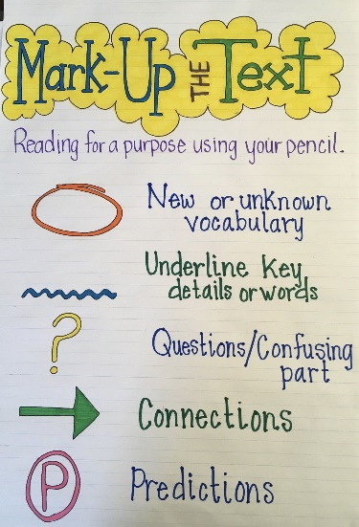
Annotating Texts
Annotating Texts – helps students identify most important parts and consider their own prior knowledge
When students are reading texts to learn new content or to apply skills, when students are reading and providing peer feedback on texts written by their peers

Slide 15
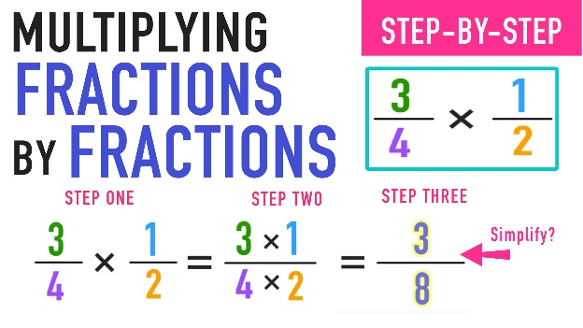
Step by Step Directions
Step by Step Directions – Breaks information into smaller pieces, provides process for visualization
When a new skill includes multiple steps, when an activity includes multiple steps

Slide 16
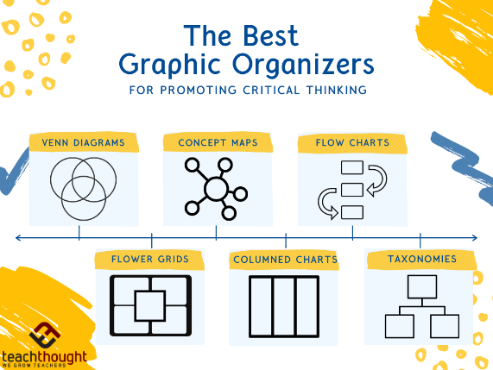
KWL Chart
Graphic Organizers- Help highlight key features and relationships
During discussions, videos, readings, etc. to provide opportunities for students to record new information in a logical way.

Slide 17
Exit Ticket
What are the three guidelines for representation? How does each guideline provide access to rigorous content for all students?
Read the scenario below and then answer the related questions.
Mr. M is about to teach his students about the life cycle of a frog. First, Mr. M shows an image of a frog on the screen. Then, he tells students that they are going to be learning about life cycles by learning about frogs. Next, Mr. M reads a nonfiction book about the life cycle of a frog. As he reads, he pauses to show images of each of the steps in the life cycle and uses his life cycle wheel to show students where they are in the life cycle.
How does Mr. M incorporate options for comprehension?
What else could Mr. M add to incorporate additional options for comprehension to provide access to rigorous content for all students.

