Slide 1
Instructional Practices| Unit 8: Planning for Diverse Learners| Lesson 8.11
Multiple Means of Action & Expression | Options for Physical Action
This work is licensed under a Creative Commons Attribution-Noncommercial-Share Alike 4.0 International License.

Slide 2
TEKS Standards & Objectives
TEKS 3B, 7A, 7D, 10A, 10B
The student will:
Define physical action
Describe and explain strategies to promote physical action in the classroom
Evaluate scenarios to determine effective use of physical action
Identify strategies for providing alternatives for physical action

Slide 3
Vocabulary
Multiple Means of Action & Expression | Offering options for ways students can interact with the instructional material, demonstrate their learning, and express what they know
Assistive technology (AT) | Any form of device, technology, or equipment that helps students with disabilities participate, communicate, and learn.

Slide 4

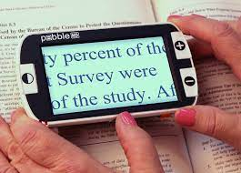
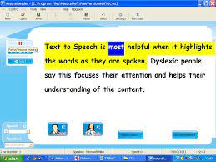
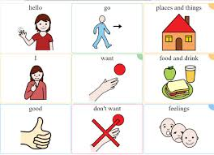
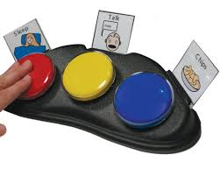

Bellringer
How do the images below relate to UDL?

Slide 5
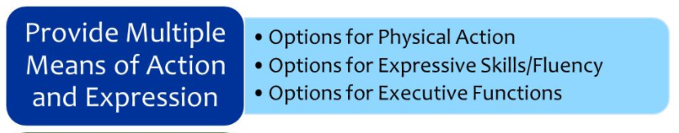
5

Slide 6
Video: Physical Action
https://www.youtube.com/watch?v=XKob82_Mfpw

Slide 7
Guideline: Physical Actions
Physical Actions
Guideline | Examples | Nonexamples
Provide alternative ways for students to interact with instructional materials and their environment | Provide flexibility with time, pacing, and range of motor action required to interact with instruction materials. Allow students to type an essay instead of writing it by hand Provide multiple ways for students to respond, compose, or select material | Require all students to interact with instructional material at the same pace and in the same way Require all students to access content in a printed format

Slide 8
Guideline: Physical Actions
Physical Actions
Guideline | Examples | Nonexamples
Provide access to and support with tools and assistive technologies | Teach alternate keyboard commands for mouse control Allow customized overlays for touch screens and keyboards Model the use of assistive technologies and accessibility tools | Require students with barriers to complete an easier assignment Allow assistance technologies without modeling and support

Slide 9
Assistive Technology Examples
Text to speech
Voice recognition
Magnifiers
Large print materials
Notetaking systems

Slide 10
Practice Scenario: Mrs. D
Mrs. D.’s students are learning about frogs and the life cycle of a frog. Students are working in groups to research and describe each stage of the frog’s life cycle. Each group has access to eBooks with the text-to-speech function, a touchscreen tablet, a laptop, and access to digital icons on their learning management system that link to specific kid-friendly websites and videos.
Mrs. D. has asked students to record their learning in a graphic organizer using Google Docs. Before placing students in groups, Mrs. D. modeled how to use the voice typing function to help those who have difficulty typing and/or spelling.

Slide 11
Exit Ticket
Return to the bellringer and consider alternative ways your teachers could provide options for physical action.

