Slide 1
Instructional Practices| Unit 8: Planning for Diverse Learners| Lesson 8.14
Putting It All Together | Multiple Means of Action & Expression
This work is licensed under a Creative Commons Attribution-Noncommercial-Share Alike 4.0 International License.

Slide 2
TEKS Standards & Objectives
TEKS 3B, 7A, 7D, 10A, 10B
The student will:
Identify strategies for providing multiple means of action and expression
Analyze a lesson to evaluate its use of multiple means of action and expression to provide access to rigorous content for all students

Slide 3
Bellringer
Match the guideline with its correct description.
Which of the following is NOT an example of one of the guidelines for multiple means of action and expression?
  Students have flexibility with time, pacing, and range of motor action required to interact with instruction materials.
  Students to communicate using multiple forms of media.
  Students share their learning through writing a summary
  Teacher supports students in developing reasonable plans for reaching their goals
Why is this a nonexample of providing multiple means of action and expression?

Slide 4
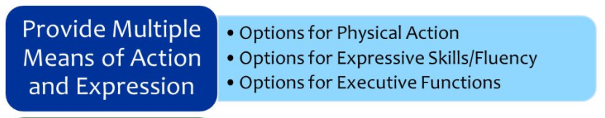
Multiple Means of Action and Expression

Slide 5
Video: UDL Multiple Means of Action & Expression in 5th Grade
https://www.youtube.com/watch?v=VglVcku1Ris

Slide 6
Exit Ticket
Examine the lesson plan to evaluate its use of multiple means of action and expression. Use the graphic organizer below to identify evidence of multiple means of action and expression from the lesson OR make suggestions of additional ways to incorporate action and expression.

