Slide 1
Instructional Practices| Unit 9: Feedback| Lesson 9.03
Practice with Formal, Written Feedback
This work is licensed under a Creative Commons Attribution-Noncommercial-Share Alike 4.0 International License.

Slide 2
TEKS Standards & Objectives
TEKS 4 B-C, 14 A,C,D
The student will:
Practice delivering formal, written feedback
Analyze and evaluate formal, written feedback based on the characteristics of effective feedback

Slide 3
Bellringer
How does formal feedback differ from informal feedback?
What are the benefits of formal written feedback over informal verbal feedback?

Slide 4
Vocabulary
Formal Feedback | Feedback that is planned and systematically scheduled into the learning process. It is provided consistently for each student.
Written Feedback | Formal feedback that is provided to as student in written form after a task has been completed.

Slide 5
Characteristics of Effective Feedback
Specific and clear
Focused on the task, not the student
Identifies both strengths and areas of improvement
Timely and actionable

Slide 6
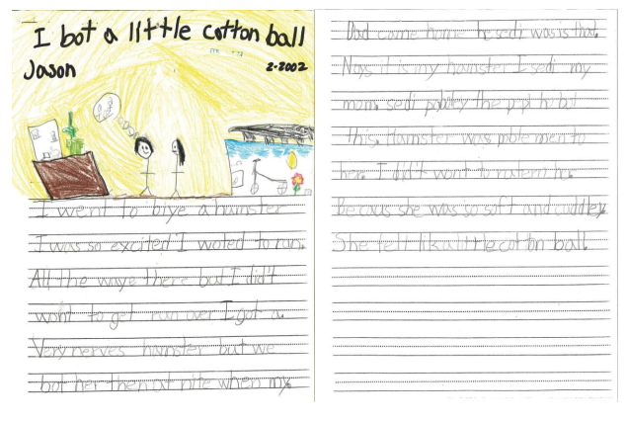
Model: Effective Formal, Written Feedback
 | Examples | Non-Examples
Strengths | You included 5 complete sentences You included at least three details Your title is interesting and descriptive Your drawing helps to visualize the event | You wrote sentences You included some details Your title is good. You are a good drawer.
Areas of Improvement | You could improve by using periods to end the sentence or thought You could improve by capitalizing only proper nouns and the beginning of sentences Be sure that all your sentences are complete with a subject and verb. | You didn’t use appropriate punctuation. Use complete sentences.

Slide 7
Exit Ticket
Below are some written feedback statements that have been provided to students. Examine each of the statements below and determine if the feedback statement meets the characteristics of effective feedback. If so, explain why. If not, make suggestions on how to revise the statement to better align to the characteristics of effective feedback.
Feedback Statements | Effective Feedback (Yes or No) | Explain Why /Make Suggestions to Improve
“Great job providing specific sensory details in these sentences.”
“Consider improving your word choice.”
“I love your drawing. You are a good artist.”
“Be sure to show all the steps of your thinking when working a problem like this.”

