Slide 1
Practicum in Education and Training| Unit 2: The Professional Educator | Lesson 2.02
What is Professionalism?
This work is licensed under a Creative Commons Attribution-Noncommercial-Share Alike 4.0 International License.

Slide 2
TEKS Standards & Objectives
TEKS 1I, 11A, 11B
The student will:
describe professional and ethical behavior as essential responsibilities of an educator.
analyze and plan a professional and ethical response to common field site scenarios
explain the importance of professionalism at the E&T field site.

Slide 3
Bellringer
How do you communicate/plan to communicate with your field site teacher?
How do you communicate/plan to communicate with the students at your field site?
How do you maintain professional conduct with your students and field site staff?
What do you have to consider when planning your attire for your field site visit

Slide 4
Teacher Professionalism
Interactions with students
Workplace professional conduct
Appearance
Interactions with colleagues and the community

Slide 5
Professionalism Scenario #1
A high school social studies teacher frequently gives students extra credit on assignments for wearing team gear from his favorite college sports team.
Unprofessional

Slide 6
Professionalism Scenario #2
Mr. Jarrell is a middle school math teacher. He just gave his students an assignment, but they seem to really be struggling. He doesn’t seem to understand because he just went over the assignment. Mr. Jarrell gives a signal for the students to direct their attention back to the board. He asks students to share what part of the assignment they are struggling with the most and models a few problems on the board before having students continue with the assignment.
Professional

Slide 7
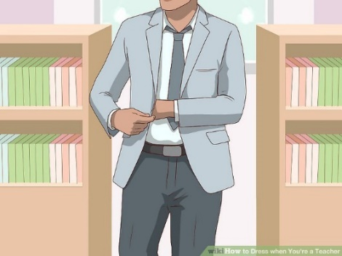
Professionalism Scenario #3
Professional

Slide 8
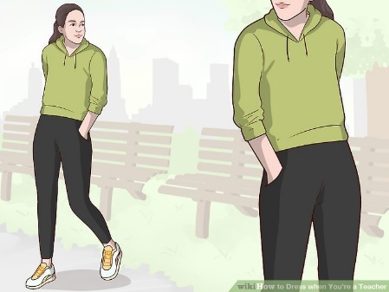
Professionalism Scenario #4
Unprofessional*
*Except for PE teacher

Slide 9
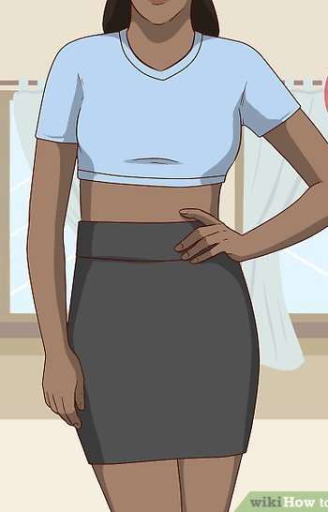
Professionalism Scenario #5
Unprofessional

Slide 10
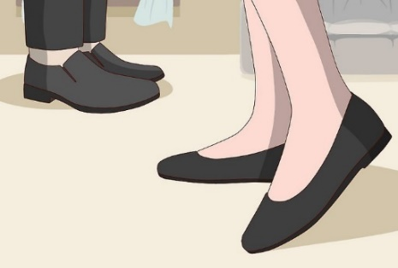
Professionalism Scenario #6
Professional

Slide 11
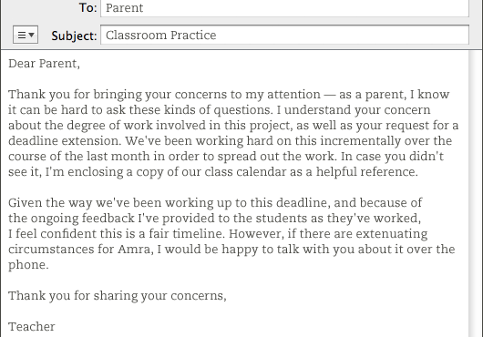
Professionalism Scenario #7
Professional

Slide 12
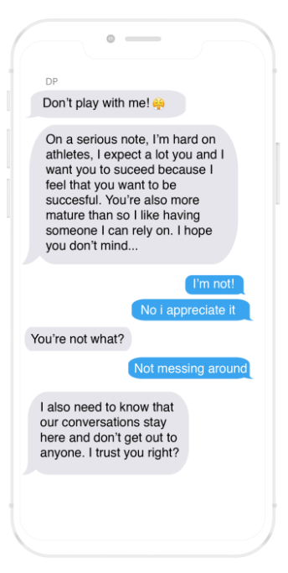
Professionalism Scenario #8
Unprofessional

Slide 13
Practice Scenario #1
You wake up late on the morning of your site visit and you don’t have time to iron the dress shirt and dress pants you had planned to wear. Your other professional attire is either dirty or wrinkled. What should you do?

Slide 14
Practice Scenario #2
One of your students asks for your personal cell phone number so they can share pictures of their project with you. You also notice that they tried to friend you on one of your personal social media accounts. What should you do?

Slide 15
Exit Ticket
Why is it important to demonstrate professional behavior at your E&T field site? How might unprofessional behavior impact your future as well as impact the students and teachers you are working with?
Analyze the scenarios. Determine if the educator behaviors are professional (P) or not professional (NP) and explain the message the teacher is sending through their actions.

