Slide 1
Practicum| Unit 3: Research-Based Instructional Strategies (RBIS) Reading Language Arts (RLA)| Lesson 3.01
Intro to RBIS for Reading Language Arts & the Science of Reading
This work is licensed under a Creative Commons Attribution-Noncommercial-Share Alike 4.0 International License.

Slide 2
TEKS Standards & Objectives
TEKS 6A, 6D, 6F
The student will…
Describe the relationship between research-based practices and student achievement in reading and language arts
Use the simple view of reading to describe the relationship between decoding, language comprehension, and reading comprehension
Practicum| Unit 3: Research-Based Instructional Strategies (RBIS) Reading Language Arts (RLA)| Lesson 3.01 |This work is licensed under a Creative Commons Attribution-Noncommercial-Share Alike 4.0 International License.

Slide 3
Bellringer
Complete the Anticipation Guide to self-assess your knowledge and understanding of foundational literacy skills.
Practicum| Unit 3: Research-Based Instructional Strategies (RBIS) Reading Language Arts (RLA)| Lesson 3.01 |This work is licensed under a Creative Commons Attribution-Noncommercial-Share Alike 4.0 International License.

Slide 4
Vocabulary
Term | Definition
Research-Based Instructional Strategies | A set of practices supported by research that should be present in classrooms, regardless of instructional materials
Foundational Skills | A set of skills a student must master to become a skilled reader
Science of Reading | Settled science about how people learn to read
Structured Literacy | Evidence-based practices for teaching foundational literacy skills
Simple View of Reading | A formula demonstrating that to be a skilled reader, a learner must master two basic concepts: word recognition (decoding) and language compression (listening comprehension)
Word Recognition (Decoding) | Ability to apply sound-symbol relationships to read words
Language Comprehension | Ability to understand spoken words
Practicum| Unit 3: Research-Based Instructional Strategies (RBIS) Reading Language Arts (RLA)| Lesson 3.01 |This work is licensed under a Creative Commons Attribution-Noncommercial-Share Alike 4.0 International License.

Slide 5
Research-Based Instructional Strategies
RBIS are… | RBIS are not…
A set of research-based practices that highlights misconceptions common in the field | Topics that are commonly agreed upon (e.g., materials should be aligned to the standards)
Topics that require conceptual or philosophical shifts in approach to instruction | Topics not related to curriculum and instructional materials (e.g., classroom management best practices)
A set of practices that are supported by research and should be present in classrooms, regardless of instructional materials
A set of practices that relate directly to the design of instructional materials AND/OR the approach required to implement them well
Practicum| Unit 3: Research-Based Instructional Strategies (RBIS) Reading Language Arts (RLA)| Lesson 3.01 |This work is licensed under a Creative Commons Attribution-Noncommercial-Share Alike 4.0 International License.

Slide 6
Content-Specific Practices for Reading Language Arts
Foundational Skills: Explicit, systematic practice with literacy foundational skills
Text Complexity: Regular practice with grade-level, complex text and its academic language
Knowledge Coherence: Building knowledge and vocabulary through text in all content areas
Text-Based Responses: Reading, writing, and speaking grounded in evidence from text, both literary and informational
Practicum| Unit 3: Research-Based Instructional Strategies (RBIS) Reading Language Arts (RLA)| Lesson 3.01 |This work is licensed under a Creative Commons Attribution-Noncommercial-Share Alike 4.0 International License.

Slide 7
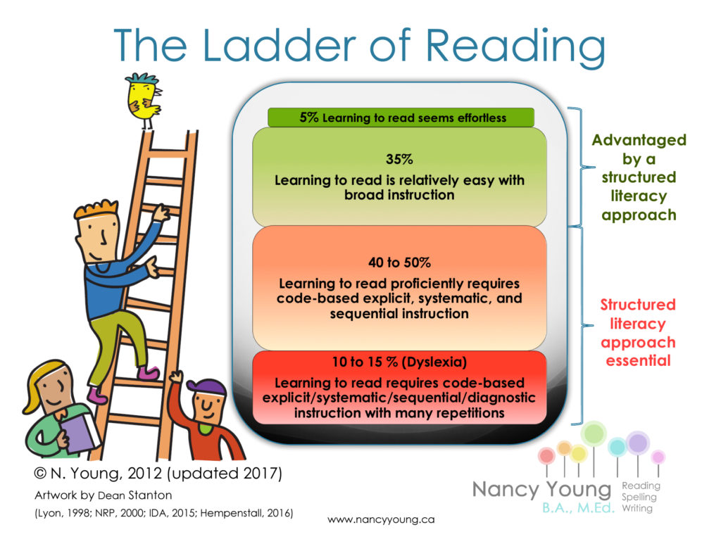
Practicum| Unit 3: Research-Based Instructional Strategies (RBIS) Reading Language Arts (RLA)| Lesson 3.01 |This work is licensed under a Creative Commons Attribution-Noncommercial-Share Alike 4.0 International License.

Slide 8
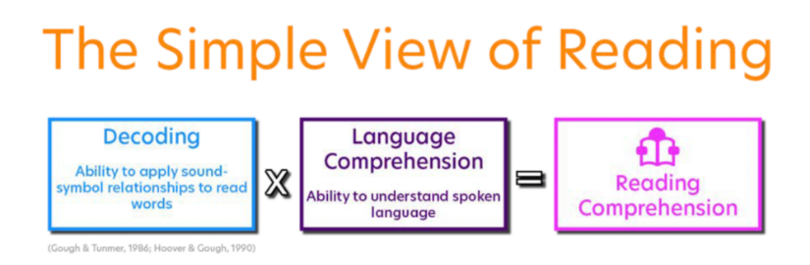
Practicum| Unit 3: Research-Based Instructional Strategies (RBIS) Reading Language Arts (RLA)| Lesson 3.01 |This work is licensed under a Creative Commons Attribution-Noncommercial-Share Alike 4.0 International License.

Slide 9
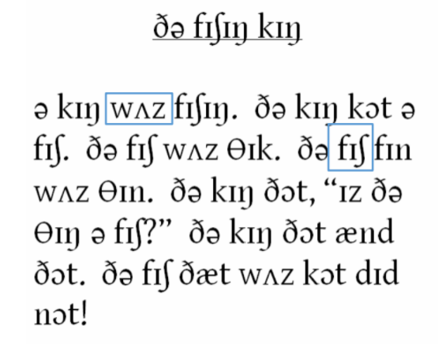
Practicum| Unit 3: Research-Based Instructional Strategies (RBIS) Reading Language Arts (RLA)| Lesson 3.01 |This work is licensed under a Creative Commons Attribution-Noncommercial-Share Alike 4.0 International License.

Slide 10

Practicum| Unit 3: Research-Based Instructional Strategies (RBIS) Reading Language Arts (RLA)| Lesson 3.01 |This work is licensed under a Creative Commons Attribution-Noncommercial-Share Alike 4.0 International License.

Slide 11
Exit Ticket
Answer the following questions:
Which of the following is an example of a research-based practice?
What are four research-based practices for RLA?
Which graphic below correctly shows the Simple View of Reading?
Why is it important for a student to have strong language comprehension skills and word recognition skills?
Practicum| Unit 3: Research-Based Instructional Strategies (RBIS) Reading Language Arts (RLA)| Lesson 3.01 |This work is licensed under a Creative Commons Attribution-Noncommercial-Share Alike 4.0 International License.

