Slide 1
Practicum| Unit 3: Research-Based Instructional Strategies (RBIS) Reading Language Arts (RLA)| Lesson 3.02
Systematic and Explicit Literacy Instruction
This work is licensed under a Creative Commons Attribution-Noncommercial-Share Alike 4.0 International License.

Slide 2
TEKS Standards & Objectives
TEKS 6A, 6C, 6D, 6F, 6G
The student will…
Define systematic and explicit literacy instruction
Explain the importance of systematic and explicit literacy instruction
Identify examples and nonexamples of systematic and explicit foundational literacy instruction
2
Practicum| Unit 3: Research-Based Instructional Strategies (RBIS) Reading Language Arts (RLA)| Lesson 3.02 |This work is licensed under a Creative Commons Attribution-Noncommercial-Share Alike 4.0 International License.

Slide 3
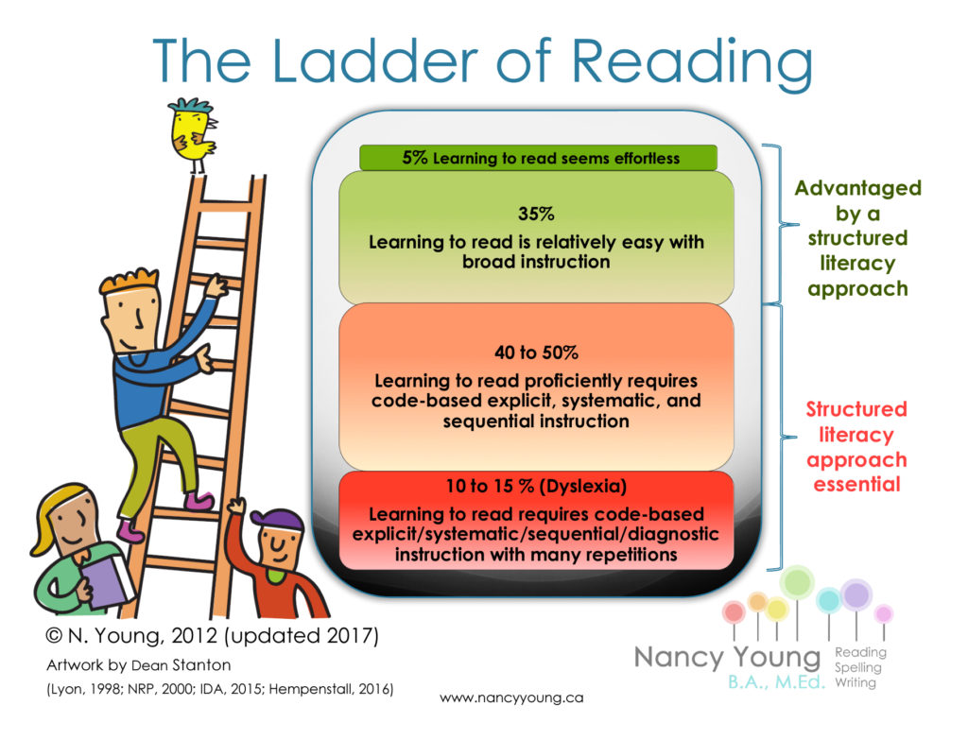
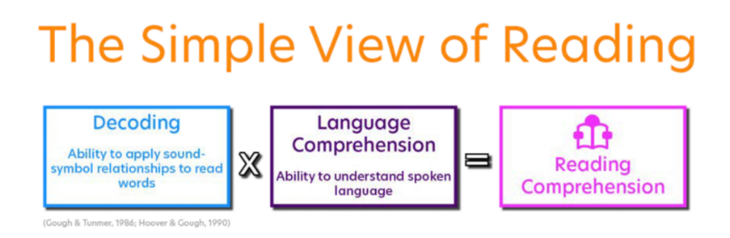
Bellringer
Look at the Ladder of Reading and the Simple View of Reading. How do these two things relate?
3
Practicum| Unit 3: Research-Based Instructional Strategies (RBIS) Reading Language Arts (RLA)| Lesson 3.02 |This work is licensed under a Creative Commons Attribution-Noncommercial-Share Alike 4.0 International License.

Slide 4
Vocabulary
Term | Definition
Phonics | The study of the relationships between letters and the sounds they represent
Systematic Phonics Instruction | Structured phonics instructional routines that provide step-by-step procedures and a scope and sequence of skills from less complex to more complex to allow students to build upon prior knowledge
Explicit Phonics Instruction | Teacher directed phonics instruction that clearly explains and models each individual concept
Incidental Phonics | Teacher directed instruction that does not follow a planned sequence of phonics concepts to guide instruction. Concepts and skills are taught as they appear in text.
4
Practicum| Unit 3: Research-Based Instructional Strategies (RBIS) Reading Language Arts (RLA)| Lesson 3.02 |This work is licensed under a Creative Commons Attribution-Noncommercial-Share Alike 4.0 International License.

Slide 5
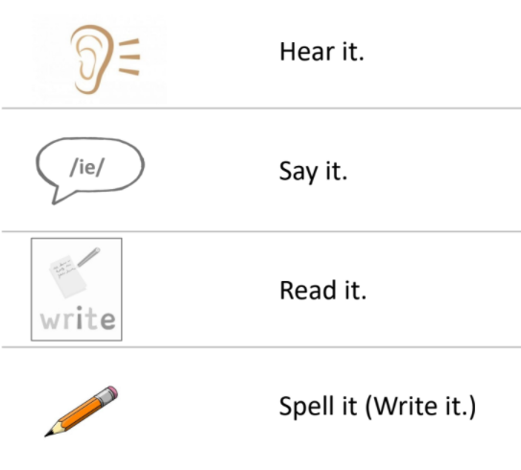
Explicit Instruction
Student need opportunities to:
5
Practicum| Unit 3: Research-Based Instructional Strategies (RBIS) Reading Language Arts (RLA)| Lesson 3.02 |This work is licensed under a Creative Commons Attribution-Noncommercial-Share Alike 4.0 International License.

Slide 6
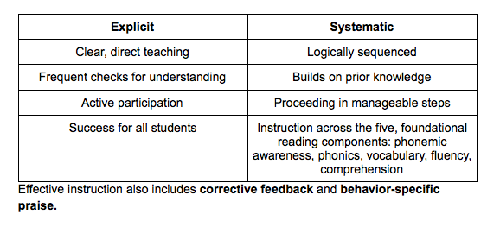
Systematic & Explicit Instruction
Systematic & Explicit Instruction should include:
6
Practicum| Unit 3: Research-Based Instructional Strategies (RBIS) Reading Language Arts (RLA)| Lesson 3.02 |This work is licensed under a Creative Commons Attribution-Noncommercial-Share Alike 4.0 International License.

Slide 7
Systematic VS Incidental
Systematic | Incidental
Sound/spelling relationships are directly taught in isolation | Sound and spelling relationships are inferred from reading whole words
Direct instruction and practice with blending previously taught sound/spelling patterns | Sound and spelling relationships are introduced as they are encountered in texts
Sound/spelling relationships are introduced in a logical sequence and increase in difficulty | No logical sequence or progression of skills
7
Practicum| Unit 3: Research-Based Instructional Strategies (RBIS) Reading Language Arts (RLA)| Lesson 3.02 |This work is licensed under a Creative Commons Attribution-Noncommercial-Share Alike 4.0 International License.

Slide 8
Exit Ticket
Examine the lesson plan for evidence of explicit instruction and complete the chart that follows.
8
Practicum| Unit 3: Research-Based Instructional Strategies (RBIS) Reading Language Arts (RLA)| Lesson 3.02 |This work is licensed under a Creative Commons Attribution-Noncommercial-Share Alike 4.0 International License.

