Slide 1
Practicum| Unit 3: Research-Based Instructional Strategies (RBIS) Reading Language Arts (RLA)| Lesson 3.05
Text Complexity
This work is licensed under a Creative Commons Attribution-Noncommercial-Share Alike 4.0 International License.

Slide 2
TEKS Standards & Objectives
TEKS 6A, 6C, 6D, 6F, 6G
The student will…
Define text complexity and academic language.
Describe the role of text complexity in effective literacy instruction.
Identify examples and nonexamples of complex text.
2
Practicum| Unit 3: Research-Based Instructional Strategies (RBIS) Reading Language Arts (RLA)| Lesson 3.05 |This work is licensed under a Creative Commons Attribution-Noncommercial-Share Alike 4.0 International License.

Slide 3
Bellringer
Explain if the following statement is true or false and why.
To help students practice reading “skills,” teachers should give struggling readers texts at their own reading level rather than reading grade level texts.
3
Practicum| Unit 3: Research-Based Instructional Strategies (RBIS) Reading Language Arts (RLA)| Lesson 3.05 |This work is licensed under a Creative Commons Attribution-Noncommercial-Share Alike 4.0 International License.

Slide 4
Vocabulary
Term | Definition
Text complexity | The level of difficulty in reading and understanding a text. The level of difficulty is based on the readability of the text, the levels of meaning or purpose in the text, the clarity and conventions of the language, the knowledge demands, and the structure of the text.
Academic Language | The specialized language, written and spoken, in classroom or other academic locations that helps students communicate and think about what they are learning.
Implicit meaning | Something in a text is not stated outright or directly but is inferred.
4
Practicum| Unit 3: Research-Based Instructional Strategies (RBIS) Reading Language Arts (RLA)| Lesson 3.05 |This work is licensed under a Creative Commons Attribution-Noncommercial-Share Alike 4.0 International License.

Slide 5
Factors Impacting Text Difficulty
The level of difficulty is based on the following aspects:
• readability of the text
• levels of meaning or purpose in the text
• clarity and conventions of the language
• knowledge demands
• structure of the text
5
Practicum| Unit 3: Research-Based Instructional Strategies (RBIS) Reading Language Arts (RLA)| Lesson 3.05 |This work is licensed under a Creative Commons Attribution-Noncommercial-Share Alike 4.0 International License.

Slide 6
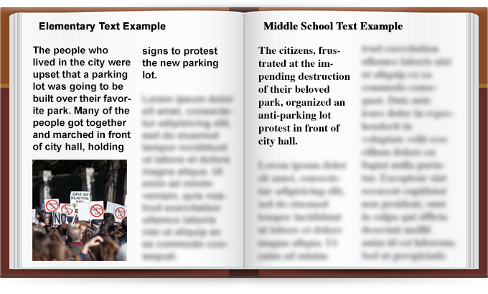
Readability of the Text
The readability of the text is determined by the length of words and sentences in the text and the frequency of unfamiliar words.
Image Source: https://iris.peabody.vanderbilt.edu/module/sec-rdng2/cresource/q1/p02/
6
Practicum| Unit 3: Research-Based Instructional Strategies (RBIS) Reading Language Arts (RLA)| Lesson 3.05 |This work is licensed under a Creative Commons Attribution-Noncommercial-Share Alike 4.0 International License.

Slide 7
Implicit Meaning
Something in the text is not stated outright or directly but is inferred.
Image Source: https://iris.peabody.vanderbilt.edu/module/sec-rdng2/cresource/q1/p02/
7
Practicum| Unit 3: Research-Based Instructional Strategies (RBIS) Reading Language Arts (RLA)| Lesson 3.05 |This work is licensed under a Creative Commons Attribution-Noncommercial-Share Alike 4.0 International License.

Slide 8
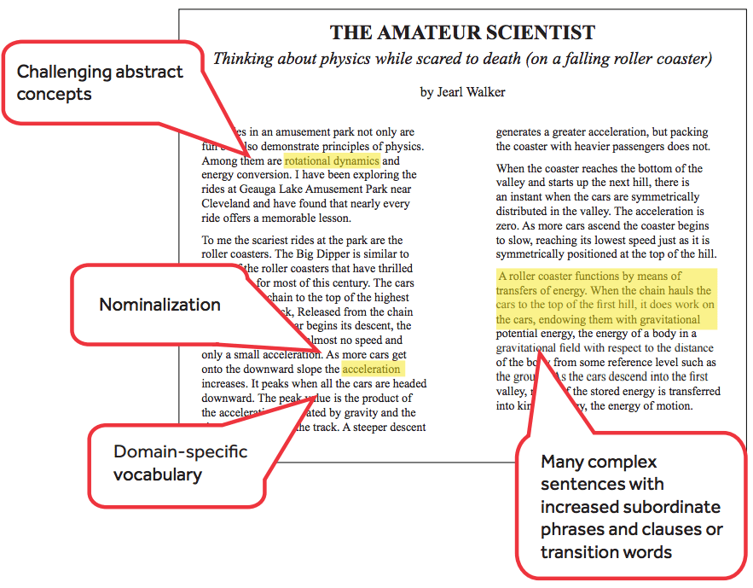
Clarity and Conventions of the Language
Complex texts tend to use figurative language, ambiguity, or unfamiliar language, such as academic or domain specific vocabulary.
Image Source: https://www.generationready.com/white-papers/a-beginners-guide-to-text-complexity/
8
Practicum| Unit 3: Research-Based Instructional Strategies (RBIS) Reading Language Arts (RLA)| Lesson 3.05 |This work is licensed under a Creative Commons Attribution-Noncommercial-Share Alike 4.0 International License.

Slide 9
Knowledge Demands
Complex texts assume that the reader has life experience that will contribute to their understanding of the information in the text.
Image Source: https://www.generationready.com/white-papers/a-beginners-guide-to-text-complexity/
9
Practicum| Unit 3: Research-Based Instructional Strategies (RBIS) Reading Language Arts (RLA)| Lesson 3.05 |This work is licensed under a Creative Commons Attribution-Noncommercial-Share Alike 4.0 International License.

Slide 10
Structure of the Text
Text structure refers to how the text is organized in regard to elements such as viewpoint, multiple characters, storylines, and complex details.
Text that are organized chronologically tend to be easier to understand than those that use flashbacks or varied time and sequence.
10
Practicum| Unit 3: Research-Based Instructional Strategies (RBIS) Reading Language Arts (RLA)| Lesson 3.05 |This work is licensed under a Creative Commons Attribution-Noncommercial-Share Alike 4.0 International License.

Slide 11
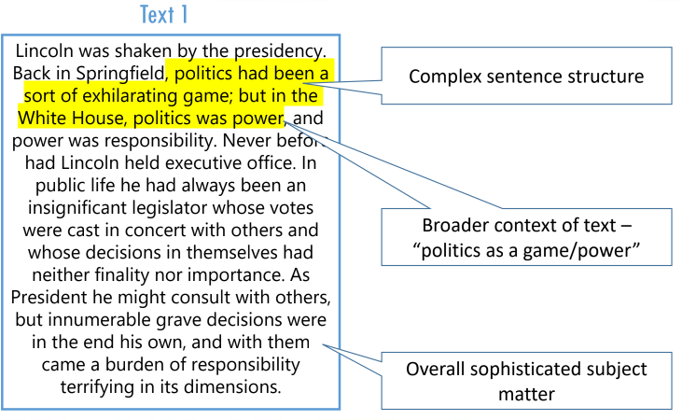
Comparing Two Texts
11
Practicum| Unit 3: Research-Based Instructional Strategies (RBIS) Reading Language Arts (RLA)| Lesson 3.05 |This work is licensed under a Creative Commons Attribution-Noncommercial-Share Alike 4.0 International License.

Slide 12
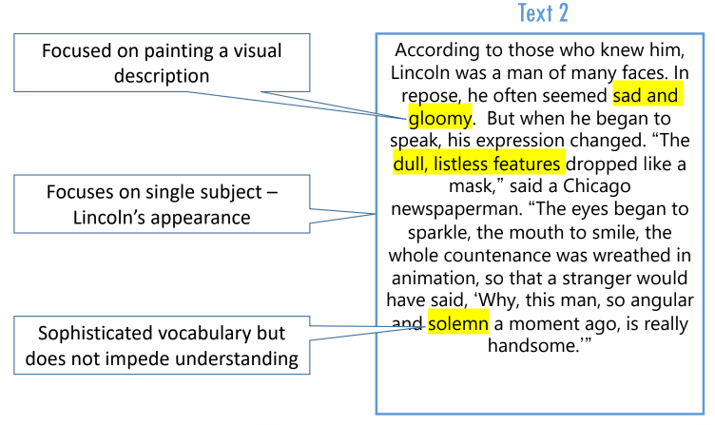
Comparing Two Texts Cont
12
Practicum| Unit 3: Research-Based Instructional Strategies (RBIS) Reading Language Arts (RLA)| Lesson 3.05 |This work is licensed under a Creative Commons Attribution-Noncommercial-Share Alike 4.0 International License.

Slide 13
Exit Ticket
Complete the multiple-choice questions:
How do you determine text complexity?
Why does text complexity matter?
What is the role of text complexity in effective literacy instruction?
13
Practicum| Unit 3: Research-Based Instructional Strategies (RBIS) Reading Language Arts (RLA)| Lesson 3.05 |This work is licensed under a Creative Commons Attribution-Noncommercial-Share Alike 4.0 International License.

