Slide 1
Practicum| Unit 3: Research-Based Instructional Strategies (RBIS) Reading Language Arts (RLA)| Lesson 3.07
Background Knowledge and Reading Comprehension
This work is licensed under a Creative Commons Attribution-Noncommercial-Share Alike 4.0 International License.

Slide 2
TEKS Standards & Objectives
TEKS 6A, 6C, 6D, 6F, 6G
The student will…
Describe the role of background knowledge in reading comprehension
Define and identify examples of a skills-based vs knowledge-based approach to reading
Compare a skills-based approach to a knowledge-based approach in various content and the affect each approach has on building background knowledge and vocabulary
2
Practicum| Unit 3: Research-Based Instructional Strategies (RBIS) Reading Language Arts (RLA)| Lesson 3.07 |This work is licensed under a Creative Commons Attribution-Noncommercial-Share Alike 4.0 International License.

Slide 3
Bellringer
Read the excerpt and write a 2-3 sentence summary of what you think the excerpt is about.
“Over the past 30 years, the number of gears on road bikes has steadily increased. Current group sets now provide 22 gears through the combination of two chainrings and 11 sprockets. The range of sizes for the chainrings and sprockets has also grown in that time, too, providing riders plenty of scope to fine-tune the gearing on their bikes.
With such a generous number of gears on offer, it is tempting to think that there wouldn’t be much point to tinkering with them, but the human engine demands it. After all, there is a finite amount of power on offer and the efficiency of the system depends upon maintaining a consistent cadence (~80rpm), regardless of any change in the terrain or riding conditions.
Every road cyclist understands that size of the chainrings and sprockets dictate the gearing of the bike, however there is more to the concept than simply the number of teeth involved. What is most important is the ratio and the way that the sprockets multiply the effort made with the chainring.”
3
Practicum| Unit 3: Research-Based Instructional Strategies (RBIS) Reading Language Arts (RLA)| Lesson 3.07 |This work is licensed under a Creative Commons Attribution-Noncommercial-Share Alike 4.0 International License.

Slide 4
Vocabulary
Term | Definition
Background Knowledge | The knowledge and skills you have based on life experiences and previous learning that is stored in the memory and acquired over time.
Skills-based Approach | Students engage in a whole-group mini-lesson that targets a reading skill such as finding the main idea or making an inference. The teacher will teach on this skill over the course of a few days using a variety of texts on different topics.
Knowledge-based Approach | Students read multiple texts on the same topic to build content-rich knowledge and vocabulary of history, geography, science, literature, etc.
4
Practicum| Unit 3: Research-Based Instructional Strategies (RBIS) Reading Language Arts (RLA)| Lesson 3.07 |This work is licensed under a Creative Commons Attribution-Noncommercial-Share Alike 4.0 International License.

Slide 5
Background Knowledge can help students
• Make connections to new information
• Make sense of new ideas and experiences
• Better understand new information
• Store and retrieve new information
• Free up working memory by chunking information
• Build vocabulary
5
Practicum| Unit 3: Research-Based Instructional Strategies (RBIS) Reading Language Arts (RLA)| Lesson 3.07 |This work is licensed under a Creative Commons Attribution-Noncommercial-Share Alike 4.0 International License.

Slide 6
Assessment
Let’s say I’m going to give a reading assessment about baseball. Who do you think will do the best on it?
Students with a high reading ability and knowledge of baseball.
Students with high reading ability and low knowledge of baseball.
Students with low reading ability but a high knowledge of baseball.
Students with low reading ability and low knowledge of baseball.
Rank your predictions from who will score the highest to who will score the lowest.
6
Practicum| Unit 3: Research-Based Instructional Strategies (RBIS) Reading Language Arts (RLA)| Lesson 3.07 |This work is licensed under a Creative Commons Attribution-Noncommercial-Share Alike 4.0 International License.

Slide 7
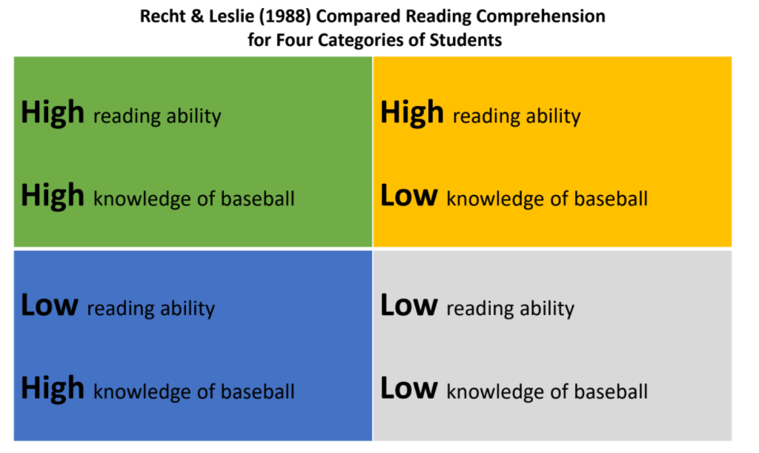
Background Knowledge Study
Source: Recht, D. & Leslie, L. “Effect of Prior Knowledge on Good and Poor Readers Memory of Text.” (1998) Journal of Educational Psychology
7
Practicum| Unit 3: Research-Based Instructional Strategies (RBIS) Reading Language Arts (RLA)| Lesson 3.07 |This work is licensed under a Creative Commons Attribution-Noncommercial-Share Alike 4.0 International License.

Slide 8
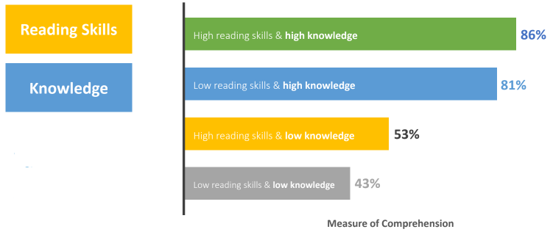
Background Knowledge Study Cont.
Source: Recht, D. & Leslie, L. “Effect of Prior Knowledge on Good and Poor Readers Memory of Text.” (1998) Journal of Educational Psychology
8
Practicum| Unit 3: Research-Based Instructional Strategies (RBIS) Reading Language Arts (RLA)| Lesson 3.07 |This work is licensed under a Creative Commons Attribution-Noncommercial-Share Alike 4.0 International License.

Slide 9
Knowledge-Based Approach
An approach to lesson planning that builds background knowledge is called a knowledge-based approach.
With a knowledge-based approach, students:
Read multiple texts on the same topic
Engage with other sources (audio, video, discussion) about the same topic.
Build content knowledge and vocabulary
This supports their ability to comprehend what they read.
9
Practicum| Unit 3: Research-Based Instructional Strategies (RBIS) Reading Language Arts (RLA)| Lesson 3.07 |This work is licensed under a Creative Commons Attribution-Noncommercial-Share Alike 4.0 International License.

Slide 10
Skills-Based Approach
A skills-based approach teaches reading skills in isolation. This would be like practicing how to shoot a basketball, but never playing a game with a team.
This is a practice that is used frequently in standardized test preparation. Think about lessons in which students read several short, unrelated passages, and are asked to find the main idea or make an inference.
Because of the focus on skills, texts and topics are unrelated. Students do not build the necessary background knowledge to aid comprehension.
10
Practicum| Unit 3: Research-Based Instructional Strategies (RBIS) Reading Language Arts (RLA)| Lesson 3.07 |This work is licensed under a Creative Commons Attribution-Noncommercial-Share Alike 4.0 International License.

Slide 11
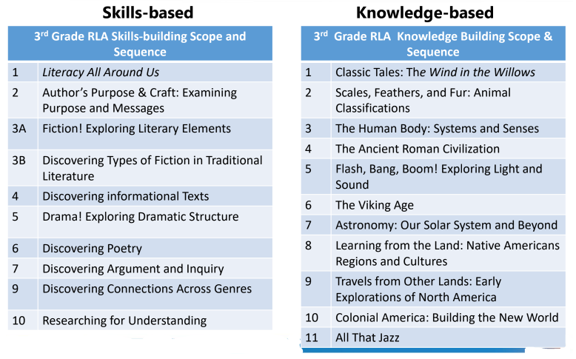
Skills-Based vs Knowledge-Based Approach
11
Practicum| Unit 3: Research-Based Instructional Strategies (RBIS) Reading Language Arts (RLA)| Lesson 3.07 |This work is licensed under a Creative Commons Attribution-Noncommercial-Share Alike 4.0 International License.

Slide 12
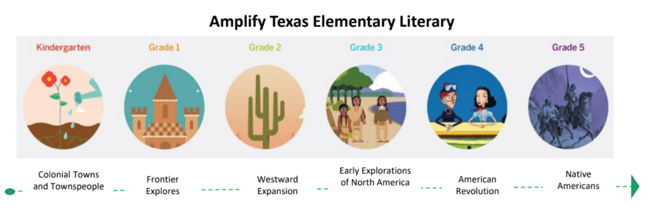
Knowledge-Based Approach Across Grade Levels
12
Practicum| Unit 3: Research-Based Instructional Strategies (RBIS) Reading Language Arts (RLA)| Lesson 3.07 |This work is licensed under a Creative Commons Attribution-Noncommercial-Share Alike 4.0 International License.

Slide 13
Exit Ticket
What is tier one Instruction?
Why is it important to provide students opportunities to access grade-level complex texts during tier one instruction?
What supports and scaffolds can a teacher provide to support students in accessing grade-level complex texts?
How have you seen complex texts used in your own internship experience?
13
Practicum| Unit 3: Research-Based Instructional Strategies (RBIS) Reading Language Arts (RLA)| Lesson 3.07 |This work is licensed under a Creative Commons Attribution-Noncommercial-Share Alike 4.0 International License.

