Slide 1
Practicum| Unit 3: Research-Based Instructional Strategies (RBIS) Reading Language Arts (RLA)| Lesson 3.10
Types of Assessments
This work is licensed under a Creative Commons Attribution-Noncommercial-Share Alike 4.0 International License.

Slide 2
TEKS Standards & Objectives
TEKS 6G, 8B, 8D
The student will…
Explain why a variety of assessments is necessary to guide reading instruction.
Describe the purpose and timing of four types of reading assessments: Diagnostic, formative, interim, and summative.
2
Practicum| Unit 3: Research-Based Instructional Strategies (RBIS) Reading Language Arts (RLA)| Lesson 3.10 |This work is licensed under a Creative Commons Attribution-Noncommercial-Share Alike 4.0 International License.

Slide 3
Bellringer
What is an assessment?
Why do you think teachers use assessments?
3
Practicum| Unit 3: Research-Based Instructional Strategies (RBIS) Reading Language Arts (RLA)| Lesson 3.10 |This work is licensed under a Creative Commons Attribution-Noncommercial-Share Alike 4.0 International License.

Slide 4
Vocabulary
Term | Definition
Assessment | Any tool used to collect, analyze, and respond to information about student understanding of learning targets.
Summative Assessment | Assessment used to evaluate learning at the end of a learning sequence.
Interim Assessment | Assessment used to check progress throughout the year, identify areas for intervention, and predict performance on summative assessment.
Formative Assessment | Assessment used to determine understanding as learning is taking place and are used to help inform a teacher’s next steps.
Diagnostic Assessment | Assessment used to determine student prior knowledge, strengths, and weaknesses in a particular area at the beginning of a learning sequence.
4
Practicum| Unit 3: Research-Based Instructional Strategies (RBIS) Reading Language Arts (RLA)| Lesson 3.10 |This work is licensed under a Creative Commons Attribution-Noncommercial-Share Alike 4.0 International License.

Slide 5
Types of Assessments
Type of Assessment | What it does | High/low stakes (typically) | Example
Summative Assessment | Evaluates learning at the end of a learning sequence. | High stakes | STAAR, unit assessment
Interim Assessment | Checks progress throughout the year, identifies areas for intervention, predicts performance on summative assessment. | Low stakes | Benchmarks
Formative Assessment | Determines understanding as learning is taking place. Informs teacher’s next steps. | Low stakes | exit tickets, checks for understandings, students practice, thumbs up-thumbs down
Diagnostic Assessment | Determines student prior knowledge, strengths, and weaknesses in a particular area at the beginning of a learning sequence. | Low stakes | Pre assessments Phonics surveys Work samples
5
Practicum| Unit 3: Research-Based Instructional Strategies (RBIS) Reading Language Arts (RLA)| Lesson 3.10 |This work is licensed under a Creative Commons Attribution-Noncommercial-Share Alike 4.0 International License.

Slide 6
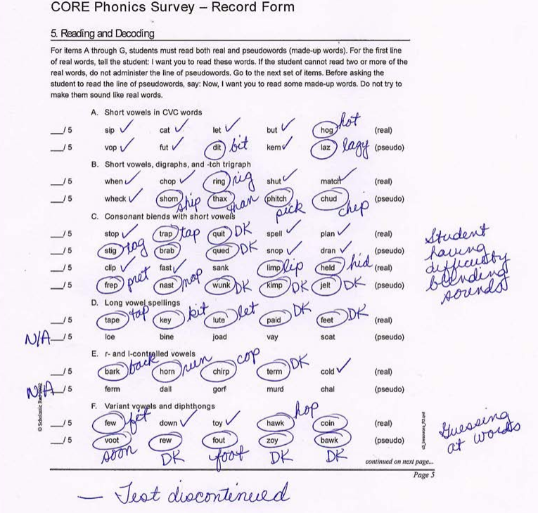
Assessment #1
6
Practicum| Unit 3: Research-Based Instructional Strategies (RBIS) Reading Language Arts (RLA)| Lesson 3.10 |This work is licensed under a Creative Commons Attribution-Noncommercial-Share Alike 4.0 International License.

Slide 7
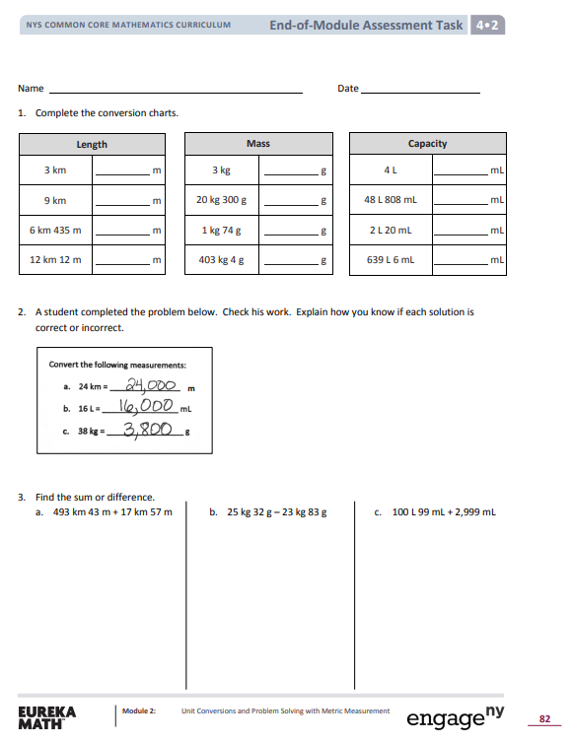
Assessment #2
7
Practicum| Unit 3: Research-Based Instructional Strategies (RBIS) Reading Language Arts (RLA)| Lesson 3.10 |This work is licensed under a Creative Commons Attribution-Noncommercial-Share Alike 4.0 International License.

Slide 8
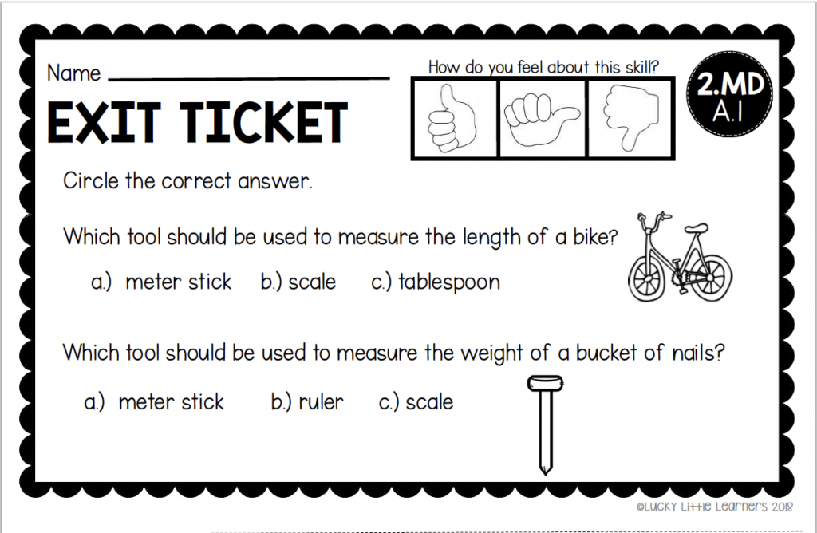
Assessment #3
8
Practicum| Unit 3: Research-Based Instructional Strategies (RBIS) Reading Language Arts (RLA)| Lesson 3.10 |This work is licensed under a Creative Commons Attribution-Noncommercial-Share Alike 4.0 International License.

Slide 9
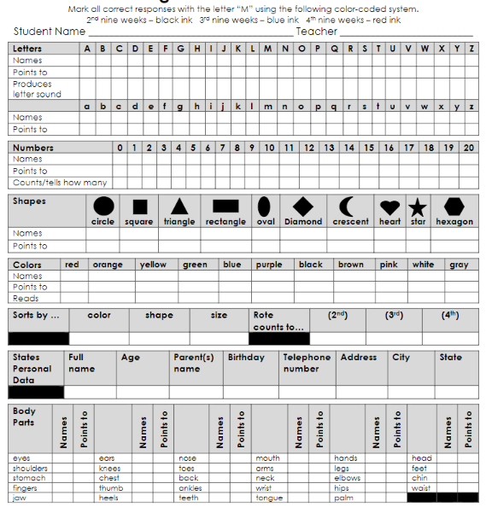
Assessment #4
9
Practicum| Unit 3: Research-Based Instructional Strategies (RBIS) Reading Language Arts (RLA)| Lesson 3.10 |This work is licensed under a Creative Commons Attribution-Noncommercial-Share Alike 4.0 International License.

Slide 10
Exit Ticket
Read the following scenario and respond to the questions:
Mr. J’s class is learning about cause and effect. Prior to starting the unit, he gave his students a pre-assessment to determine what they already knew about cause and effect. Based on the data, he had his students engage in several text-based activities using various sources to identify cause and effect relationships. At the end of the unit, he gives his students an assessment on cause and effect. He thought his students were going to do well, but many didn’t pass the test or show a basic understanding of cause and effect.
What assessment types did Mr. J implement? Based on what you learned about assessments, what could Mr. J have done differently to ensure his students were learning the content throughout the unit?
10
Practicum| Unit 3: Research-Based Instructional Strategies (RBIS) Reading Language Arts (RLA)| Lesson 3.10 |This work is licensed under a Creative Commons Attribution-Noncommercial-Share Alike 4.0 International License.

