Slide 1
Practicum| Unit 3: Research-Based Instructional Strategies (RBIS) Reading Language Arts (RLA)| Lesson 3.13
Curriculum Embedded Supports
This work is licensed under a Creative Commons Attribution-Noncommercial-Share Alike 4.0 International License.

Slide 2
TEKS Standards & Objectives
TEKS 4E
The student will…
Identify examples of curriculum-embedded supports
Analyze examples of curriculum-embedded supports to determine alignment with UDL guidelines for engagement, representation, and/or action and expression.
2
Practicum| Unit 3: Research-Based Instructional Strategies (RBIS) Reading Language Arts (RLA)| Lesson 3.13 | This work is licensed under a Creative Commons Attribution-Noncommercial-Share Alike 4.0 International License.

Slide 3
Bellringer
True or False. If the answer is false, provide an explanation of why it is false.
Planning instruction with UDL includes anticipating differences in learner abilities and experiences.
In using a UDL approach, a teacher should reduce the rigor of an activity for students who are performing below grade-level.
UDL includes two guideline areas: multiple means of engagement and multiple means of action and expression.
3
Practicum| Unit 3: Research-Based Instructional Strategies (RBIS) Reading Language Arts (RLA)| Lesson 3.13 | This work is licensed under a Creative Commons Attribution-Noncommercial-Share Alike 4.0 International License.

Slide 4
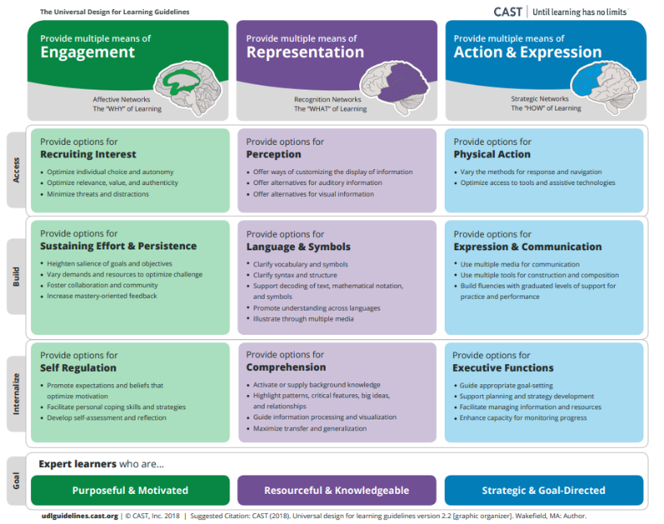
UDL Guidelines
4
Practicum| Unit 3: Research-Based Instructional Strategies (RBIS) Reading Language Arts (RLA)| Lesson 3.13 | This work is licensed under a Creative Commons Attribution-Noncommercial-Share Alike 4.0 International License.

Slide 5
Sorting Activity: UDL Principles
Engagement | Representation | Action & Expression
B (Self-Regulation) | A (Language & Symbols) | E (Physical Action)
D (Recruiting Interest) | C (Perception) | F (Executive Functions)
I (Effort & Persistence) | G (Comprehension) | H (Expression & communication)
5
Practicum| Unit 3: Research-Based Instructional Strategies (RBIS) Reading Language Arts (RLA)| Lesson 3.13 | This work is licensed under a Creative Commons Attribution-Noncommercial-Share Alike 4.0 International License.

Slide 6
Vocabulary
Term | Definition
Curriculum-Embedded Supports | Scaffolding and support opportunities build into the curriculum that ensure challenging and rigorous learning for all students.
6
Practicum| Unit 3: Research-Based Instructional Strategies (RBIS) Reading Language Arts (RLA)| Lesson 3.13 | This work is licensed under a Creative Commons Attribution-Noncommercial-Share Alike 4.0 International License.

Slide 7
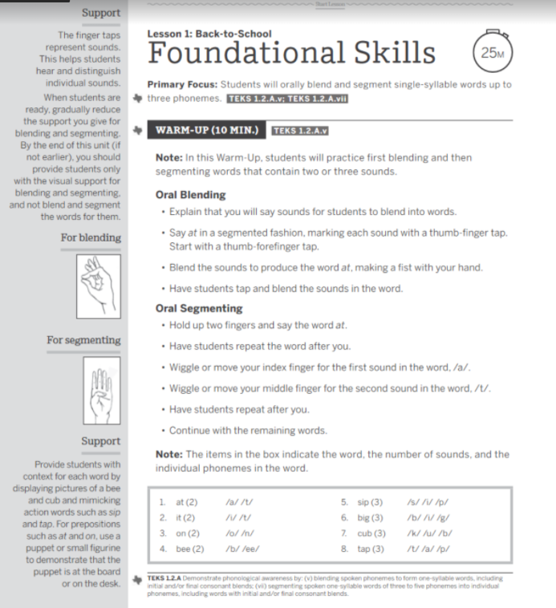
Example:
HQIM & UDL Guidelines
7
Practicum| Unit 3: Research-Based Instructional Strategies (RBIS) Reading Language Arts (RLA)| Lesson 3.13 | This work is licensed under a Creative Commons Attribution-Noncommercial-Share Alike 4.0 International License.

Slide 8
UDL: Engagement Strategies
Recruiting Interest | Optimize individual choice and autonomy Optimize relevance, value, and authenticity Minimize threats and distractions
Sustaining Effort and Persistence | Heighten salience of goals and objectives Vary demands and resources to optimize challenge Foster collaboration and community Increase mastery-oriented feedback
Self Regulation | Promote expectations and beliefs that optimize motivation Facilitate personal coping skills and strategies Develop self-assessment and reflection
8
Practicum| Unit 3: Research-Based Instructional Strategies (RBIS) Reading Language Arts (RLA)| Lesson 3.13 | This work is licensed under a Creative Commons Attribution-Noncommercial-Share Alike 4.0 International License.

Slide 9
UDL: Representation Strategies
Perception | Offer ways of customizing the display of information Offer alternatives for auditory information Offer alternatives for visual information
Language and Symbols | Clarify vocabulary and symbols Clarify syntax and structure Support decoding of text, mathematical notation and symbols Illustrate through multiple media
Comprehension | Activate or supply background knowledge Highlight patterns, critical features, big ideas, and relationships Guide information processing and visualization Maximize transfer and generalization
9
Practicum| Unit 3: Research-Based Instructional Strategies (RBIS) Reading Language Arts (RLA)| Lesson 3.13 | This work is licensed under a Creative Commons Attribution-Noncommercial-Share Alike 4.0 International License.

Slide 10
UDL: Action & Expression Strategies
Physical Action | Vary the methods for response and navigation Optimize access to tools and assistive technologies
Expression & Communication | Use multiple media for communication Use multiple tools for construction and composition Build fluencies with graduated levels of support for practice and performance
Executive Functions | Guide appropriate goal-setting Support planning and strategy development Facilitate managing information and resources Enhance capacity for monitoring progress
10
Practicum| Unit 3: Research-Based Instructional Strategies (RBIS) Reading Language Arts (RLA)| Lesson 3.13 | This work is licensed under a Creative Commons Attribution-Noncommercial-Share Alike 4.0 International License.

Slide 11
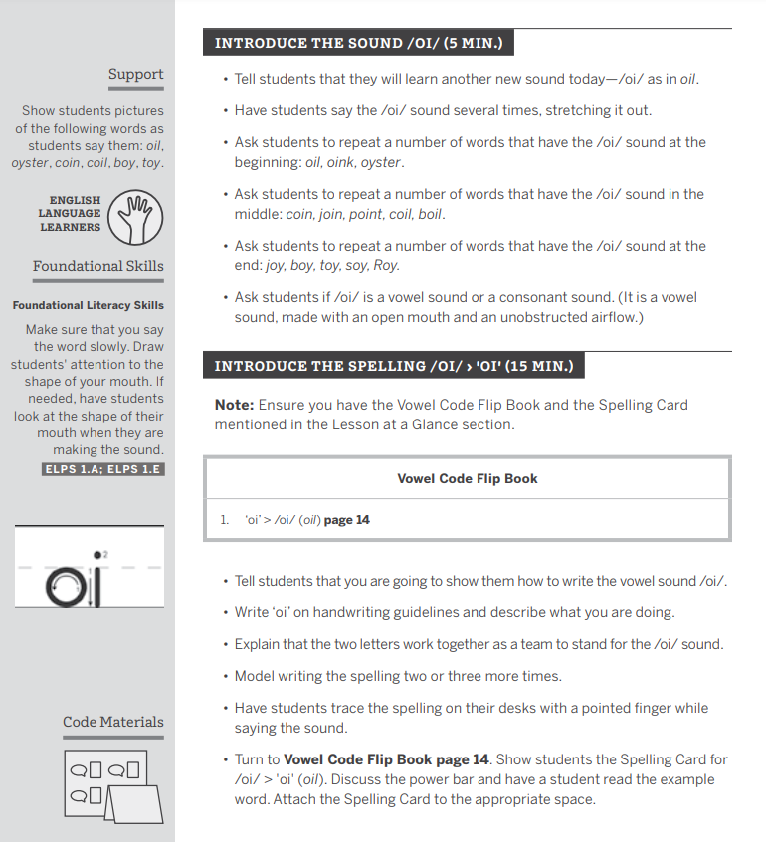
Exit Ticket
What is the importance of planning with both HQIM and UDL? How can this approach support learning for all students?
Examine the HQIM provided. Identify at least one example of where the HQIM aligns to each UDL guideline.
11
Practicum| Unit 3: Research-Based Instructional Strategies (RBIS) Reading Language Arts (RLA)| Lesson 3.13 | This work is licensed under a Creative Commons Attribution-Noncommercial-Share Alike 4.0 International License.

