Slide 1
Practicum| Unit 3: Research-Based Instructional Strategies (RBIS) Reading Language Arts (RLA)| Lesson 3.12
UDL in Literacy Instruction
This work is licensed under a Creative Commons Attribution-Noncommercial-Share Alike 4.0 International License.

Slide 2
TEKS Standards & Objectives
TEKS 4E
The student will…
Compare a traditional approach to planning with a UDL approach
Describe how a UDL approach promotes more accessible outcomes for all students
2
Practicum| Unit 3: Research-Based Instructional Strategies (RBIS) Reading Language Arts (RLA)| Lesson 3.12 | This work is licensed under a Creative Commons Attribution-Noncommercial-Share Alike 4.0 International License.

Slide 3
Bellringer
The dance instructor of a ballet and tap class is buying new dance shoes for her students. Since the average shoe size for a 16-year-old is a women’s 8.5, she buys everyone the same size dance shoes.
Provide three reasons why this isn’t a good idea.
3
Practicum| Unit 3: Research-Based Instructional Strategies (RBIS) Reading Language Arts (RLA)| Lesson 3.12 | This work is licensed under a Creative Commons Attribution-Noncommercial-Share Alike 4.0 International License.

Slide 4
Vocabulary
Term | Definition
Universal Design | The design of buildings, products or environments to make them accessible to people, regardless of age, disability or other factors.
Universal Design for Learning (UDL) | An educational framework to guide the development of flexible learning environments that can accommodate individual learning differences through engagement, representation, and expression. UDL minimizes barriers and maximizes learning for all students.
UDL Guidelines | A set of strategies that can be applied to any subject or grade level to ensure that all learners can access and participate in meaningful, challenging learning opportunities. (CAST, 2022)
Multiple Means of Engagement | Providing various ways of engaging with material to stimulate interest and motivation for learning
Multiple Means of Representation | Presenting information and content in different ways to support learning for all students
Multiple Means of Action & Expression | Offering options for ways students can demonstrate their learning and express what they know
4
Practicum| Unit 3: Research-Based Instructional Strategies (RBIS) Reading Language Arts (RLA)| Lesson 3.12 | This work is licensed under a Creative Commons Attribution-Noncommercial-Share Alike 4.0 International License.

Slide 5

Notes: Defining UDL
5
Practicum| Unit 3: Research-Based Instructional Strategies (RBIS) Reading Language Arts (RLA)| Lesson 3.12 | This work is licensed under a Creative Commons Attribution-Noncommercial-Share Alike 4.0 International License.

Slide 6

Notes: Defining UDL Cont.
6
Practicum| Unit 3: Research-Based Instructional Strategies (RBIS) Reading Language Arts (RLA)| Lesson 3.12 | This work is licensed under a Creative Commons Attribution-Noncommercial-Share Alike 4.0 International License.

Slide 7
Learning Styles vs UDL
Learning Styles | UDL
Each student has a fixed and rigid way of learning Not supported by research Causes students to become limited in their views of themselves as learners Often leads to less rigorous activities for struggling readers | All learners need multiple means of engagement, representation, and expression Supported by research Proactive approach to addressing barriers in the environment and curriculum Makes grade-level content accessible to all learners
7
Practicum| Unit 3: Research-Based Instructional Strategies (RBIS) Reading Language Arts (RLA)| Lesson 3.12 | This work is licensed under a Creative Commons Attribution-Noncommercial-Share Alike 4.0 International License.

Slide 8
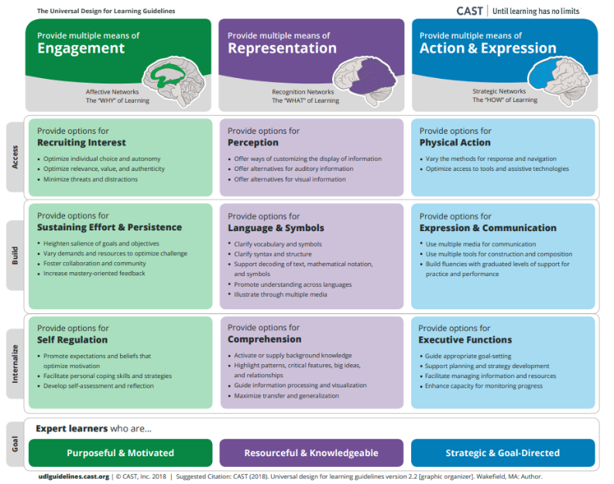
UDL Guidelines
8
Practicum| Unit 3: Research-Based Instructional Strategies (RBIS) Reading Language Arts (RLA)| Lesson 3.12 | This work is licensed under a Creative Commons Attribution-Noncommercial-Share Alike 4.0 International License.

Slide 9
Traditional Vs UDL Approach to Planning
Traditional Approach to Planning | UDL Approach to Planning
Plan for grade-level, general education students first Modify activities for some learners Reduce rigor of activities for students performing below-grade level | Establish clear outcomes Anticipate differences in learner abilities and experiences Use embedded supports to meet learner differences for below and above grade level learners Provide embedded scaffolds and support as needed to support access while maintaining rigor All students have full access to learning opportunities
9
Practicum| Unit 3: Research-Based Instructional Strategies (RBIS) Reading Language Arts (RLA)| Lesson 3.12 | This work is licensed under a Creative Commons Attribution-Noncommercial-Share Alike 4.0 International License.

Slide 10
Exit Ticket
Respond to the questions below by completing the exit ticket, creating a PPT slide, creating a video explanation, etc.
How does a traditional approach to planning differ from a UDL approach?
How does a UDL approach promote accessible outcomes for all students?
How have you seen a UDL approach to planning in your own internship experience?
10
Practicum| Unit 3: Research-Based Instructional Strategies (RBIS) Reading Language Arts (RLA)| Lesson 3.12 | This work is licensed under a Creative Commons Attribution-Noncommercial-Share Alike 4.0 International License.

