Slide 1
Practicum| Unit 3: Research-Based Instructional Strategies (RBIS) Math | Lesson 4.01
Balancing Conceptual Understanding and Procedural Fluency
This work is licensed under a Creative Commons Attribution-Noncommercial-Share Alike 4.0 International License.

Slide 2
TEKS Standards & Objectives
TEKS 4 B-D, 5B, 6E-G
The student will:
Describe the relationship between research-based practices and student achievement in math.
Define conceptual understanding and procedural fluency as they relate to mathematics.
Identify examples of student work that demonstrate conceptual understanding and procedural fluency

Slide 3
Bellringer
Read through each of the statements below and decide whether you believe the statement to be true or false.
  Not every student can understand math. Some students are just “math people” and others are not.
  There are practices in mathematics that can lead to better student outcomes for all students.
  Understanding the process for how to solve a math problem is more important than understanding why that solution works.
  The U.S. scores above average on Math scores on international assessments such as the PISA (Program for International Assessment) exam.
  Memorizing math facts doesn’t help students to learn math.

Slide 4
Vocabulary
Research-Based Instructional Strategies (RBIS) | A set of practices supported by research that should be present in classrooms, regardless of instructional materials
Conceptual Understanding | The ability to access concepts from a number of perspectives and to see math as more than a set of mnemonics or discrete procedures.
Procedural Fluency | The ability to quickly perform mathematical calculations accurately.

Slide 5
Research Based Instructional Strategies (RBIS)
RBIS are…
A set of research-based practices that highlights misconceptions common in the field
Topics that require conceptual or philosophical shifts in approach to instruction
A set of practices that are supported by research and should be present in classrooms, regardless of instructional materials
A set of practices that relate directly to the design of instructional materials AND/OR the approach required to implement them well

Slide 6
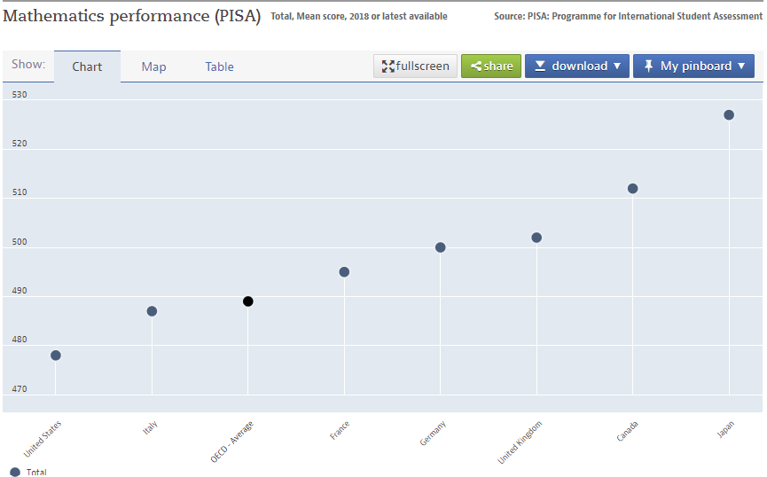
Mathematics Performance (PISA) 2018

Slide 7
RBIS for Math
Balancing Conceptual Understanding with Procedural Fluency
Requiring and encouraging productive struggle
Providing curriculum embedded supports to accelerate student learning

Slide 8
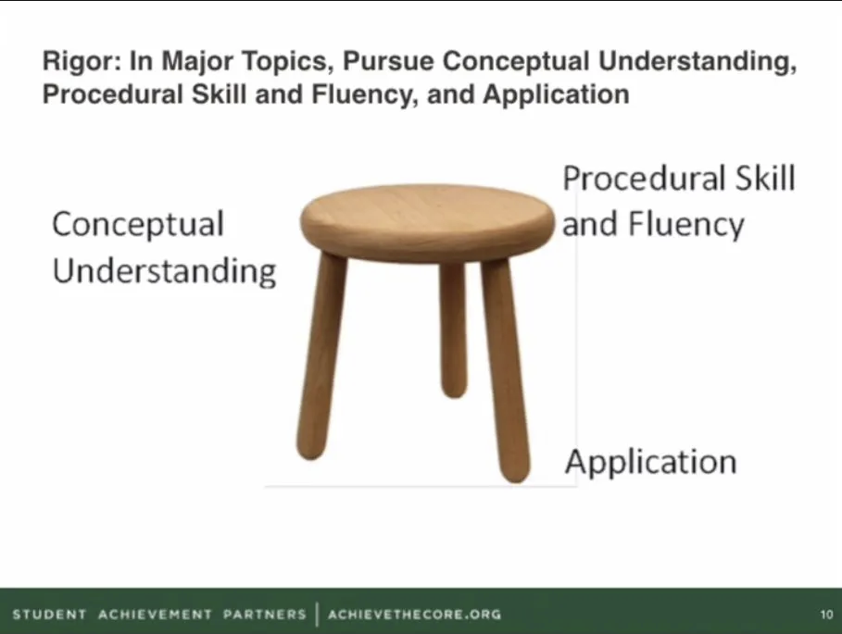
Rigor

Slide 9
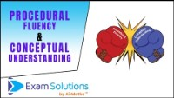
Video

Slide 10
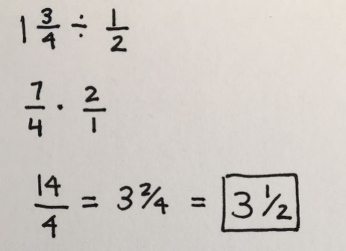
Example: Procedural Fluency
Example from TEA Strong Foundations RBIS Math PPT presentation

Slide 11
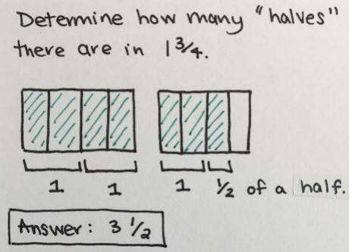
Example: Conceptual Understanding

Slide 12
Exit Ticket
Why is using research-based instructional strategies in math important to the academic achievement of all math students?
Describe the difference between procedural fluency and conceptual understanding.
Read each scenario and identify whether the scenario is describing procedural fluency or conceptual understanding.
  Students are working on memorizing their multiplication facts for the numbers 1-5
  Students are asked to show how many tens groups are in the number 65 by drawing a picture
  Use a number line to find determine the answer of 3 + 5
  Solve for x in the equation 3x + 5 = 20

