Slide 1
Practicum| Unit 3: Research-Based Instructional Strategies (RBIS) Math | Lesson 4.07
Productive Struggle: Encouraging Productive Struggle in the Classroom
This work is licensed under a Creative Commons Attribution-Noncommercial-Share Alike 4.0 International License.

Slide 2
TEKS Standards & Objectives
TEKS 4B, 4C, 4D, 5B, 6E, 6F, 6G
The student will:
Identify and apply strategies that encourage productive struggle in mathematics instruction

Slide 3
Bellringer
Think about the strategies for productive struggle from the last lesson. Which of these strategies will be most difficult for you to use as a teacher? Why? Which strategy will be easiest to use? Why?

Slide 4
Encouraging Productive Struggle through the Use of High-Quality Instructional Materials
1 | High-quality instructional materials ask students to engage with grade-level content, which ensures that there are high expectations for students to meet.
2 | High-quality instructional materials also give students opportunities to engage with the content in different ways. As we discussed in the previous lessons, one of the ways that students can struggle productively is by trying to solve problems in different ways.
3 | When a teacher plans to use high-quality instructional materials, part of the planning process can focus on identifying the misconceptions that students might have and how they can support them with struggling productively through those misconceptions.

Slide 5
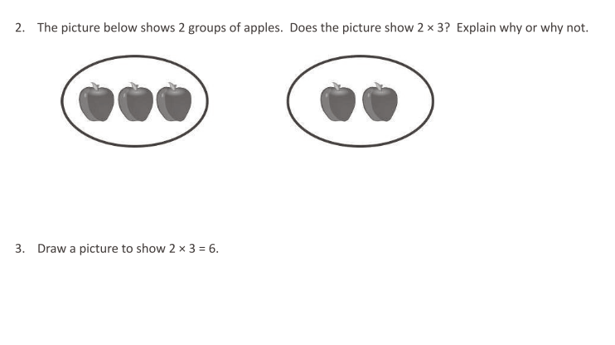
Modeling: Problem 1
(Question from Eureka Math: TEKS Edition, Grade 3, Modules 1 & 2. Learn Book)

Slide 6
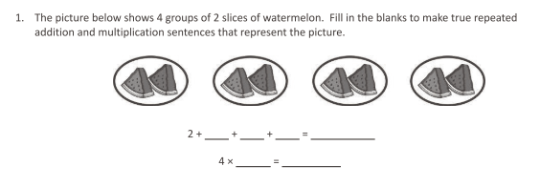
Modeling: Problem 2
(Question from Eureka Math: TEKS Edition, Grade 3, Modules 1 & 2. Learn Book)

Slide 7
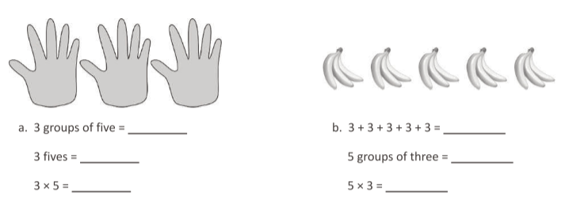
Exit Ticket
Review the mathematics questions below and respond to the questions that follow.
(Question from Eureka Math: TEKS Edition, Grade 3, Modules 1 & 2. Learn Book)
Do these questions align with the mathematics TEKS for third grade that we reviewed in class?
Do these questions provide multiple entry points for a student? If so, how?
How might students struggle with these questions? How would you help struggle productively through those challenges?

