Slide 1
Practicum| Unit 3: Research-Based Instructional Strategies (RBIS) Math | Lesson 4.09
Curriculum Embedded Supports
This work is licensed under a Creative Commons Attribution-Noncommercial-Share Alike 4.0 International License.

Slide 2
TEKS Standards & Objectives
TEKS 4E, 5B
Objectives:
Identify examples of curriculum-embedded supports
Analyze samples of curriculum-embedded supports to determine alignment with UDL guidelines for engagement, representation, and/or action and expression

Slide 3
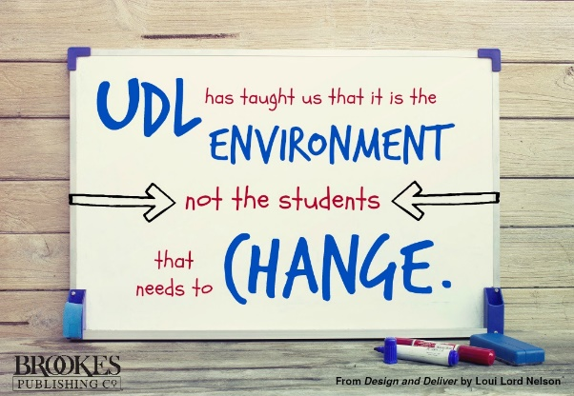
Bellringer
Do you agree or disagree with the quote below?
Why might some teachers find UDL practices to be challenging to implement in the math classroom?

Slide 4
Vocabulary
Universal Design for Learning (UDL) | An educational framework to guide the development of flexible learning environments that can accommodate individual learning differences through engagement, representation, and expression. UDL minimizes barriers and maximizes learning for all students.

Slide 5
Multiple Means of Engagement
Allowing students choice in how they might reach a learning target
Providing opportunities for students to engage in learning experiences that are relevant and valuable to their goals and individual interests
Creating a supportive environment where students feel safe to learn and take risks

Slide 6
Multiple Means of Representation
Offering options for customizing the display of information
Offering alternatives for auditory information
Offering alternatives for visual information

Slide 7
Multiple Means of Action and Expression
Allowing students to share their learning in different ways
Providing alternative ways for students to interact with instructional materials and their environment
Providing access to and support with tools and assistive technologies
Providing opportunities for students to communicate using multiple forms of media
Supporting learners in setting challenging and authentic goals
Provide flexible tools and processes to support organization and memory

Slide 8
Exit Ticket
Consider your own field experience during your classroom visits. What examples of UDL strategies have you seen your teacher (or other teachers) use?
Mr. L is teaching his fourth-grade math students how to add decimal numbers. The students are doing well with the content. Therefore, as an in-class activity to show their mastery, Mr. L asks students to write their own word problem using decimals and demonstrate how to solve the problem. How does this assignment meet the criteria for UDL guidelines? How does it not? What else could Mr. L do to make this assignment more accessible for all students?

