Slide 1
Practicum| Unit 4: Research Based Instructional Strategies (RBIS) Math | Lesson 4.11
Just-In-Time Supports for Acceleration
This work is licensed under a Creative Commons Attribution-Noncommercial-Share Alike 4.0 International License.

Slide 2
TEKS Standards & Objectives
TEKS 4E, 6A, 6H, & 6F
The student will…
  Identify how curriculum-embedded just-in-time interventions are used to support acceleration.

Slide 3
Bellringer
Ms. L teaches Algebra 1. This week, she is introducing the slope-intercept form linear equation: y = mx + b. She feels confident that her students will be able to understand the terms and graph examples but is concerned that a few of her students have struggled to solve for an unknown variable in an equation. Once students need to solve for x, some of them will not be able to complete the assignment.
She decides to provide a targeted review of how to solve for unknown variables in an equation during her school’s study hall block the day before the lesson and asks the students who have the most difficulty on this topic attend. By providing this support, nearly 90 percent of her students were proficient on her exit ticket the following day.
  Describe how Ms. L set her students up for success using the terms “acceleration” and “just-in-time interventions.”

Slide 4
Planning Effective Just-In-Time Interventions
Steps for Effective Just-In-Time Interventions | Description
Identify Prerequisite Skills and Knowledge | Examine the unit’s standards and objectives and use an aligned pre-test to identify the prior knowledge needed to master grade level content.
2. Schedule within the Scope and Sequence | Identify timely opportunities to provide just-in-time interventions within the scope and sequence.
3. Design and Implement Appropriate Interventions | Implement lesson activities that embed just-in-time interventions alongside grade-level content.

Slide 5
Applying the Steps of Just-in-Time Interventions for Acceleration
Mr. H is in his fourth-year teaching second grade. This year, he wants to be more intentional about using just-in-time interventions to support students with engaging in grade level content. Follow along with Mr. H as he completes the steps to developing a plan for his just-in-time interventions and respond to the questions along the way.

Slide 6
Step 1: Identify Prerequisite Skills and Knowledge
Grade 2, Module 2: Addition and Subtraction of Length Units
Grade Level Content Standards
Geometry and Measurement | The student applies mathematical process standards to select and use units to describe length, area, and time. The student is expected to:
2.9A | find the length of objects using concrete models for standard units of length;
2.9B | describe the inverse relationship between the size of the unit and the number of units needed to equal the length of an object;
2.9C | represent whole numbers as distances from any given location on a number line;
Foundational Standards
1.7A | use measuring tools to measure the length of objects to reinforce the continuous nature of linear measurement;
1.7B | illustrate that the length of an object is the number of same-size units of length that, when laid end-to-end with no gaps or overlaps, reach from one end of the object to the other;
1.7D | describe a length to the nearest whole unit using a number and a unit.

Slide 7
Step 1: Identify Prerequisite Skills and Knowledge
Based on the standards above, what foundational concepts should students know in order to be successful on the 2nd-grade content?
Why is it important that a student can do this before moving onto grade level content?

Slide 8
Step 1: Identify Prerequisite Skills and Knowledge
Pre-Test Results:
In his class of 18 students,
17 students were able to correctly compare the units to identify student’s preferred vegetable.
12 students were able to correctly identify what pictures had the correct measurements in centimeter cubes.
Given the results of this assessment, what concept should Mr. H focus on with his just-in-time intervention? How many students should be in this intervention group?

Slide 9
Step 2: Schedule within the Scope and Sequence
TEKS | Lesson Number | Lesson Topics | A
2.9A 2.9D 2.9B | 1 | Connect measurement with physical units by using multiple copies of the same physical unit to measure.
 | 2 | Use iteration with one physical unit to measure.
 | 3 | Apply concepts to create unit rulers and measure lengths using unit rulers.
2.9A 2.9D 2.9E 2.2E 2.2F | 4 | Measure various objects using centimeter rulers and meter sticks. | B
 | 5 | Develop estimation strategies by applying prior knowledge of length and using mental benchmarks.
2.9A 2.9B 2.9D 2.2E 2.2F | 6 | Measure and compare lengths using centimeters and meters. | C
 | 7 | Measure and compare lengths using standard metric length units and non-standard length units; relate measurement to unit size.
2.2E 2.2F 2.9C 2.9D 2.9E | 8 | Solve addition and subtraction word problems using the ruler as a number line.
 | 9 | Measure lengths of string using measurement tools and use strip diagrams to represent and compare the lengths.
 | 10 | Apply conceptual understanding of measurement by solving two-step word problems.

Slide 10
Step 2: Schedule within the Scope and Sequence
Based on the sequence of topics and objectives provided by Mr. H’s high-quality instructional materials, at what point should he provide this just in time intervention (A, B, or C)? Explain your choice.

Slide 11
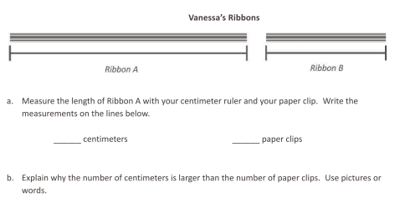
Step 3: Design and Implement Appropriate Interventions
Source: Eureka Math, Grade 2, Module 2 Assessment.
How does the content of his intervention connect to the grade level content his students must master?

Slide 12
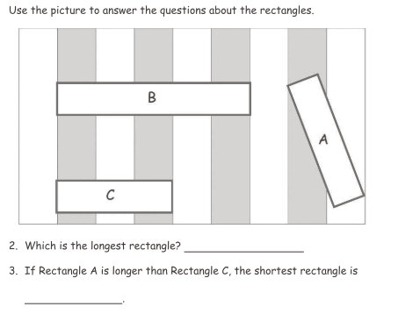
Step 3: Design and Implement Appropriate Interventions
Identifying the Sample Problems
Option A:
Source: Eureka Math, Grade 1, Module 3 Assessment.

Slide 13
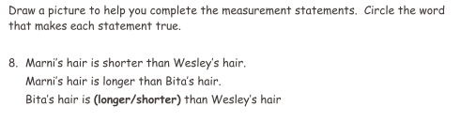
Step 3: Design and Implement Appropriate Interventions
Identifying the Sample Problems
Option B:
Source: Eureka Math, Grade 1, Module 3 Assessment.

Slide 14
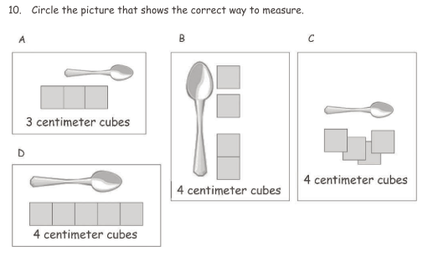
Step 3: Design and Implement Appropriate Interventions
Identifying the Sample Problems
Option C:
Source: Eureka Math, Grade 1, Module 3 Assessment.

Slide 15
Step 3: Design and Implement Appropriate Interventions
Identifying Sample Problems
Which problem do you think best helps students access the grade level content shown in the unit assessment question? Explain your reasoning using the sample unit test question above.

Slide 16
Exit Ticket
In your own words, describe the three steps to planning and implementing a just-in-time intervention.
Consider the intervention you are planning in your internship class. What step do you think will be most challenging for you to complete in this process? Why?

