Slide 1
Practicum| Unit 4: RBIS Math| Lesson 4.14
Portfolio Presentations

Slide 2
TEKS Standards & Objectives
TEKS 1C,1I, 14A, 14B, 14C
The student will:
Present key elements of portfolio while highlighting professional and educational goals
Reflect on lessons learned while completing professional portfolio
Provide feedback to peers on professional portfolio presentation

Slide 3
Bellringer
In this course, you have completed several presentations. Think about the feedback you have received. What are the three most important things you need to do during today’s presentation?

Slide 4
Portfolio Presentation Outline
Name
Your Education and Training Career Goal
Portfolio Element: Name of First Portfolio Element | The two most important things I learned while creating this part of my portfolio are: Response 2. Response

Slide 5
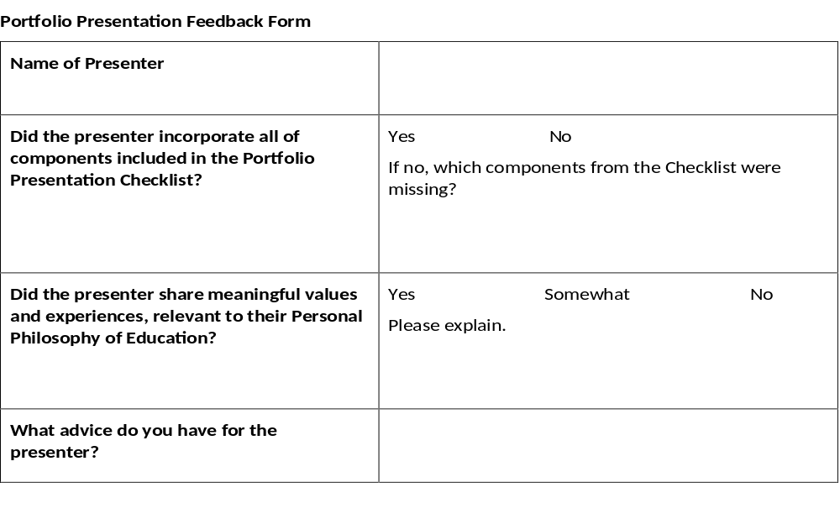
Portfolio Presentation Feedback Form

Slide 6
Portfolio Presentation Norms
As you are an audience member of Portfolio Presentations, please use the following Norms:
• Listen actively.
• Remain engaged and focused on the presenter.
• Respect the presenter.
• Raise your hand to ask relevant questions.

Slide 7
Exit Ticket
What are the three most important things you learned during this course?

