Slide 1
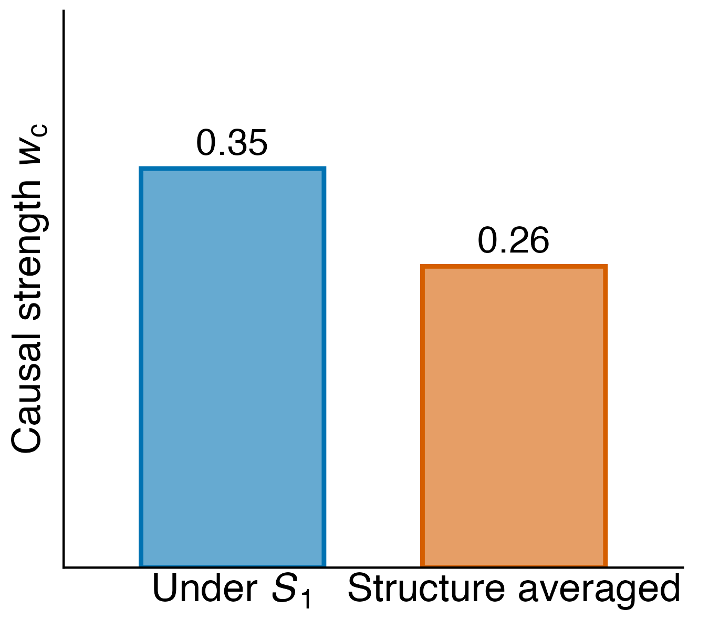
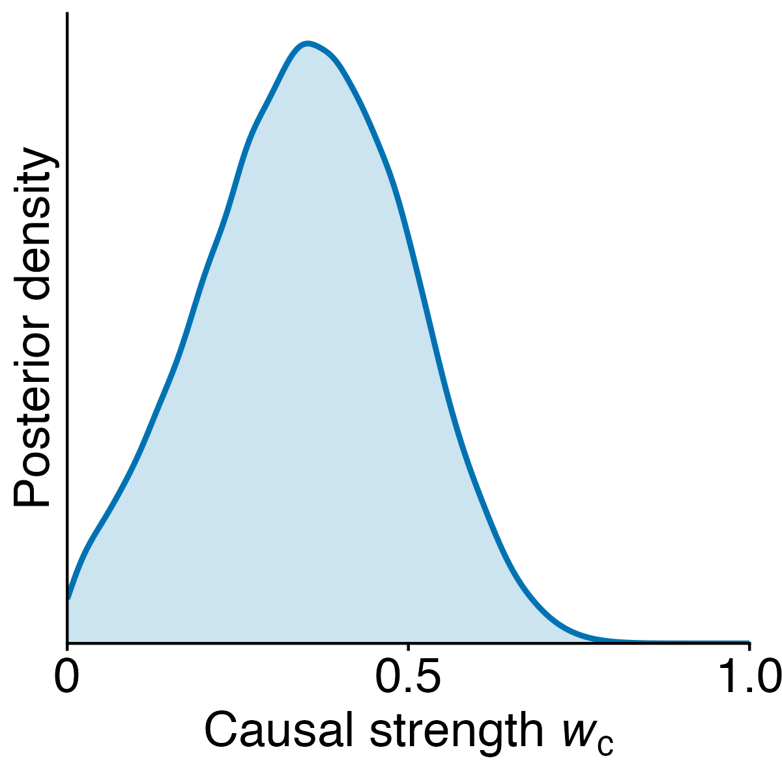
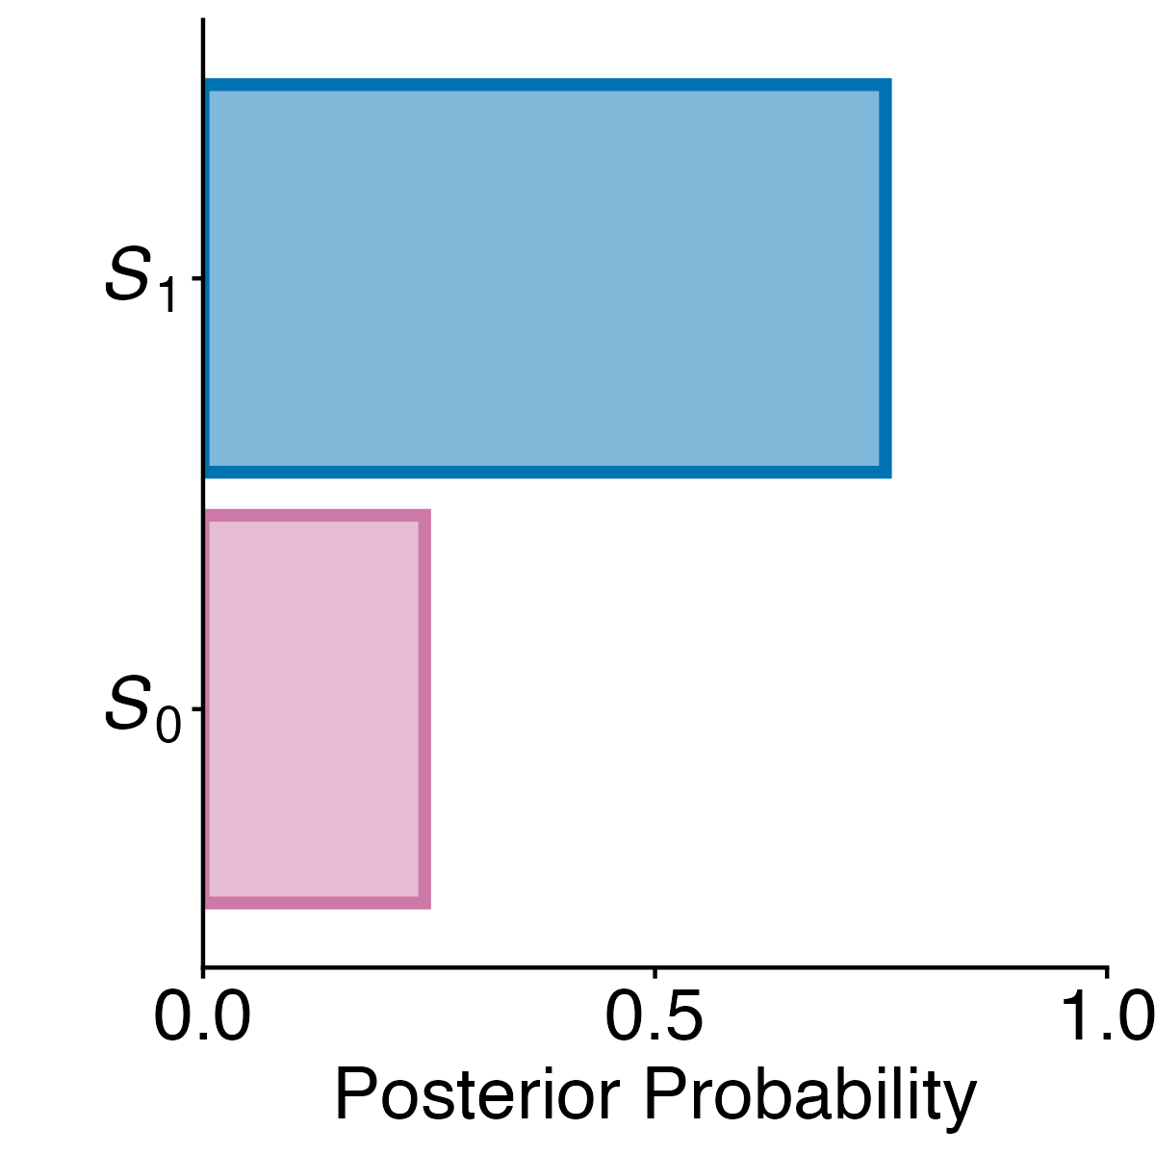
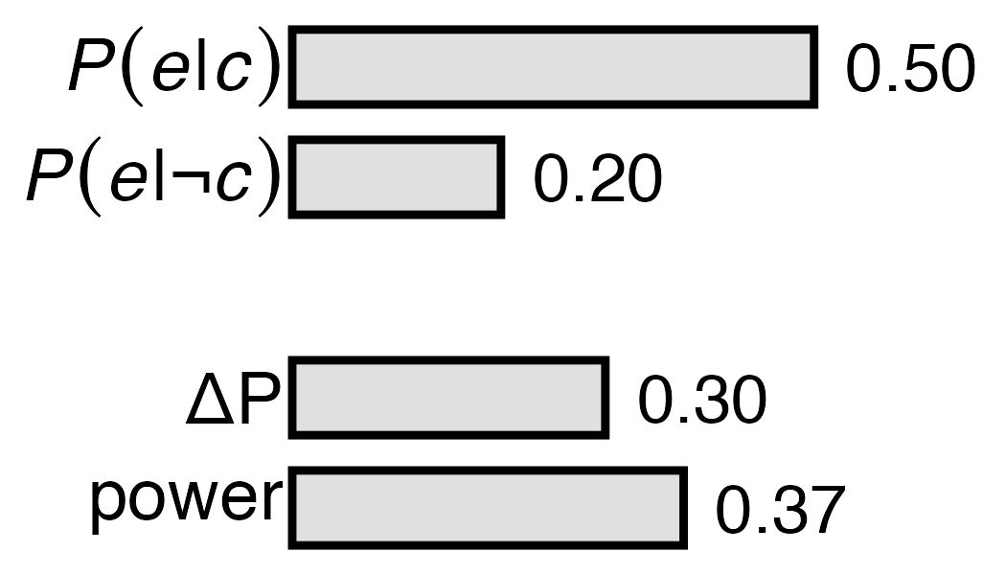



A) Learning data
B) Causal structures
C) Causal Strength under S₁
D) Structure posteriors
E) Causal strength
 | e | ¬e
c | 10 | 10
¬c | 4 | 16
S₁
A
w_{a}
b_{c}
C
w_{c}
E
S₀
A
w_{a}
b_{c}
C
E
$$P(θ|D;S_{i})$$
$$P(S_{i}|D)$$
$$𝔼\left[w_{c} |D\right]$$
Structure hypotheses
Estimate parameters and structure posteriors
Bayesian model averaging

Slide 2
A) Learning data
B) Sample probabilities
C) Model predictions
 | e | ¬e
c | 12 | 8
¬c | 4 | 16
Positive
 | e | ¬e
c | 15 | 5
¬c | 15 | 5
Zero
 | e | ¬e
c | 10 | 10
¬c | 16 | 4
Negative

Slide 3
Structure S₀
Structure S₁
A
A
w_{a}
w_{a}
b_{c}
C
E
b_{c}
C
w_{c}
E
Structure S₁
b_{c}
C
w_{c}
E
w_{a}
A
Structure S₁
Structure S₀
A
A
w_{a}
w_{a}
b_{c}
C
w_{c}
E
b_{c}
C
E

