Slide 1
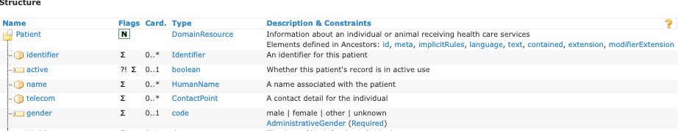

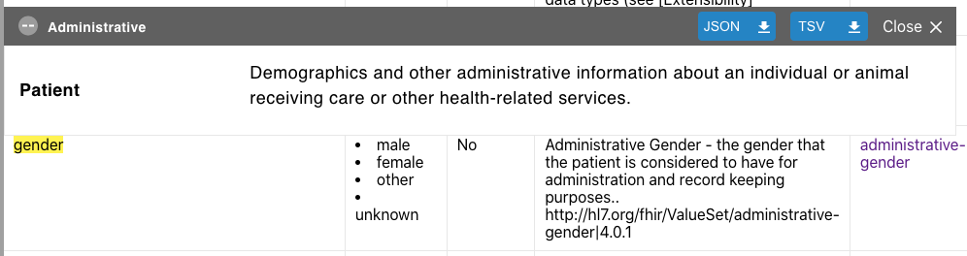


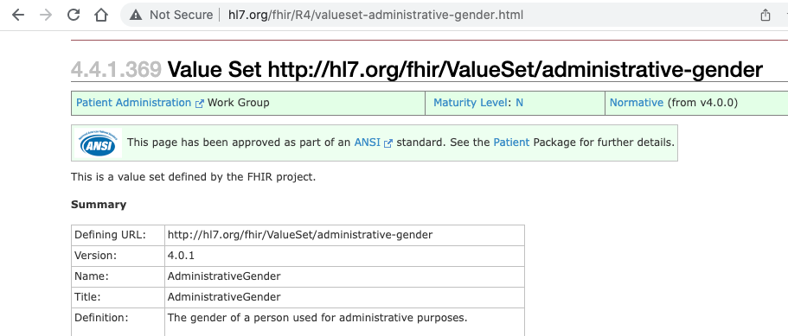
Schema types and enumerations auto-populated
Terminology link
Figure 4: Terminology Linkages

Slide 2





resources/*.json
pfb_fhir
pfb.avro
config.yaml
terminologies, structure definitions

