Slide 1
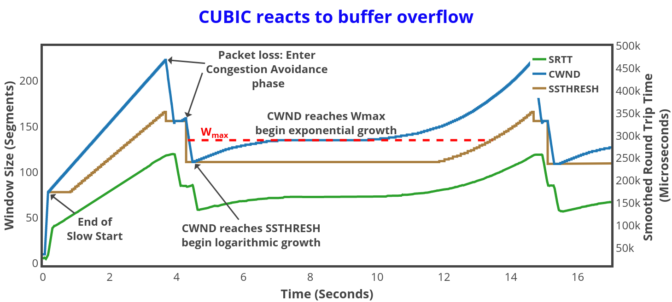
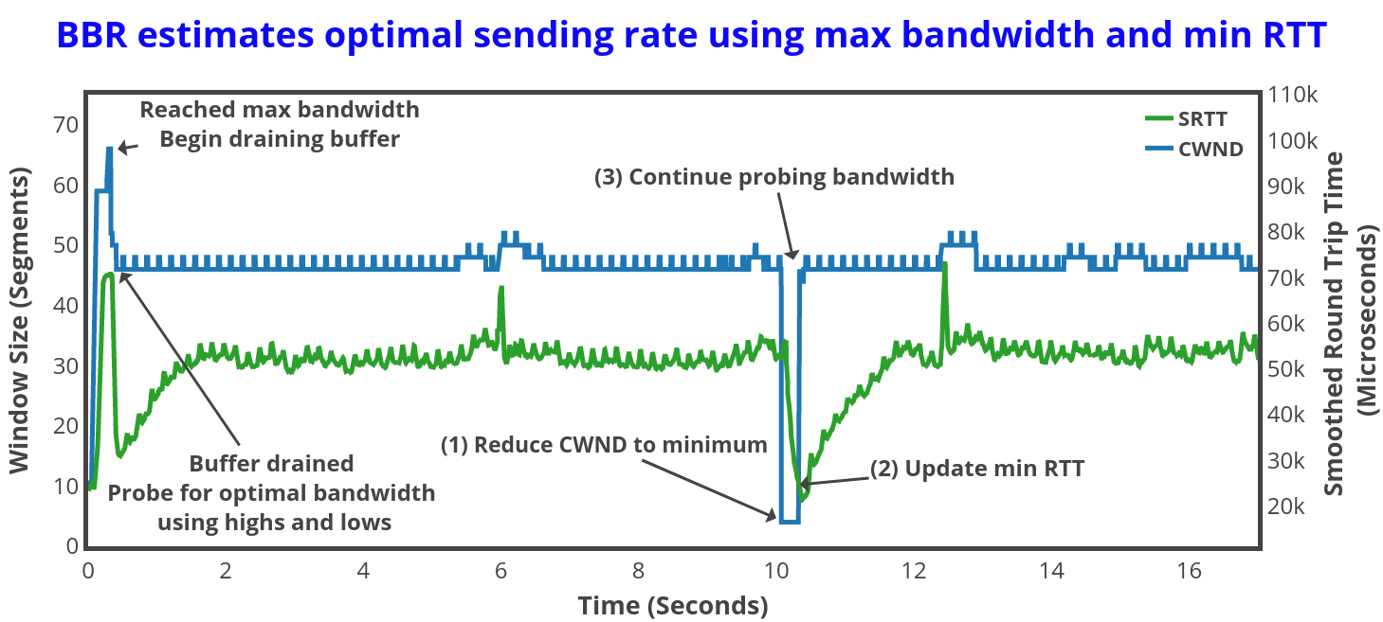
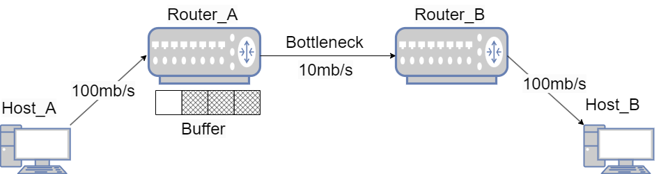
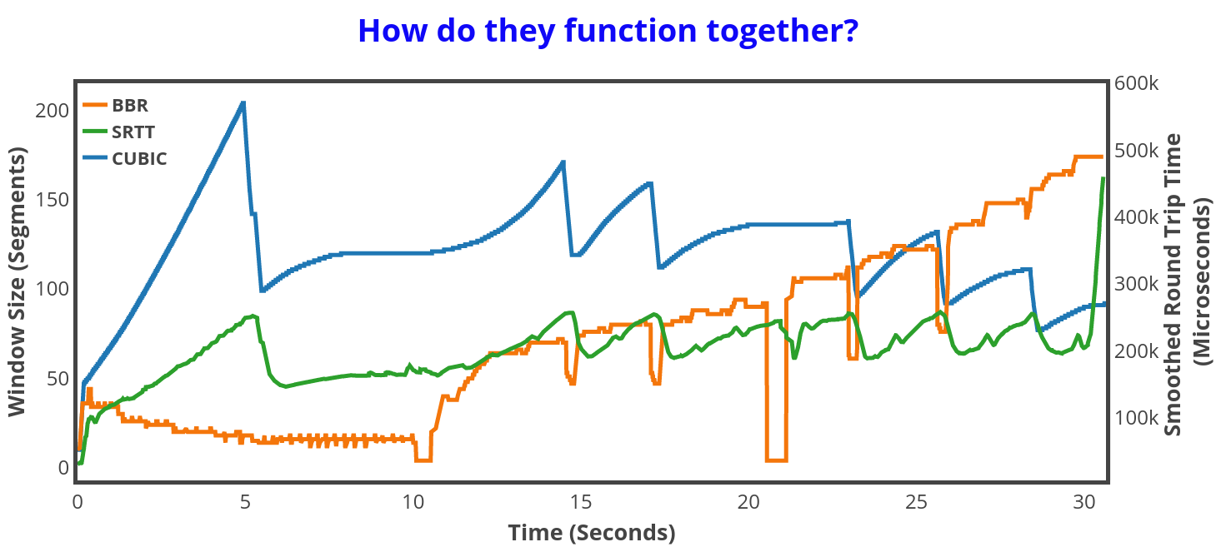
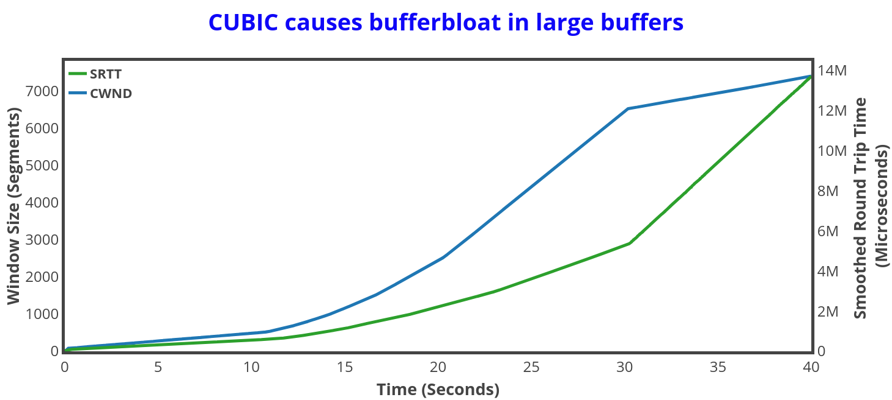
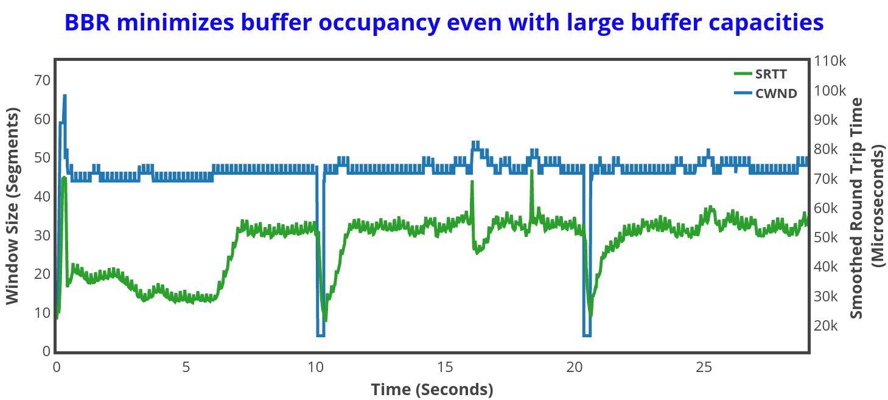
Inspecting Network Congestion Control Algorithms in an Emulation Environment Joshua Wolfel, Dr. Elahi Department of Mathematics and Computing, Mount Royal University, Calgary, AB, Canada
Introduction
Results – Small Buffer
Transmission Control Protocol (TCP) is a fundamental protocol within the Internet protocol suite that provides reliable, ordered, and error-checked delivery of a stream of bytes between applications.
Congestion Control is a set of mechanisms within the TCP designed to detect and prevent network congestion by adjusting the rate at which data is sent and is crucial for providing internet stability by preventing excessive data from overwhelming network paths.
The complexity and variability of network conditions, high diversity in traffic patterns, and variety in congestion control implementation, makes analyzing congestion control on a case-by-case basis difficult.
We aim to create a controlled environment to consistently measure and inspect congestion control behavior for purpose of teaching and research, including the effect of router buffer sizes in relation to overall network performance.
Figure 4: With a small buffer, CUBIC visualizes the interplay of its states. Aggressive growth during the “Slow Start” phase, shrinking of window size while encountering packet loss during “Congestion Avoidance” phase, and cubic growth until subsequent congestion.
Methods
Two congestion control algorithms are tested: CUBIC, and Bottleneck Bandwidth and Round-trip propagation time (BBR)
Each is tested using a large buffer with a capacity of 10,000 packets, and a small buffer with a capacity of 100 packets
The environment uses Mininet to emulate the behavior of the physical devices within a network.
Iperf3 is used to generate TCP data streams between the hosts.
Ftrace is used to collect the Congestion Window size (CWND), Smoothed Round Trip Time (SRTT) and Slow Start Threshold (SSTHRESH) as reported by the kernel of the sending hosts
TCP stream information and RTT are also collected using tcpdump’s packet capture and the ping utility
Figure 5: BBR records minimum Round-Trip-Time (min RTT) and seeks maximum bandwidth (BW) during “STARTUP” phase. The “DRAIN” phase follows to allow any built-up packets to clear in the buffer. BBR then probes near the “optimal” BW, a function of max BW and min RTT. The min RTT is updated periodically by shrinking the window size and is the RTT with minimum buffer occupancy.
Figure 1: The network topology is in the shape of a dumbbell; it consists of two sets of hosts, connected to each other through two routers. The routers are connected by a single bottleneck link where congestion occurs.
Results - Large Buffer
Figure 6: When used concurrently within a network, things become more complicated. BBR cannot control buffer occupancy due to CUBIC and eventually ends up utilizing more buffer space. Is their network contention fair?.
Conclusion
Figure 2: As CUBIC continues to expand its congestion window, data accumulates excessively in the buffer, causing high latency (~5 second SRTT after 30 seconds)
CUBIC causes excessive buffer occupancy in routers with large buffers connected to bottleneck links, resulting in high network latency
BBR minimizes latency and buffer occupancy in routers connected to bottleneck links
We can closely examine how the various parts of CUBIC and BBR function, including the relationship between their CWND, SRTT, and SSTHRESH
Our environment could be used for further teaching/research into the behavior between CUBIC and BBR when contending for throughput within a network
Acknowledgements
Figure 3: BBR maintains low latency (~0.03 second RTT after 30 seconds) by proactively managing the congestion window.
XXX

