Slide 1

Chris Hostetter
2010-11-05
http://people.apache.org/~hossman/apachecon2010/
http://lucene.apache.org/solr/

Slide 2
Why Are We Here?
Learn What Solr Is
Opening the Box – aka: Getting Started
Digging Deeper
  schema.xml
  solrconfig.xml
Use Case: Starting from Scratch
But Wait! There's More!

Slide 3
What Is Solr?

Slide 4
Elevator Pitch
"Solr is a highly scalable open source enterprise search server based on the Lucene Java search library, with HTTP APIs, caching, replication, and a web administration interface."

Slide 5
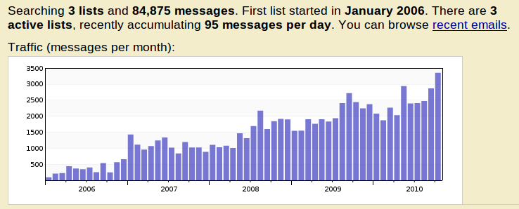
What Does That Mean?
Information Retrieval Application
Java5 WebApp (WAR) With A Web Services-ish API
Uses The Java Lucene Search Library
Healthy And Growing Lucene Sub-Project

Slide 6
Solr In A Nutshell
Index/Query Via HTTP
Comprehensive HTML Administration Interfaces
Scalability - Horizontal and Vertical
Extensible Plugin Architecture
Highly Configurable And User Extensible Caching
Flexible And Adaptable With XML Configuration
  Customizable Request Handlers And Response Writers
  Data Schema With Dynamic Fields And Unique Keys
  Analyzers Created At Runtime From Tokenizers And TokenFilters

Slide 7
Getting Started
-> 51

Slide 8
The Solr Tutorial
http://lucene.apache.org/solr/tutorial.html
OOTB Quick Tour Of Solr Basics Using Jetty
Comes With Example Config, Schema, And Data
Trivial To Follow Along...
cd example
java -jar start.jar
http://localhost:8983/solr/
cd example/exampledocs
java -jar post.jar *.xml

Slide 9
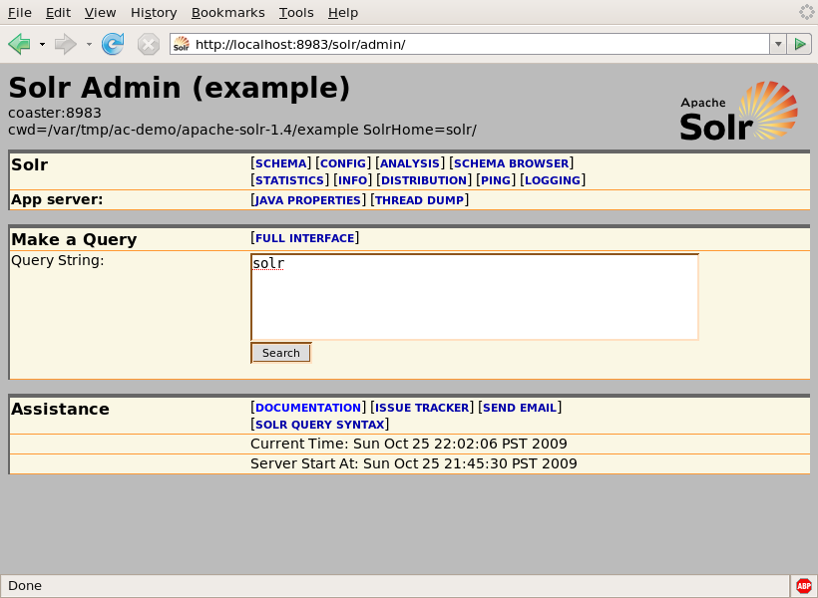
The Admin Console

Slide 10
Loading Data
Documents Can Be Added, Deleted, Or Replaced
Canonical Message Transport: HTTP POST
Canonical Message Format: XML...
<add><doc>
<field name="id">SOLR</field>
<field name="name">Apache Solr</field>
</doc></add>
<delete><id>SP2514N</id></delete>
<delete><query>name:DDR</query></delete>

Slide 11
Querying Data
HTTP GET or POST, params specifying query options...
http://solr/select?q=electronics
http://solr/select?q=electronics&sort=price+desc
http://solr/select?q=electronics&rows=50&start=50
http://solr/select?q=electronics&fl=name+price
http://solr/select?q=electronics&fq=inStock:true

Slide 12
Querying Data: Results
Canonical response format is XML...
<response>
<lst name="responseHeader">
<int name="status">0</int>
<int name="QTime">1</int>
</lst>
<result name="response" numFound="14" start="0">
<doc>
<arr name="cat">
<str>electronics</str>
<str>connector</str>
</arr>
<arr name="features">
<str>car power adapter, white</str>
</arr>
<str name="id">F8V7067-APL-KIT</str>
<bool name=”inStock”>true</bool>
...

Slide 13
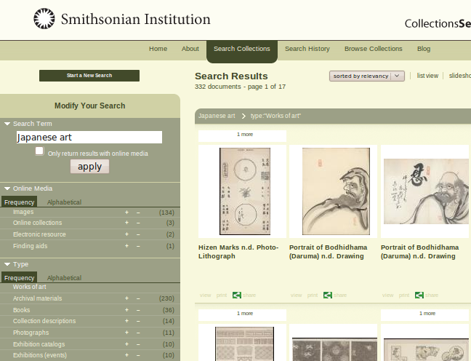
Querying Data: Facet Counts

Slide 14
Querying Data: Facet Counts
Constraint counts can be computed for the whole result set using field values or explicit queries....
&facet=true&facet.field=cat&facet.field=inStock
&facet.query=price:[0 TO 10]&facet.query=price:[10 TO *]
...
<lst name="facet_counts">
<lst name="facet_queries">
<int name="price:[0 TO 10]">0</int>
<int name="price:[10 TO *]">13</int>
</lst>
<lst name="facet_fields">
<lst name="inStock">
<int name="true">10</int>
<int name="false">4</int>
</lst>
...

Slide 15
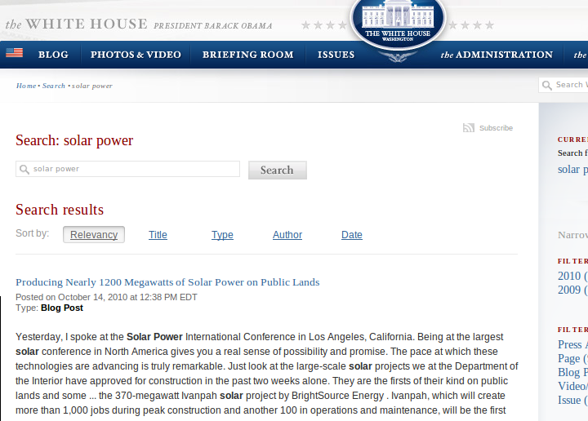
Querying Data: Highlighting

Slide 16
Querying Data: Highlighting
Generates summary "fragments" of stored fields showing matches....
&hl=true&hl.fl=features&hl.fragsize=30
...
<lst name="highlighting">
<lst name="F8V7067-APL-KIT">
<arr name="features">
<str>car power &lt;em&gt;adapter&lt;/em&gt;, white</str>
</arr>
</lst>
...

Slide 17
Digging Deeper schema.xml

Slide 18
Describing Your Data
schema.xml is where you configure the options for various fields.
Is it a number? A string? A date?
Is there a default value for documents that don't have one?
Is it created by combining the values of other fields?
Is it stored for retrieval?
Is it indexed? If so is it parsed? If so how?
Is it a unique identifier?

Slide 19
Fields
<field> Describes How You Deal With Specific Named Fields
<dynamicField> Describes How To Deal With Fields That Match A Glob
(Unless There Is A Specific <field> For Them)
<copyField> Describes How To Construct Fields From Other Fields
<field name="body" type="text" stored=”false” />
<dynamicField name="price*" type="float" indexed="true" />
<copyField source="*" dest="catchall" />

Slide 20
Field Types
Every Field Is Based On A <fieldType> Which Specifies:
  The Underlying Storage Class (FieldType)
  The Analyzer To Use For Parsing If It Is A Text Field
OOTB Solr Has 26 FieldType Classes
<fieldType name="float" class="solr.TrieFloatField"
sortMissingLast="true" omitNorms="true" />
<fieldtype name="string" class="solr.StrField"
indexed="true" stored="true" />
<fieldtype name="unstored" class="solr.StrField"
indexed="true" stored="false" />

Slide 21
Analyzers
'Analyzer' Is A Core Lucene Class For Parsing Text
Solr Includes 25 Lucene Analyzers That Can Be Used OOTB If They Meet Your Needs
<fieldType name="text_greek" class="solr.TextField">
<analyzer
class="org.apache.lucene.analysis.el.GreekAnalyzer"/>
</fieldType>
...BUT WAIT!

Slide 22
Configurable Analyzers
Solr Lets You Mix And Match CharFilters, Tokenizers and TokenFilters In Your schema.xml To Define Analyzers On The Fly
  CharFilter: Mutates And Manipulates The Stream of Characters
  Tokenizer: Splits the Characters into Tokens
  TokenFilter: Mutates And Manipulates The Stream Of Tokens
OOTB Solr Has Factories For 2 CharFilters, 14 Tokenizers and 50 TokenFilters
Many Factories Have Customization Options -- Limitless Combinations

Slide 23
Configurable Analyzers
<fieldType name="text" class="solr.TextField">
<analyzer type="index">
<charFilter class=”solr.HTMLStripCharFilterFactory”/>
<tokenizer class="solr.WhitespaceTokenizerFactory"/>
<filter class="solr.StopFilterFactory words="stop.txt"/>
<filter class="solr.WordDelimiterFilterFactory"
generateWordParts="1" generateNumberParts="1"/>
<filter class="solr.LowerCaseFilterFactory"/>
<filter class="solr.EnglishPorterFilterFactory"
protected="protwords.txt"/>
</analyzer>
<analyzer type="query">
<tokenizer class="solr.WhitespaceTokenizerFactory"/>
<filter class="solr.SynonymFilterFactory"
synonyms="synonyms.txt" expand="true"/>
...

Slide 24
Notable Analysis Factories
HTMLStripCharFilterFactory
MappingCharFilterFactory
StandardTokenizerFactory
WhitespaceTokenizerFactory
KeywordTokenizerFactory
NGramTokenizerFactory
PatternTokenizerFactory
EnglishPorterFilterFactory
SynonymFilterFactory
StopFilterFactory
PatternReplaceFilterFactory

Slide 25
Analysis Tool
HTML Form Allowing You To Feed In Text And See How It Would Be Analyzed For A Given Field (Or Field Type)
Displays Step By Step Information For Analyzers Configured Using Solr Factories...
  Char Stream Produced By The CharFilter
  Token Stream Produced By The Tokenizer
  How The Token Stream Is Modified By Each TokenFilter
  How The Tokens Produced When Indexing Compare With The Tokens Produced When Querying
Helpful In Deciding How to Configure Analyzer Factories For Each Field Based On Your Goals

Slide 26
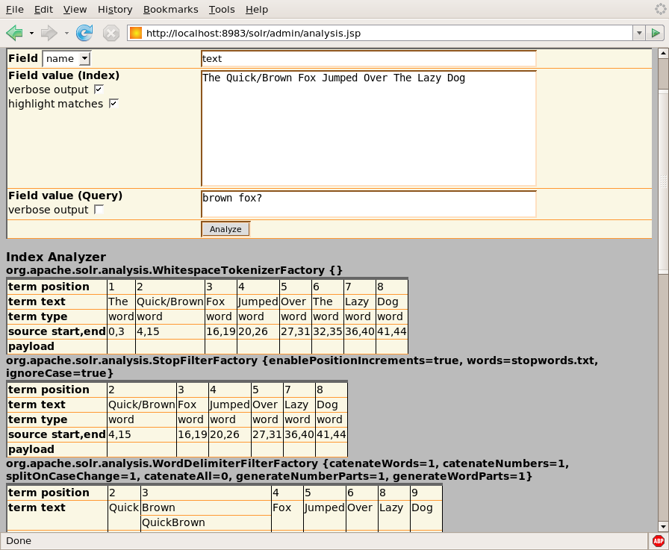
Analysis Tool: Output

Slide 27
Digging Deeper solrconfig.xml

Slide 28
Interacting With Your Data
solrconfig.xml is where you configure options for how this Solr instance should behave.
Low-Level Index Settings
Performance Settings (Cache Sizes, etc...)
Types of Updates Allowed
Types of Queries Allowed
Note:
solrconfig.xml depends on schema.xml.
schema.xml does not depend on solrconfig.xml.

Slide 29
Request Handlers
Type Of Request Handler Determines Options, Syntax, And Logic For Processing Requests
OOTB Indexing Handlers:
  XmlUpdateRequestHandler
  BinaryUpdateRequestHandler
  CSVRequestHandler
  DataImportHandler
  ExtractingRequestHandler
OOTB Searching Handler:
  SearchHandler + SearchComponents + QParsers

Slide 30
SearchHandler
SearchHandler Executes Query With Filtering, Pagination, Return Field List, Highlighting, Faceting, Etc...
Uses a QParser To Parse Query String
OOTB Solr Provides Two Main QParsers You Can Use Depending On Your Needs
&defType=lucene (Default)
&defType=dismax

Slide 31
LuceneQParserPlugin
Main Query String Expressed In The "Lucene Query Syntax"
Clients Can Search With Complex "Boolean-ish" Expressions Of Field Specific Queries, Phrase Queries, Range Queries, Wildcard And Prefix Queries, Etc...
Queries Must Parse Cleanly, Special Characters Must Be Escaped
?q=name:solr+%2B(cat:server+cat:search)+popular:[5+TO+*]
?q=name:solr^2+features:"search+server"~2
?q=features:scal*

Slide 32
LuceneQParserPlugin
q = name:solr +(cat:server cat:search) popular:[5 TO *]
q = name:solr^2 features:"search server"~3
q = features:scal*
Good for situations where you want to give smart users who understand both the syntax and the fields of your index the ability to search for very specific things.

Slide 33
DisMaxQParserPlugin
Main Query String Expressed As A Simple Collection Of Words, With Optional "Boolean-ish" Modifiers
Other Params Control Which Fields Are Searched, How Significant Each Field Is, How Many Words Must Match, And Allow For Additional Options To Artificially Influence The Score
Does Not Support Complex Expressions In The Main Query String
?q=%2Bsolr+search+server&qf=features+name^2&bq=popular:[5+TO+*]

Slide 34
DisMaxQParserPlugin
q = +solr search server
& qf = features name^2
& bq = popular:[5 TO *]
Good for situations when you want to pass raw input strings from novice users directly to Solr.

Slide 35
QParser For Other Params?
By Default Other Query Params Use LuceneQParser
“LocalParams” Prefix Notation Exists To Override This, And Customize Behavior
Even Supports Parameter Dereferencing
&bq={!dismax qf=desc^2,review}cheap
&fq={!lucene df=keywords}lucene solr java
&fq={!raw f=$ff v=$vv}&ff=keywords&vv=solr

Slide 36
Request Handler Configuration
Multiple Instances Of Various RequestHandlers, Each With Different Configuration Options, Can Be Specified In Your solrconfig.xml
Any Params That Can Be Specified In A URL, Can Be "Baked" Into Your solrconfig.xml For A Particular RequestHandler Instance
Options Can Be:
  "defaults" Unless Overridden By Query Params
  "appended" To (Multi-Valued) Query Params
  "invariants" That Suppress Query Params
http://solr/select?q=ipod
http://solr/simple?q=ipod
http://solr/complex?q=ipod

Slide 37
Example: Handler Configuration
<requestHandler name="/select” class="solr.SearchHandler" />
<requestHandler name="/simple" class="solr.SearchHandler" >
<lst name="defaults">
<str name="defType">dismax</str>
<str name="qf">catchall</str> </lst>
</requestHandler>
<requestHandler name="/complex" class="solr.SearchHandler" >
<lst name="defaults">
<str name="defType">dismax</str>
<str name="qf">features^1 name^2</str> </lst>
<lst name="appends">
<str name="fq">inStock:true</str>
</lst>
<lst name="invariants">
<bool name="facet">false</bool>
...

Slide 38
Output: Response Writers
Response Format Can Be Controlled Independently From Request Handler Logic
Many Useful Response Writers OOTB
http://solr/select?q=electronics
http://solr/select?q=electronics&wt=xml
http://solr/select?q=electronics&wt=json
http://solr/select?q=electronics&wt=python
http://solr/select?q=electronics&wt=ruby
http://solr/select?q=electronics&wt=php
http://solr/select?q=electronics&wt=xslt&tr=example.xsl
<queryResponseWriter name="xml" default=”true”
class="solr.XMLResponseWriter"/>

Slide 39
Use Case
Starting From Scratch
-> 51

Slide 40
Installing Solr
Put The solr.war Where Your Favorite Servlet Container Can Find It
Create A "Solr Home" Directory
Steal The Example solr/conf Files
Point At Your Solr Home Using Either:
  JNDI
  System Properties
  The Current Working Directory
(Or just use the Jetty example setup.)

Slide 41
Example: Tomcat w/JNDI
<Context docBase="f:/solr.war"
debug="0"
crossContext="true" >
<Environment name="solr/home"
value="f:/my/solr/home"
type="java.lang.String"
override="true" />
</Context>

Slide 42
Minimalist Schema
<schema name="minimal" version="1.1">
<types>
<fieldType name="string" class="solr.StrField"/>
</types>
<fields>
<dynamicField name="*" type="string"
indexed="true" stored="true" />
</fields>
<!-- A good idea, but not strictly neccessary
<uniqueKey>id</uniqueKey>
<defaultSearchField>catchall</defaultSearchField>
-->
</schema>

Slide 43
Feeding Data From The Wild
I Went Online And Found A CSV File Containing Data On Books
Deleted Some Non UTF-8 Characters
Made Life Easier For Myself By Renaming The Columns So They Didn't Have Spaces
curl 'http://solr/update/csv?commit=true'
-H 'Content-type:text/plain; charset=utf-8'
--data-binary @books.csv

Slide 44
Understanding The Data: Luke
The LukeRequestHandler Is Based On A Popular Lucene GUI App For Debugging Indexes (Luke)
Allows Introspection Of Field Information:
  Options From The Schema (Either Explicit Or Inherited From Field Type)
  Statistics On Unique Terms And Terms With High Doc Frequency
  Histogram Of Terms With Doc Frequency Above Set Thresholds
Helpful In Understanding The Nature Of Your Data
Schema Browser: Luke On Steroids

Slide 45
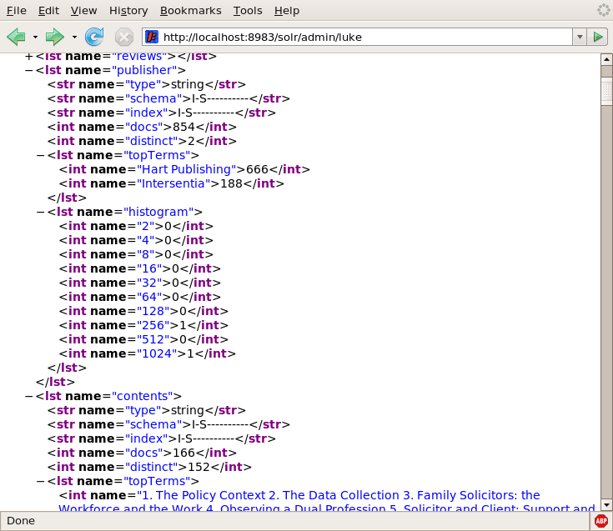
Example: Luke Output

Slide 46
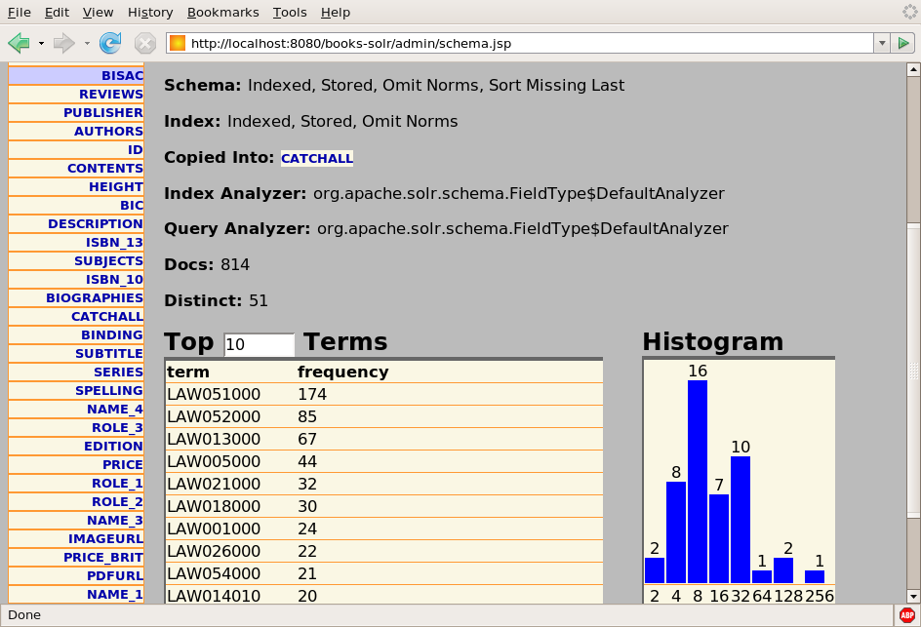
Example: Schema Browser

Slide 47
Refining Your Schema
Pick Field Types That Make Sense
Pick Analyzers That Make Sense
Use <copyField> To Make Multiple Copies Of Fields For Different Purposes:
  Faceting
  Sorting
  Loose Matching
  Etc...

Slide 48
Example: "BIC" Codes
<!-- used by the bic field, a prefix based code -->
<fieldType name="bicgram" class="solr.TextField" >
<analyzer type="index">
<tokenizer class="solr.EdgeNGramTokenizerFactory"
minGramSize="1"
maxGramSize="100"
side="front" />
<filter class="solr.LowerCaseFilterFactory"/>
</analyzer>
<analyzer type="query">
<tokenizer
class="solr.WhitespaceTokenizerFactory" />
<filter class="solr.LowerCaseFilterFactory"/>
</analyzer>
</fieldType>

Slide 49
But Wait!
There's More!

Slide 50
Indexing Message Transports
Request Handlers Deal Abstractly With "Content Streams"
Several Ways To Feed Data To Solr As A Content Stream...
  Raw HTTP POST Body
  HTTP Multipart "File Uploads"
  Read From Local File
  Read From Remote URL
  URL Param String

Slide 51
ExtractingRequestHandler
Aka: “Solr Cell”
Uses Tika to Parse Binary & Rich Content Documents
  HTML
  PDF
  MS-Word
  MP3
Maps Tika Output Fields To Solr Schema Fields
Supports XPath Filtering Of The Generated DOM

Slide 52
DataImportHandler
Builds and incrementally updates indexes based on configured SQL or XPath queries.
<entity name="item" pk="ID" query="select * from ITEM"
deltaQuery="select ID ... where
ITEMDATE > '${dataimporter.last_index_time}'">
<field column="NAME" name="name" />
...
<entity name="f" pk="ITEMID"
query="select DESC from FEATURE where ITEMID='${item.ID}'"
deltaQuery="select ITEMID from FEATURE where
UPDATEDATE > '${dataimporter.last_index_time}'"
parentDeltaQuery="
select ID from ITEM where ID=${f.ITEMID}">
<field name="features" column="DESC" />
...

Slide 53
Search Components
Default Components That Power SearchHandler
  QueryComponent
  HighlightComponent
  FacetComponent
  MoreLikeThisComponent
  StatsComponent
  DebugComponent
Additional Components You Can Configure
  SpellCheckComponent
  QueryElevationComponent
  TermsComponent
  TermVectorComponent
  ClusteringComponent

Slide 54
Score Explanations
Why Did Document X Score Higher Then Y?
Why Didn't Document Z Match At All?
Debugging Options Can Answer Both Questions...
  idf - How Common A Term Is In The Whole Index
  tf - How Common A Term Is In This Document
  fieldNorm - How Significant Is This Field In This Document (Usually Based On Length)
  boost - How Important The Client Said This Clause Is
  coordFactor - How Many Clauses Matched
&debugQuery=true&explainOther=documentId:Z

Slide 55
Example: Score Explanations
<str name="id=9781841135779,internal_docid=111">
0.30328625 = (MATCH) fieldWeight(catchall:law in 111),
product of:
3.8729835 = tf(termFreq(catchall:law)=15)
1.0023446 = idf(docFreq=851)
0.078125 = fieldNorm(field=catchall, doc=111)
</str>
...
<str name="id=9781841135335,internal_docid=696">
0.26578674 = (MATCH) fieldWeight(catchall:law in 696),
product of:
4.2426405 = tf(termFreq(catchall:law)=18)
1.0023446 = idf(docFreq=851)
0.0625 = fieldNorm(field=catchall, doc=696)
</str>
...

Slide 56
Multiple Indexes
Using a solr.xml file, you can configure Solr to manage several different indexes.
<solr persistent="true" sharedLib="lib">
<cores adminPath="/core-admin/">
<core name="books" instanceDir="books" />
<core name="games" instanceDir="games" />
...
The CoreAdminHandler let's you create, reload and swap indexes on the fly.
/core-admin?action=RELOAD&core=books
/core-admin?action=CREATE&name=books2&instanceDir=books2
/core-admin?action=SWAP&core=books&other=books2

Slide 57
Replication
Use ReplicationHandler to efficiently mirror an index on multiple machines (ie: Scale Horizontally)
<requestHandler name="/replication"
class="solr.ReplicationHandler">
<lst name="master">
<str name="replicateAfter">commit</str>
</lst>
</requestHandler>
...
<requestHandler name="/replication"
class="solr.ReplicationHandler">
<lst name="slave">
<str name="masterUrl">
http://master:8080/solr/replication
</str>
<str name="pollInterval">00:00:60</str>
...

Slide 58
Distributed Searching
SearchHandler Options For Aggregating Results From Multiple Solr “Shards”
Handy When “Index” Is Too Big For One Machine (ie: Scale Vertically)
Most Core Features Supported:
  Basic Queries
  Highlighting
  Faceting
?shards=host1:8983/solr,host2:7574/solr&q=ipod

Slide 59
Questions? http://lucene.apache.org/solr/

