Slide 1
Intro

Slide 2
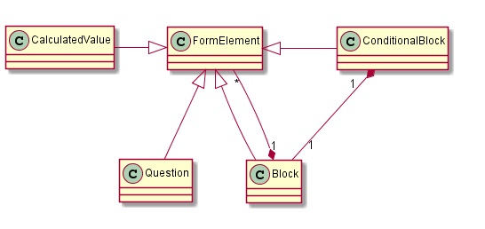
Metamodel
Notes:
FormElement <|-- Block
FormElement <|-- Question
CalculatedValue -|> FormElement
ConditionalBlock -|> FormElement
ConditionalBlock "1" *-- "1" Block
Block "1" *-- "*" FormElement

Slide 3
Application (Demo)
Click-through
Dependencies
Save/Load/New

Slide 4
Editor
Type checking
Multiline help text
Refactor (varname change)

Slide 5
Generator
Generated code (readable)
Main generator
Template checking during generator writing
Switches
Runtime/Generation-time

Slide 6
Conclusion
+Reuse of baseLanguage (java) (expressions and extension of expressions – question is subclass of java expression)
+Generation time/run time options (dependencies, QL runtime (kind of library), QLS generates QL runtime)
+Language composition and reuse (typechecking over 2 generation phases – you get type checking over transient models – errors are given as soon as possible)
+Graphical diff tool on logical (model) level (very helpful for the merges)
-Learning curve (one tutorial, one course is not enough – you need serious guidance)

