Slide 1
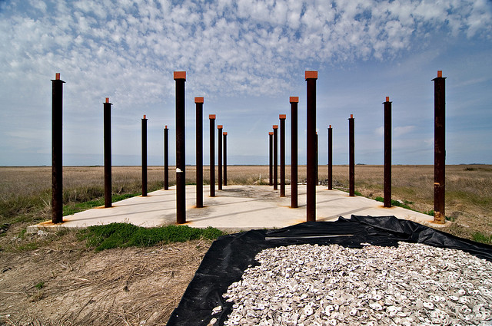
Control Flow, Iterators, and Exceptions
C++ Foundation
flickr/Paul Goyette

Slide 2
Control Flow, Iterators, and Exceptions
throwing exceptions
catching exceptions
exceptions and object lifetime
the RAII idiom
predefined exception classes
iterators
iterator pairs to express a range
iterator based algorithm examples

Slide 3
Puzzle
Consider a function to find the average of a vector of doubles
What should this function return if the vector is empty?
double average(const std::vector<double> & data);
void puzzle()
{
std::vector<double> empty;
assert(average(empty) == ???);
}

Slide 4
Introducing throw
Stops normal “forward” execution
The program starts to unwind backwards!
not a return
not tied to double
double average(const std::vector<double> & data)
{
if (data.empty())
throw expression;
...
}
return double;

Slide 5
Introducing try and catch
This test passes if average throws any kind of exception
void check_average_of_empty_vector()
{
std::vector<double> empty;
bool caught = false;
try
{
average(empty);
}
catch (...)
{
caught = true;
}
assert(caught);
}
test fails if no exception is thrown
catch-all
the ... is part of the syntax and not ellision!

Slide 6
Refined test
void check_average_of_empty_vector()
{
std::vector<double> empty;
bool caught = false;
try
{
average(empty);
}
catch (std::invalid_argument &)
{
caught = true;
}
catch (...)
{
}
assert(caught);
}
test fails if no exception is thrown
test passes if invalid_argument is thrown
test fails if different exception is thrown

Slide 7
Standard Exception Classes
Live in <stdexcept>
namespace std
{
exception;
bad_cast;
bad_typeid;
bad_alloc;
bad_exception;
logic_error;
domain_error;
invalid_argument;
length_error;
out_of_range;
runtime_error;
range_error;
overflow_error;
underflow_error;
...
}
thrown by dynamic_cast
thrown by typeid
thrown by new
errors in the internal logical of the program
errors that can only be determined at runtime

Slide 8
The exception Base Class
Lives in <exception>
namespace std
{
class exception
{
public:
exception();
virtual ~exception();
exception(const exception &);
exception & operator=(const exception &);
virtual const char * what() const;
private:
...
};
}

Slide 9
Refined test
This test passes only if a specific exception is thrown with a specific diagnostic string
void check_average_of_empty_vector()
{
std::vector<double> empty;
try
{
average(empty);
assert(false);
}
catch (std::invalid_argument & error)
{
assert(error.what() == std::string(“empty”));
}
catch (...)
{
assert(false);
}
}

Slide 10
Average
Modified to make the test pass
#include <stdexcept>
double average(const std::vector<double> & data)
{
if (data.empty())
throw std::invalid_argument(“empty”);
double sum = 0.0;
for (size_t at = 0; at != data.size(); at++)
sum += data[at];
return sum / data.size();
}

Slide 11
Object Lifetime
A fully constructed object will have
  it's destructor called automatically when it goes out of scope -
  regardless of how it goes out of scope
void f()
{
wibble w;
}
w.~wibble()
void f()
{
wibble w;
throw ...;
}
w.~wibble()

Slide 12
Resource Acquisition is Initialization
Acquire a resource in a constructor so you can automatically release it in the destructor
RAII
class auto_file
{
public:
auto_file(const std::string & name)
: file(std::fopen(name))
{
}
~auto_file()
{
std::fclose(file);
}
...
private:
FILE * file;
};
file.~auto_file()
void eg(const std::string & name)
{
auto_file file(name);
...exception?...
}
file.~auto_file()

Slide 13

Common Mistakes/Misunderstanding
throwing new'd objects (drop the new)
throw new std::invalid_argument(“...”);
catch (std::exception error)
{
// ...
}
catching by copy (catch by reference)
catch (std::exception & error)
{
}
catching an exception and
doing nothing?
catch (...)
{
}

Slide 14
Iteration
Two models for iteration...
int array[42];
for (int at = 0; at != 42; ++at)
{
eg(array[at]);
}
random
access
int array[42];
for (int * pos = &array[0];
pos != &array[42];
++pos)
{
eg(*pos);
}
sequential
access

Slide 15
Iteration
C++ iterators follow the sequential model
typedef std::list<int> container;
container values;
for (container::iterator pos = values.begin();
pos != values.end();
++pos)
{
eg(*pos);
...
}
template<typename T>
class list<T>
{ ...
class iterator
{ ...
operator*()
operator++()
};
bool operator==(iterator, iterator);
bool operator!=(iterator, iterator);
}

Slide 16
begin() and end()
Container classes offer begin() and end() member functions
end() returns an iterator “one-beyond-the-end”
template<typename Type>
class list
{ ...
class iterator { ... };
class const_iterator { ... };
iterator begin();
iterator end();
const_iterator begin() const;
const_iterator end() const;
...
};
begin and end are
overloaded on const

Slide 17
Iterator Pair == Range
Using a pair of iterators to express a range is a dominant C++ idiom
The standard library offers many algorithms based on iterator pairs
template<typename Iterator, typename Value>
Value accumulate(Iterator at, Iterator end,
Value sum)
{
while (at != end)
{
sum += *at;
++at;
}
return sum;
}
#include <numeric>

Slide 18
Refactor
average() implemented using accumulate
#include <numeric>
double average(const std::vector<double> & data)
{
if (data.empty())
throw std::invalid_argument(“empty”);
return std::accumulate(
data.begin(), data.end(), 0.0)
/ data.size();
}

Slide 19
std::sort
template<typename Iterator>
void sort(Iterator begin, Iterator end);
#include <algorithm>
void example(std::list<int> & values)
{
...
std::sort(values.begin(), values.end());
...
}

Slide 20
std::for_each
template<typename Iterator, typename Function>
Function for_each(Iterator begin, Iterator end,
Function f);
#include <algorithm>
void print(int value)
{
std::cout << value << ',';
}
void example(const std::list<int> & values)
{
std::for_each(values.begin(),
values.end(),
print);
}

