Slide 1

Object Oriented Programming
C++ Foundation
flickr/Paul Goyette

Slide 2
Object Oriented Programming
encapsulation
information hiding
liskov substitution principle
parameterize from above
single repsonsibility principle
separation of concerns
dependency
abstraction
patterns

Slide 3
En(capsule)ation
ata and functions can be bundled together
An access restriction mechanism
struct file
{ ...
};
int getc(file*);
int ungetc(int, file*);
class file
{ ...
int getc();
int ungetc(int);
};
class file
{
public:
int getc();
int ungetc(int);
private:
...
};

Slide 4
Information Hiding in C++
We hide information partly so we can change what's hidden and limit the change's impact
  public - private
    change requires recompilation
  header file - source file
    change of implementation requires relinking
  opaque types
    change of representation requires relinking
  inheritance hierarchies
    change of type does not require relinking!

Slide 5
Liskov Subtitution Principle
If for each object o1 of type S there is an
object o2 of type T such that for all programs
P defined in terms of T, the behaviour of P is
unchanged when o1 is substituted for o2,
then S is a subtype of T.
Barbara Liskov
P1
T
b()
P2
S1
b()
S2
b()
S3
b()

Slide 6
Liskov Subtitution Principle
For example...
use
ostream
operator<<
WHAT I WANT
HOW IT
GETS DONE
ostringstream
ofstream
string
FILE

Slide 7
Hard-wired From Below :-(
Complicates testing, increases dependencies
struct date
{ ...
void print() const
{
std::cout << ...;
}
};
Non-parameterized
Fixed below / inside
void example(date when)
{
when.print();
}
Not-parameterized
from above / outside

Slide 8
Parameterize From Above :-)
Aim to make parameterization an explicit and visible part of the public api of a class/method
void example(date when)
{
when.print(std::cout);
}
Parameterized
from above / outside
struct date
{ ...
void print(std::ostream & os) const
{
os << ...;
}
};

Slide 9
Single Responsibility Principle
A class should be responsible for one thing and one thing only
struct date
{ ...
void print(std::ostream & os) const
{
os << ...;
}
};
2011/12/25
?
struct date
{ ...
int year() const;
int month() const;
int day() cont;
};

Slide 10
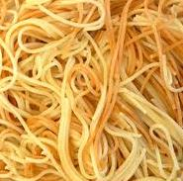

Separation of Concerns
Codebases tend to have a lot of effort focused on their functionalilty and not so much effort focused on their structure :-(
Separate but dependent :-)

Slide 11
Dependency
A
D
Claimed

Slide 12
Dependency
A
D
Actual

Slide 13
Dependency
A
D

Slide 14
Dependency
A
D
Claimed

Slide 15
Dependency
A
D
Actual

Slide 16
Dependency
A
D

Slide 17
Dependency
A
D

Slide 18

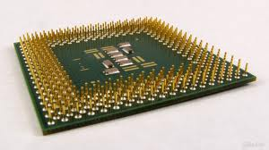
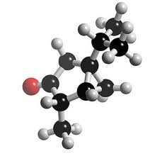
Abstraction
We also hide information when creating
crisp new semantic levels
Edsger Dijkstra
Being abstract is something profoundly
different from being vague... The purpose
of an abstraction is not to be vague, but
to create a new semantic level in which
one can be absolutely precise.

Slide 19
Abstraction
How different are the semantic levels?
use
implementation
abstraction
Some abstractions are weak and abstract away very little
implementation
use
use
abstraction
Some abstractions are strong and abstract away a lot more
implementation

Slide 20
Abstraction?
How much focus is on the implementation?
use
implementation
abstraction
implementation
implementation
implementation

Slide 21
Abstraction
How much focus is on the structure?
use
use
abstraction
implementation
implementation
implementation

Slide 22
Patterns
A class is not a useful unit of design!
Patterns help you raise the level of abstraction
Patterns document the role each class plays in a cluster of collaboration
There are many named patterns
Proxy
Composite
Decorator
Observer
Adapter
Bridge
Iterator
Null Object

Slide 23
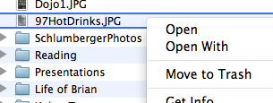
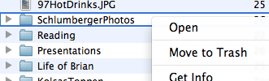
Deleting Files & Folders on a Mac
Right click on the file or folder
Click Move To Trash
file
move_to_trash()
folder
move_to_trash()

Slide 24
Files and Folders
user
???
move_to_trash()
file
move_to_trash()
folder
move_to_trash()
*
*

Slide 25
Files and Folders and Folder Entries
*
entries
user
folder_entry
move_to_trash()
file
move_to_trash()
folder
move_to_trash()

Slide 26
The Composite Pattern
client
component
leaf
composite
Composite: Applicability
You want to represent part-whole hierarchies
of objects.
You want clients to be able to ignore the
differences between compositions of objects
and individual objects. Clients will treat
all objects in the composite structure
uniformly.

Slide 27
Files and Folders
*
entries
user
folder_entry
move_to_trash()
component
file
move_to_trash()
folder
move_to_trash()
leaf
composite
Composite

Slide 28
Patterns
user
folder_entry
move_to_trash()
component
file
move_to_trash()
folder
move_to_trash()
leaf
composite
Composite

