Slide 1
Microcontrollers -Final project: Room thermostat-
Student: Bogdan Meseșan
Coordinating teacher: Andreea Ignat

Slide 2
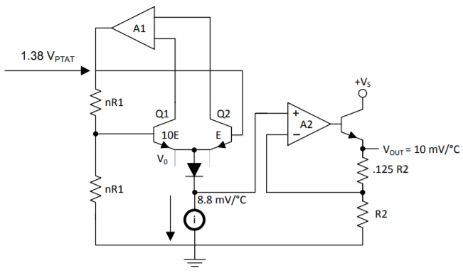
Temperature sensor-LM35

Slide 3
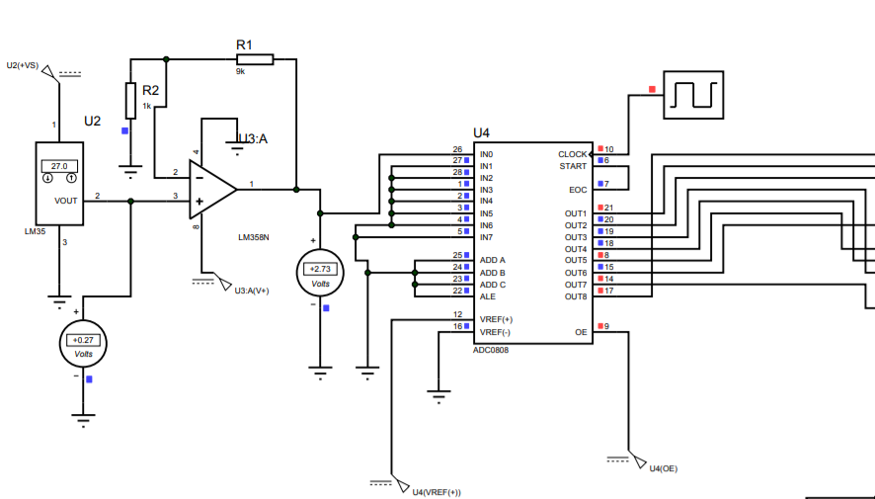
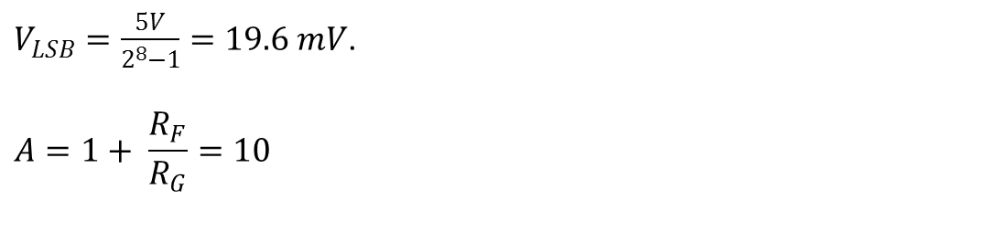
The ADC stage
$V_{LSB}=\frac{5V}{2^{8}−1}=19.6 mV$.
$$A=1+ \frac{R_{F}}{R_{G}}=10$$

Slide 4
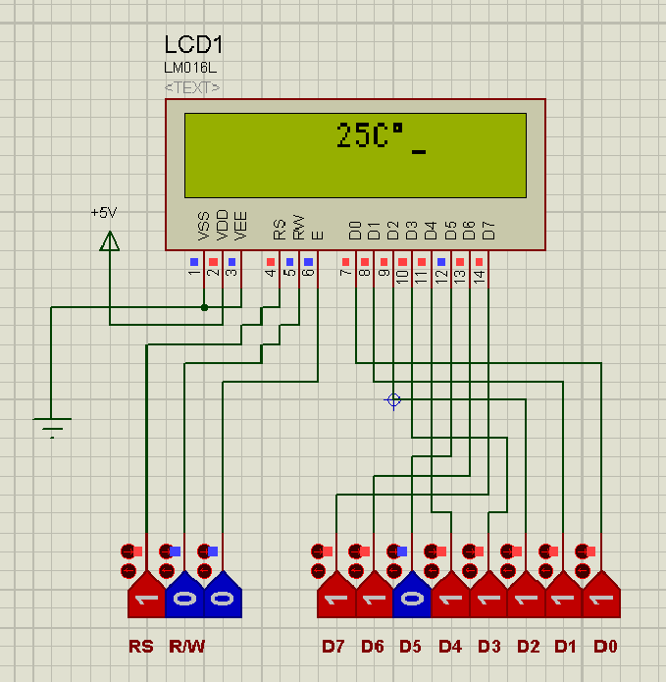
LCD configuration
The sequence I use to initialize the Display:
-instruction1: function set
-instruction2: display off
-instruction3: display on
-instruction4: display on/off control
RS | R/W | D7 | D6 | D5 | D4 | D3 | D2 | D1 | D0
0 | 0 | 0 | 0 | 1 | 1 | 1 | 0 | 0 | 0
0 | 0 | 0 | 0 | 0 | 0 | 1 | 0 | 0 | 0
0 | 0 | 0 | 0 | 0 | 0 | 0 | 0 | 0 | 1
0 | 0 | 0 | 0 | 0 | 0 | 1 | 1 | 1 | 1

Slide 5
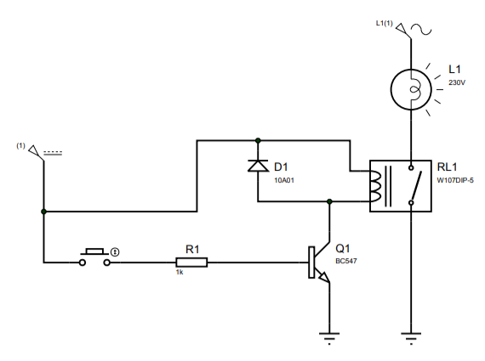
The relay stage

Slide 6
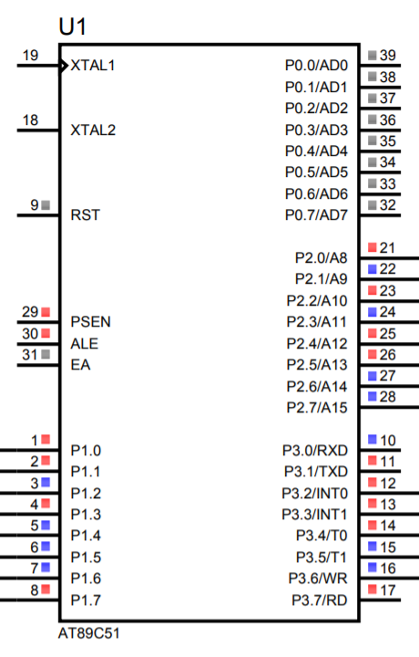
The microcontroller-AT89C51
Utility of the Ports and Pins:
-Port 1: Input port, connected to the output of the ADC, tasked with receiving temperature information in digital form.
-Port 2: Output port, connected to the Data lines of the LCD, tasked with sending instructions to the Display
-Port 3: Output port:
P3.0-Relay control;
P3.2 – “Button+” external interrupt 0;
P3.3 - “Button-” external interrupt 1;
P3.4 – LCD RS;
P3.5 – LCD R/W;
P3.6 – LCD Enable;

Slide 7
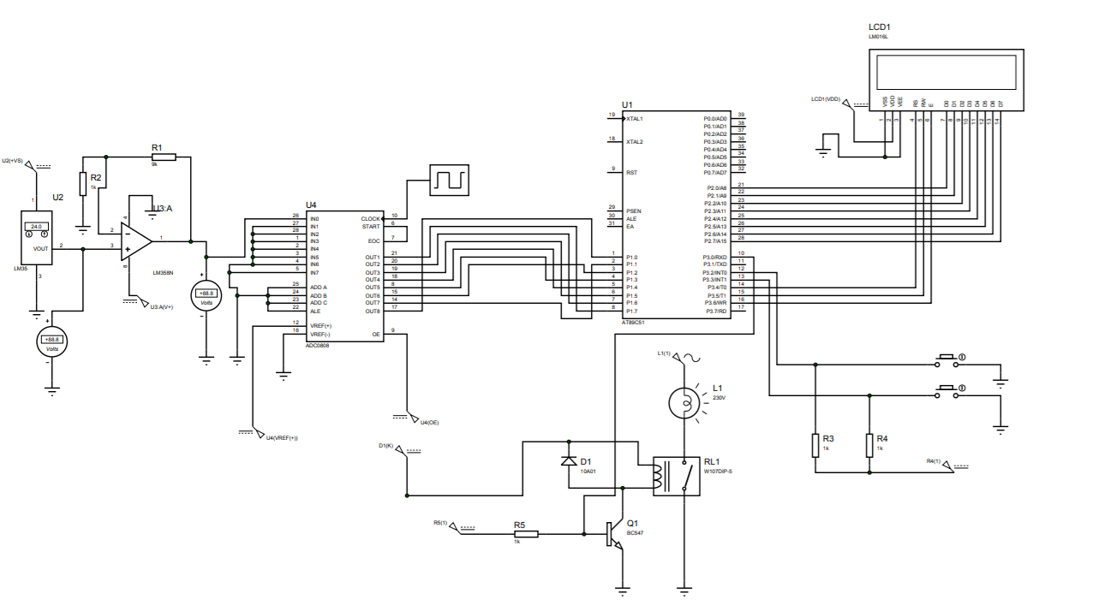
The final circuit

Slide 8
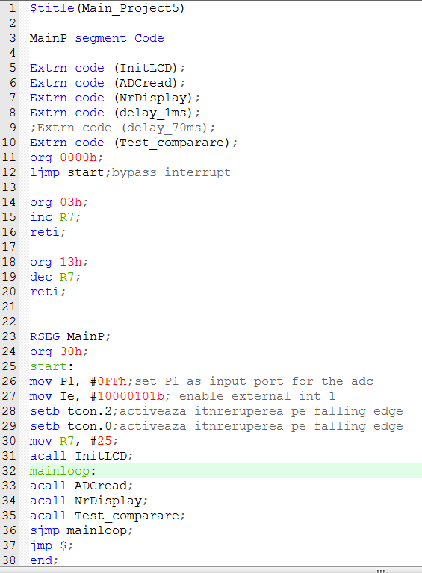
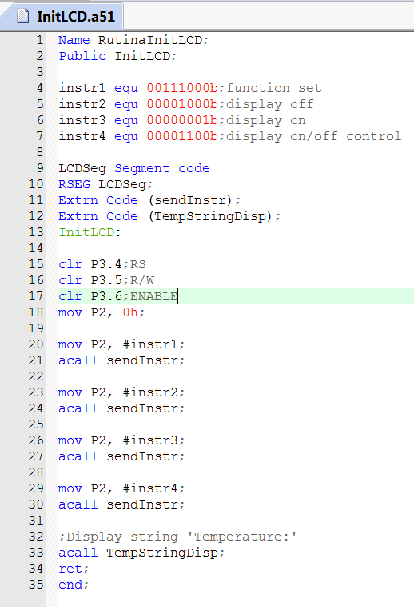
Program in ASM

Slide 9
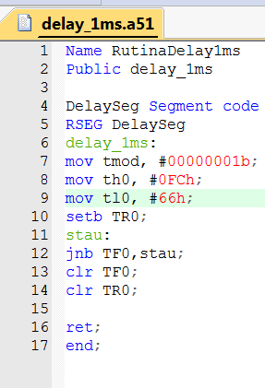
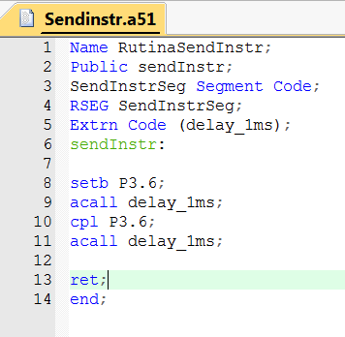

Slide 10
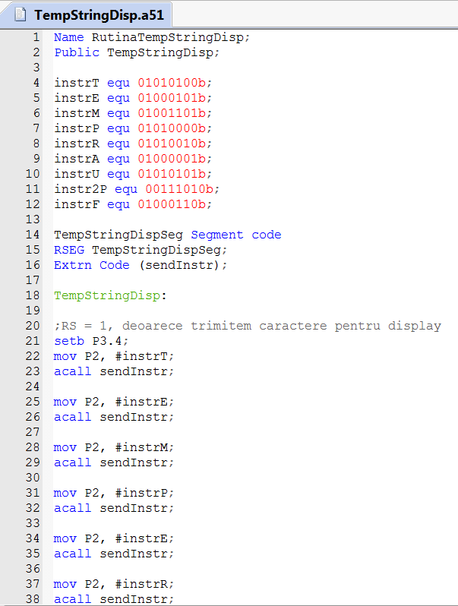
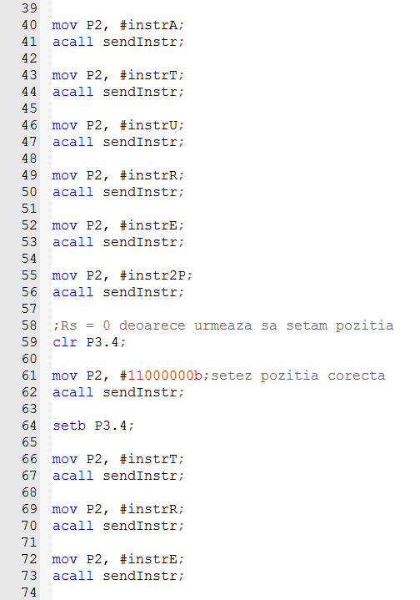
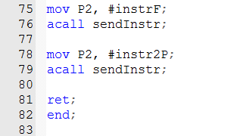

Slide 11
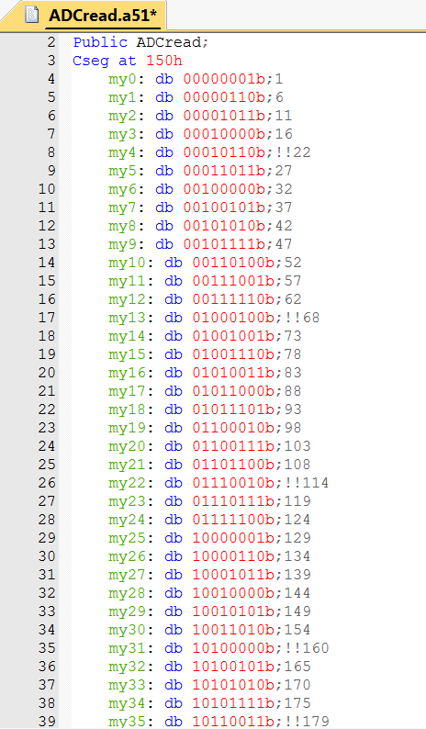
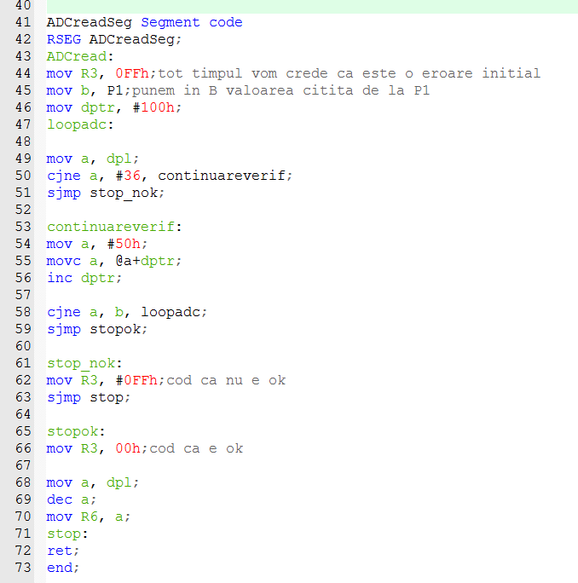

Slide 12
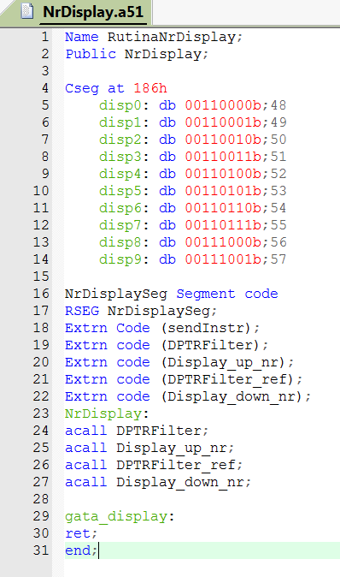
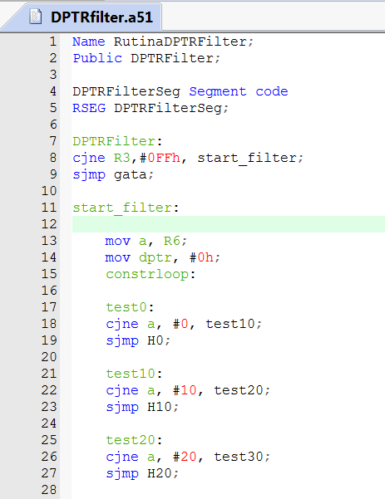
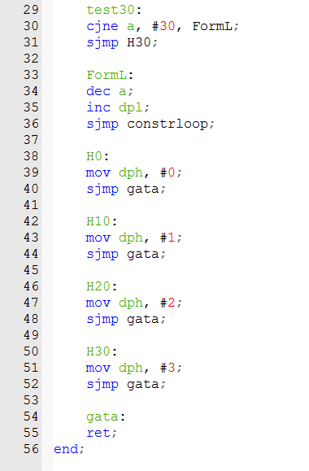

Slide 13
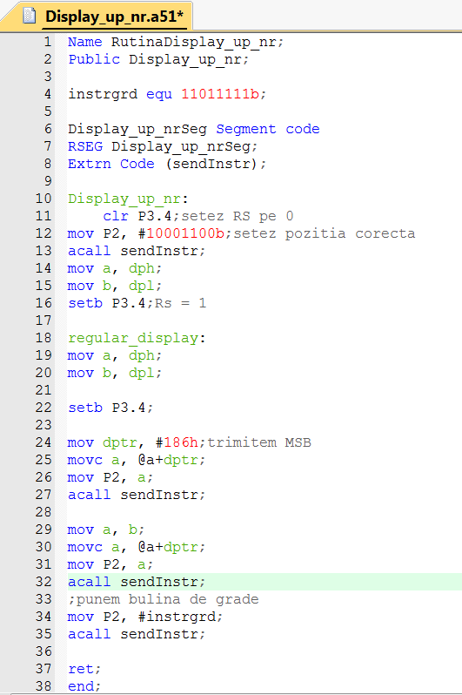
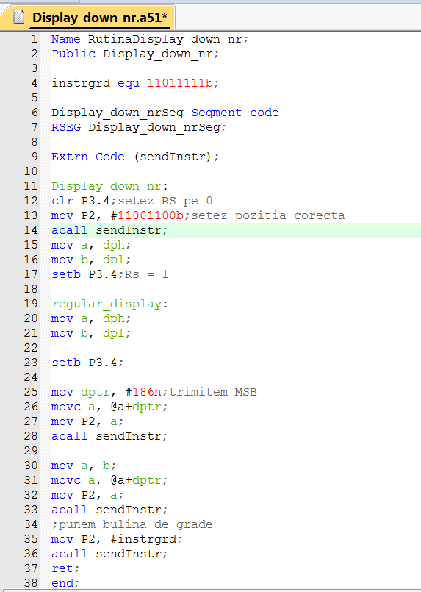

Slide 14
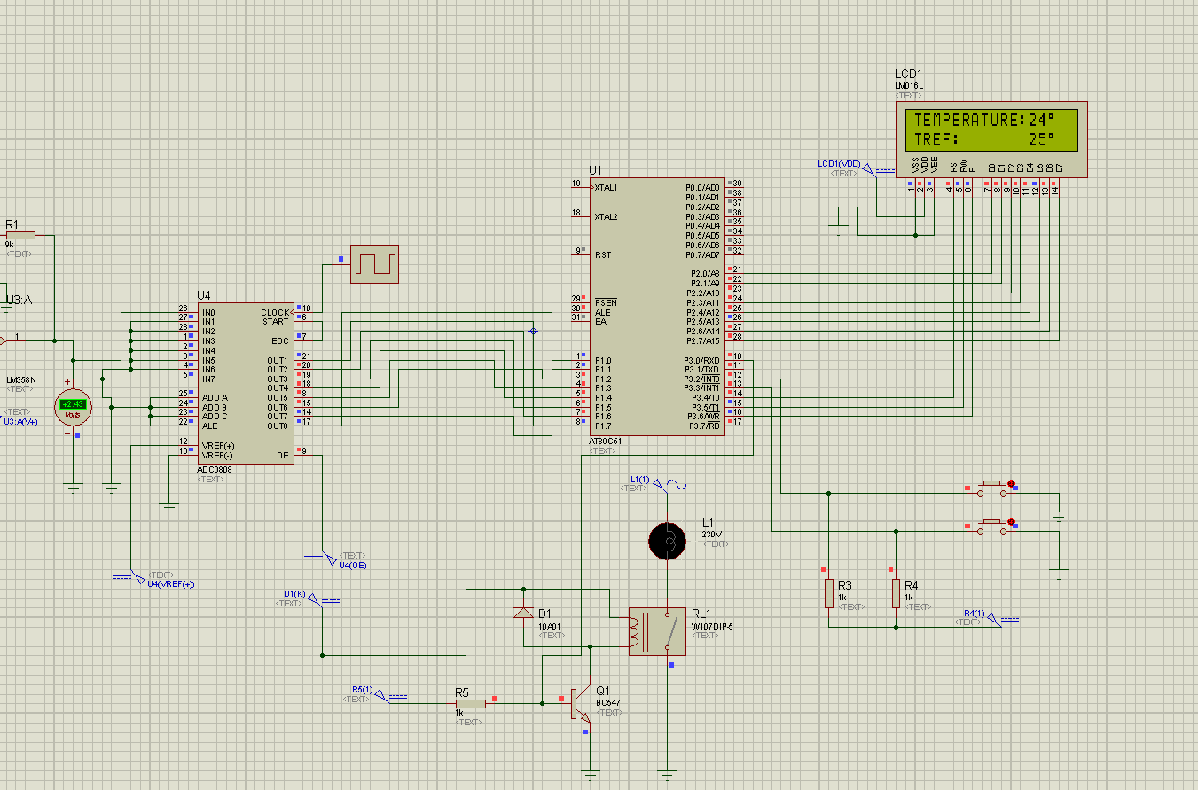

Slide 15
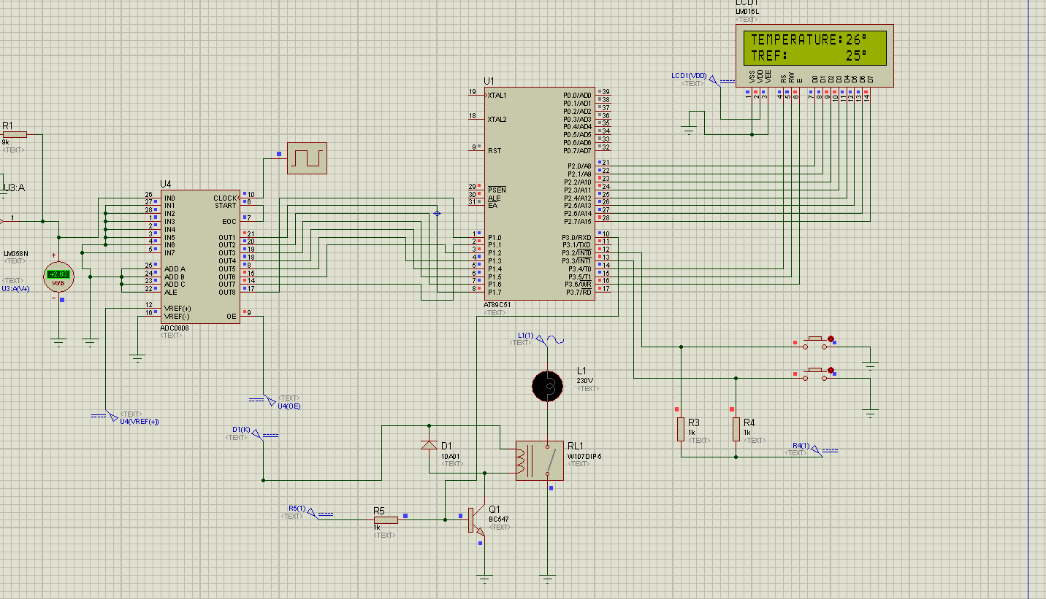

Slide 16
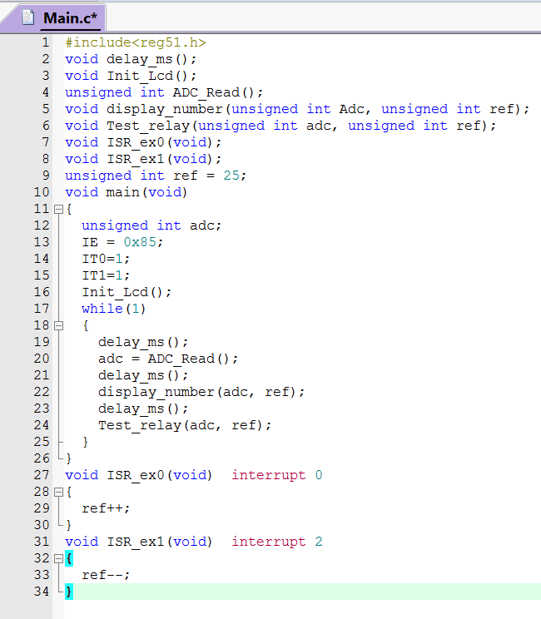
The program in C

Slide 17
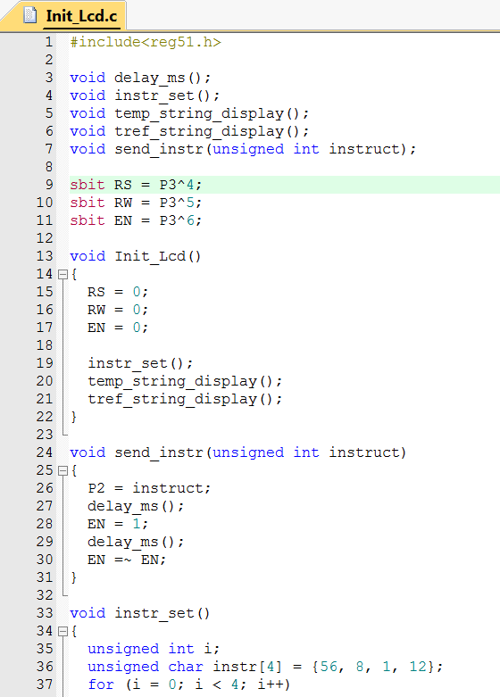
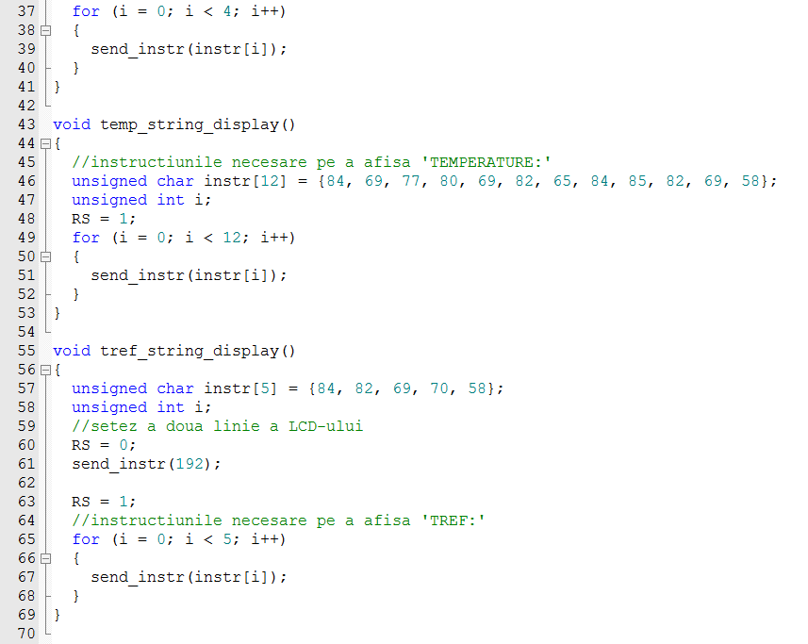

Slide 18
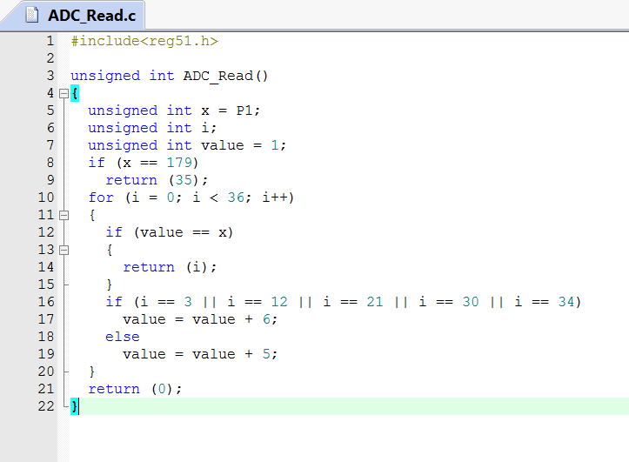
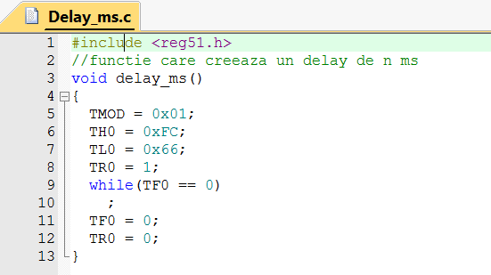
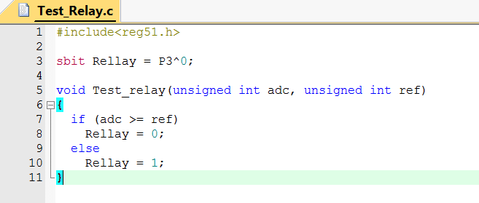

Slide 19
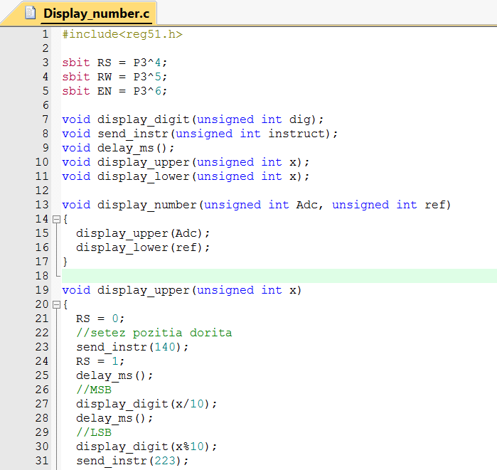
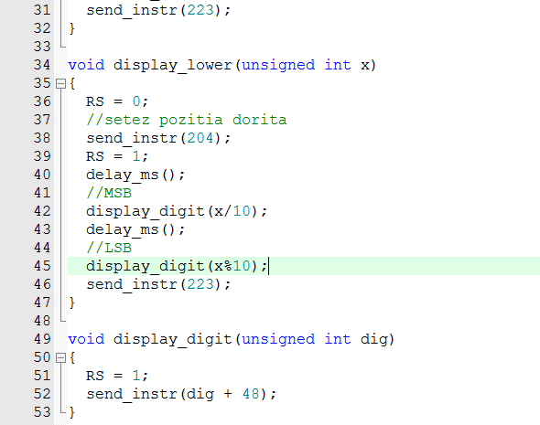

Slide 20
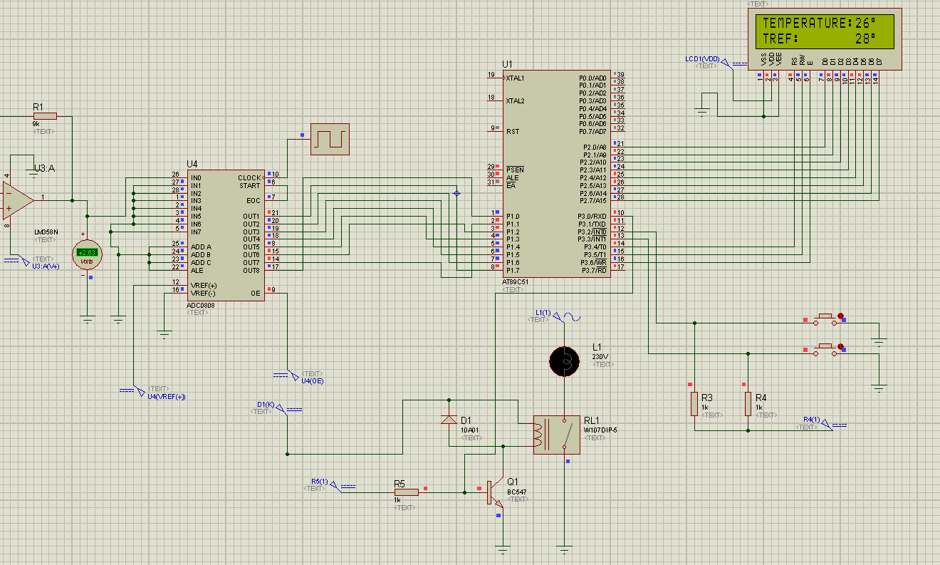

Slide 21
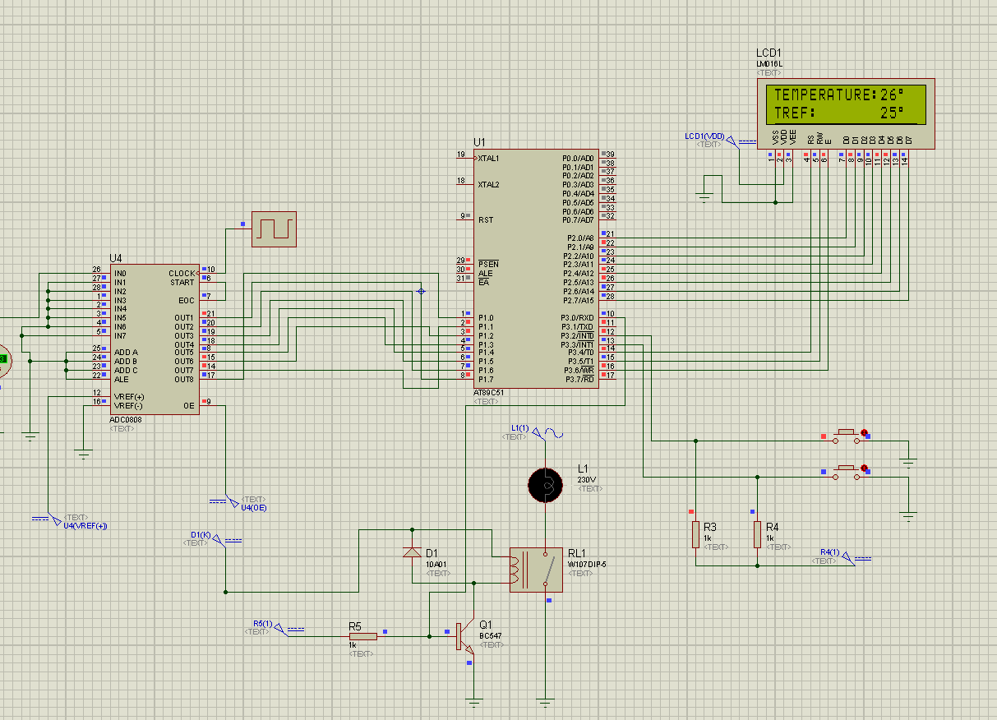

Slide 22
Questions?

