Slide 1
R Shiny Tips and Tricks: An App Store Project Demo
Author: Bohdan Metenko
Thursday, August 15th, 2019 < > 6:00pm
PhillyR Meetup
Hosted by Slalom Consulting,
100 N 18th St #2000, Philadelphia, PA

Slide 2
Talk Outline
Intro to Shiny
App Overview
CSS styling and options.
Maintaining a color theme.
Hover and gradients.
Mobile considerations and splitting up plots.
Showing and hiding plots.
Taglists to plot multiple UI elements.
Smaller Tips
Plot caching.
Pivot table and scrollability.
Highlighting information using KPI boxes.
[[ShinyWidgets]]
Travis CI and requirements. (Continuous Deployment and Integration.)

Slide 3
Introduction to Shiny [Logo?]
Shiny is a R package that helps build web-based applet like functionality without the need for JavaScript, CSS, or HTML knowledge. (It can help though.)
Enables interactivity for both you and the end-user.
Easily web-publishable.
Maintained by Rstudio.
Example below.

Slide 4
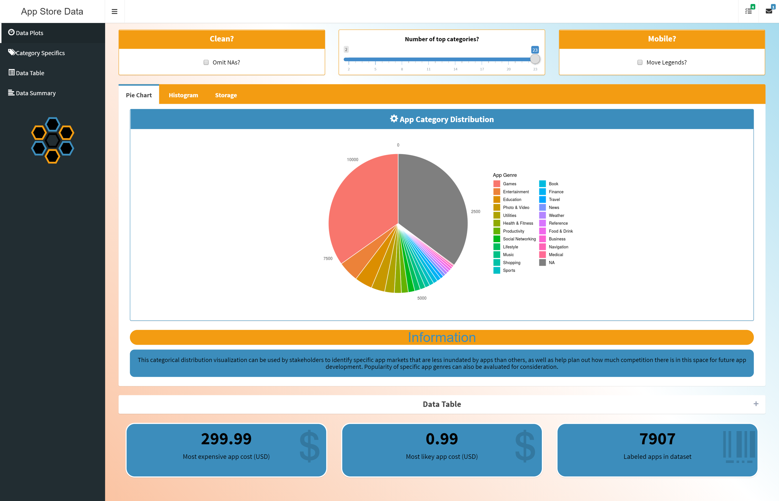
Current App State
Code available at
https://www.github.com/bmetenko/RShinyAppStore
(Note: please run package_check.R before running the app from RStudio on your machine.)
A Live version is published on
https://bmetenko.shinyapps.io/RShinyAppStore/
(Limited to the Free tier, so please everyone don’t jump on there at once.)
Purpose: Visualization and Presentation of
Apple App Store Data from 2017
(App Sizes, App Ratings, App Genre)

Slide 5
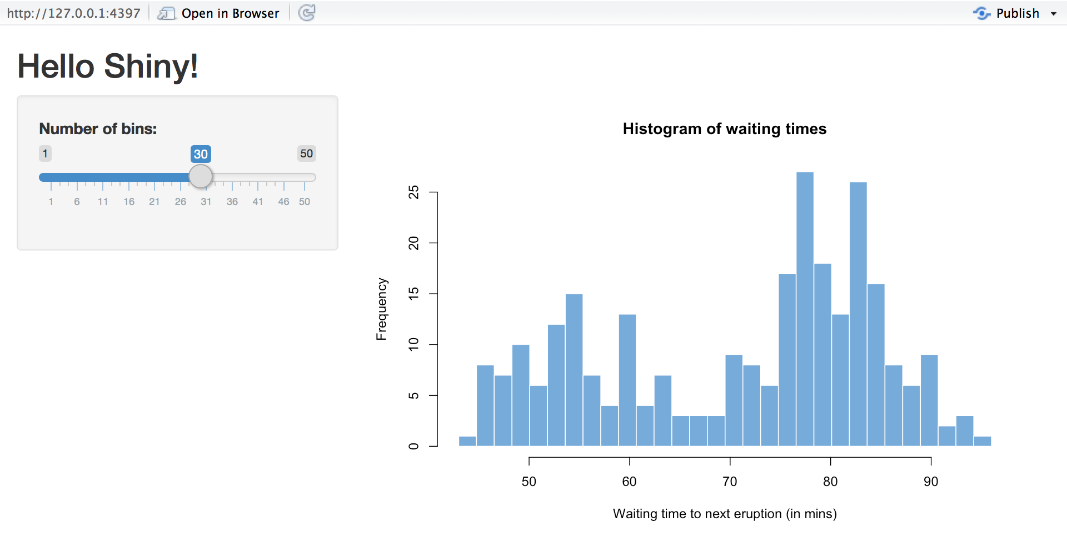
Tips and Tricks #1 | CSS styling
Normal Shiny is plain.
Overriding CSS can change that.
Helps you change colors, add hover over effects, create background gradients and the like.

Slide 6
Tips and Tricks #1 | CSS styling
In Practice:
Multiple choices for CSS:
Inside specific elements of the app
Example picture of code. (EPOC)
In the header element of your main app body.
EPOC
Personal and seperate stylesheet and reference.
EPOC
External Specialized Stylesheet
EPOC – Tailwind CSS

Slide 7
Tips and Tricks #1 | CSS styling
In Practice:
Multiple choices for CSS:
Inside specific elements of the app
Example picture of code. (EPOC)
In the header element of your main app body.
EPOC
Personal and seperate stylesheet and reference.
EPOC
External Specialized Stylesheet
EPOC – Tailwind CSS

Slide 8
Tips and Tricks #1 | CSS styling
In Practice:
Multiple choices for CSS:
Inside specific elements of the app
Example picture of code. (EPOC)
In the header element of your main app body.
EPOC
Personal and seperate stylesheet and reference.
EPOC
External Specialized Stylesheet
EPOC – Tailwind CSS

Slide 9
Tips and Tricks #1 | CSS styling
In Practice:
Multiple choices for CSS:
Inside specific elements of the app
Example picture of code. (EPOC)
In the header element of your main app body.
EPOC
Personal and seperate stylesheet and reference.
EPOC
External Specialized Stylesheet
EPOC – Tailwind CSS

Slide 10
Finding the class tag and using it.
Run your shiny app externally >
Press F12, click a button like this and find the element.
Or
Right click your element and click inspect.
Look for class CSS that looks like this:
Wherever you have CSS locate add something like to this, depending on your preference:

Slide 11
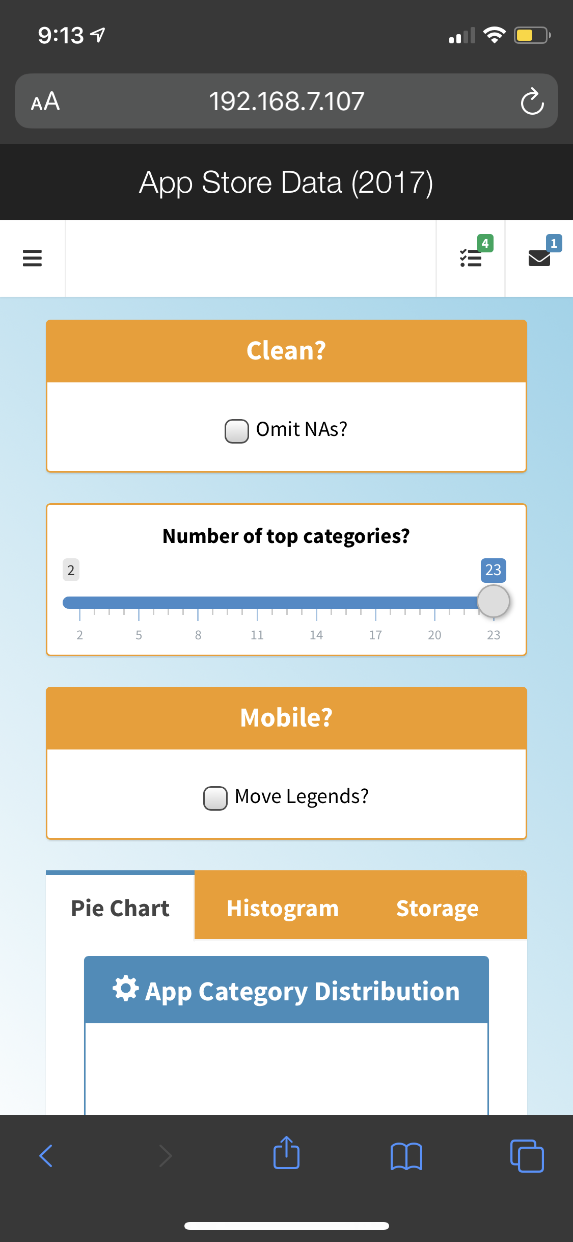
Remember your cell phone?
Your shiny applications can be published to online services like shinyapps.io where they can be accessed from most devices.
To test how they will look on other machines, you can run your shiny app in an R session using
Prereq = { library(shiny) }
runApp(host="0.0.0.0", port=5050)
You’ll have to check for your IP address using ipconfig or ifconfig then connect to the app via a webpage URL such as 192.168.1.107:5050
If the device you are using is connected to the same network, then there shouldn’t be any issues.

Slide 12
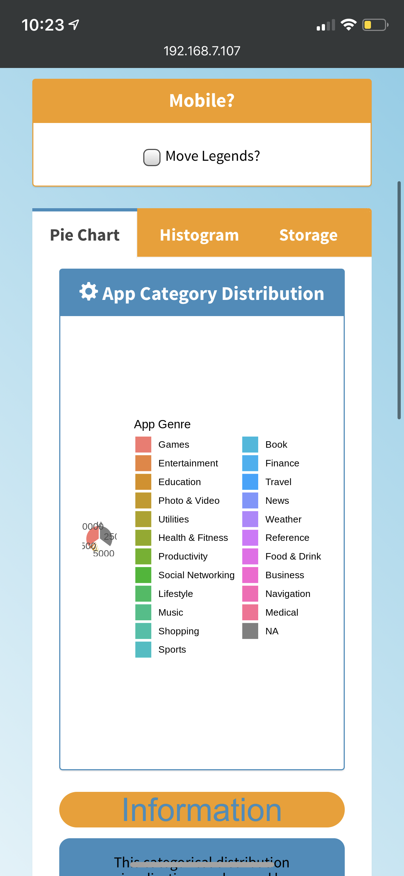
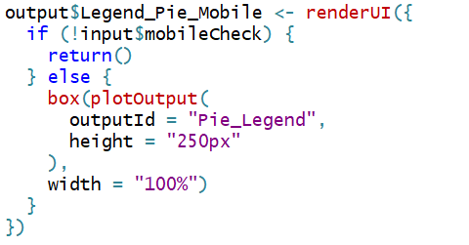

This helps us find interesting problems…
Solution >
Such as incorrect plot scaling.
But the fix leads us into two more shiny tips:
renderUI (on the fly) based on conditions
Toggle a new plot to be rendered based on mobile checkbox toggle.
Said plot only contains the legend. (cowplot library required.)
Problem >

Slide 13
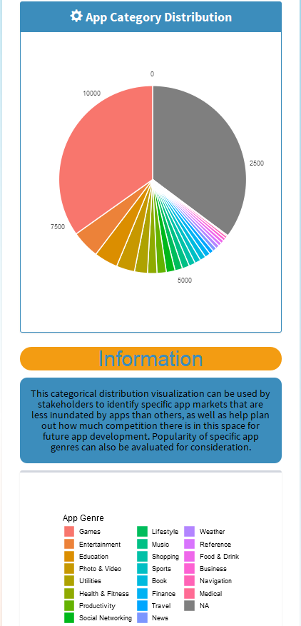

Slide 14
Smaller tips
Plot caching
Pivot table and scrollability.
Highlighting information using KPI boxes.
[[ShinyWidgets]]

Slide 15
Travis CI (Continuous Deployment and Integration.)
Basic requirements:
YAML
> - Connect to *travis-ci.com?* using github.
> - setup specific foreign keys
> - deployment script when run.
> - yaml file.

