Slide 1
R Shiny Tips and Tricks: An App Store Project Demo
Author: Bohdan Metenko
Thursday, August 15th, 2019 < > 6:00pm
PhillyR Meetup
Hosted by Slalom Consulting,
100 N 18th St #2000, Philadelphia, PA

Slide 2
Talk Outline
Intro to Shiny
App Overview
CSS styling and options.
Mobile considerations and splitting up plots.
Smaller Tips
Travis CI and requirements. (Continuous Deployment and Integration.)

Slide 3

Introduction to Shiny
Shiny is a R package that helps build web-based applet like functionality without the need for JavaScript, CSS, or HTML knowledge. (It can help though.)
Enables interactivity for both you and the end-user.
Easily web-publishable.
Maintained by Rstudio.
Example:

Slide 4
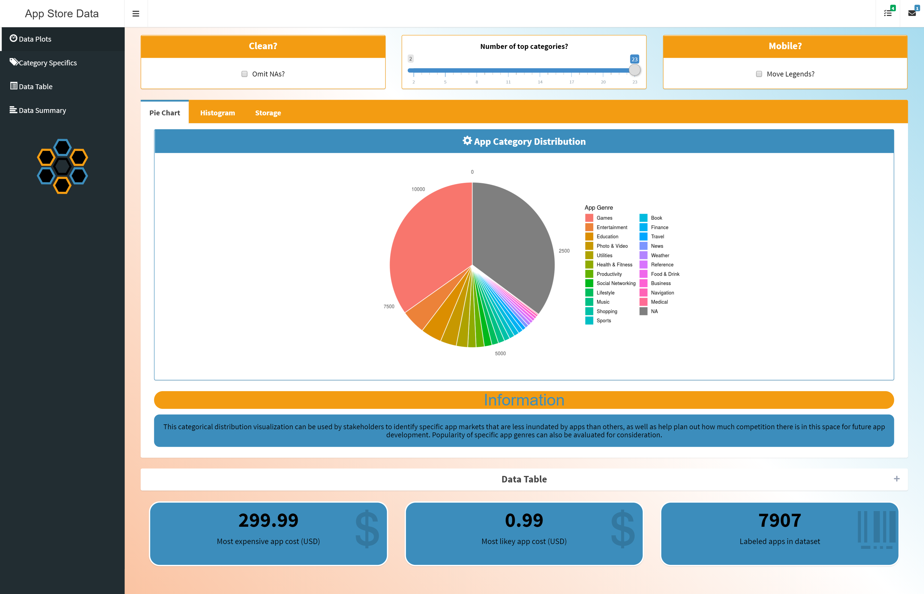
Current App State
Code available at
https://www.github.com/bmetenko/RShinyAppStore
(Note: please run package_check.R before running the app from RStudio on your machine.)
A Live version is published on
https://bmetenko.shinyapps.io/RShinyAppStore/
(Limited to the Free tier, so please everyone don’t jump on there at once.)
Purpose: Visualization and Presentation of
Apple App Store Data from 2017
(App Sizes, App Ratings, App Genre)

Slide 5
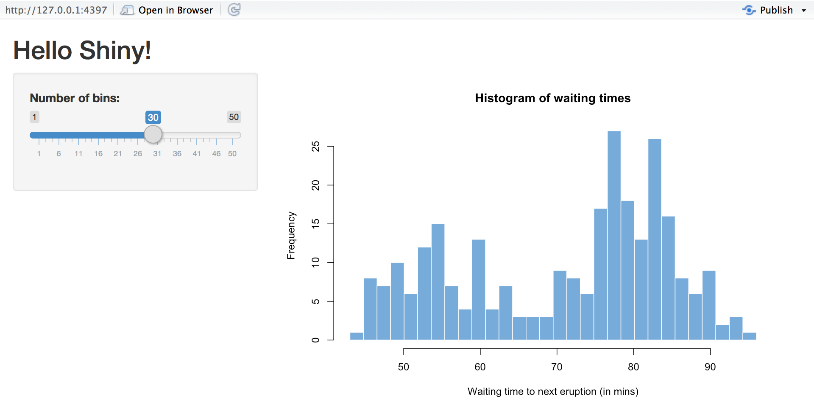
Tips and Tricks #1 | CSS styling
Normal Shiny is plain.
Overriding CSS can change that.
Helps you change colors, add hover over effects, create background gradients and the like.

Slide 6
With and Without

Slide 7
Tips and Tricks #1 | CSS styling
In Practice:
Multiple choices for CSS:
Inside specific elements of the app
Example picture of code. (EPOC)
EPOC – Tailwind CSS
In the header element of your main app body.
EPOC
Personal and seperate stylesheet and reference.
EPOC
External Specialized Stylesheet

Slide 8
Tips and Tricks #1 | CSS styling
In Practice:
Multiple choices for CSS:
Inside specific elements of the app
In the header element of your main app body.
EPOC
Personal and seperate stylesheet and reference.
EPOC
External Specialized Stylesheet
EPOC – Tailwind CSS
Example picture of code. (EPOC)

Slide 9
Tips and Tricks #1 | CSS styling
In Practice:
Multiple choices for CSS:
Inside specific elements of the app
Example picture of code. (EPOC)
In the header element of your main app body.
EPOC
Personal and seperate stylesheet and reference.
EPOC
External Specialized Stylesheet
EPOC – Tailwind CSS

Slide 10
Tips and Tricks #1 | CSS styling
In Practice:
Multiple choices for CSS:
Inside specific elements of the app
Example picture of code. (EPOC)
In the header element of your main app body.
EPOC
Personal and seperate stylesheet and reference.
EPOC
External Specialized Stylesheet
EPOC – Tailwind CSS

Slide 11
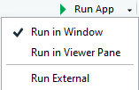


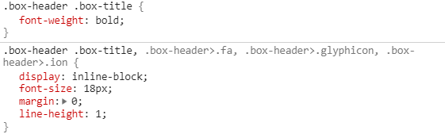

Finding the class tag you want to assign CSS properties to.
Run your shiny app externally
Press F12
Click
and select the element
Or
Right click your element and click inspect
Add something new to your CSS file.
.box-header .box-title:hover {
color: black;
padding: 0.1em;
}

Slide 12
Important notes
If you change some color or property that is locked in by the stylesheet provided by shiny, it may be useful to override it with:
color: blue!important;
Another important point is that once you change and apply styles to one class of objects, they will all have those styles.
If this is not useful:
Make a new class for the element you care about and style it using .new-class { }
Adding JavaScript, jQuery, and HTML follows some of the rules mentioned, but would deserve their own talk and are definitely worth checking into.
CSS is just more manageable for most people.

Slide 13
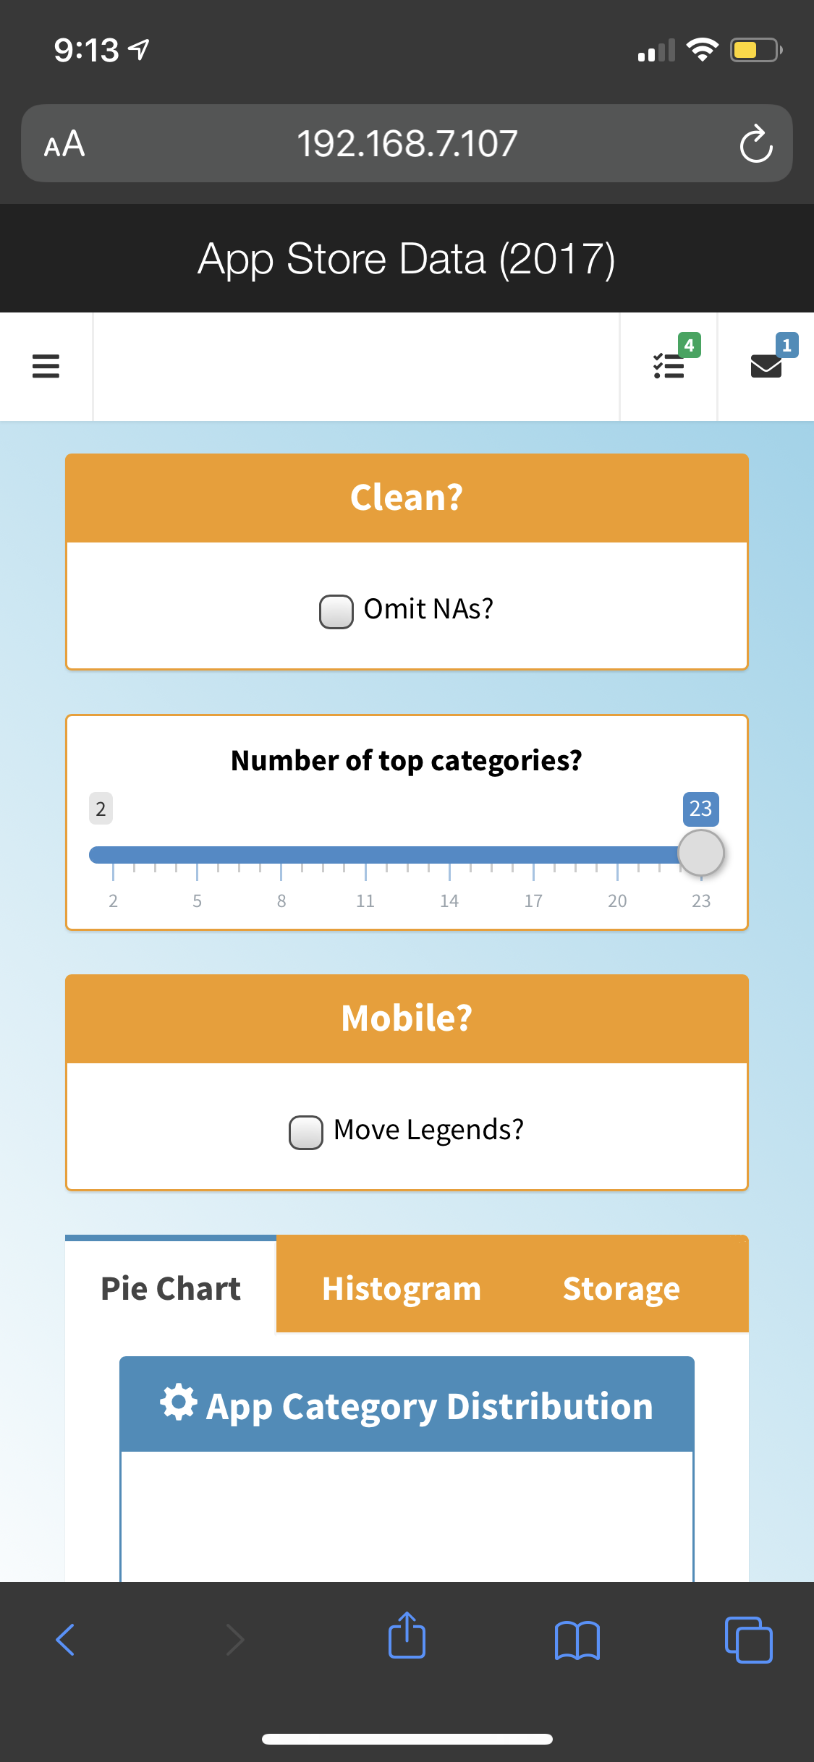
Remember your cell phone?
Your shiny applications can be published to online services like shinyapps.io where they can be accessed from most devices by anyone.
To test how they will look on other machines, you can run your shiny app in an R session using
Prereq = { library(shiny) }
runApp(host="0.0.0.0", port=5050)
You’ll have to check for your IP address using ipconfig or ifconfig then connect to the app via a webpage URL such as 192.168.1.107:5050
If the device you are using is connected to the same network, then there shouldn’t be any issues.

Slide 14
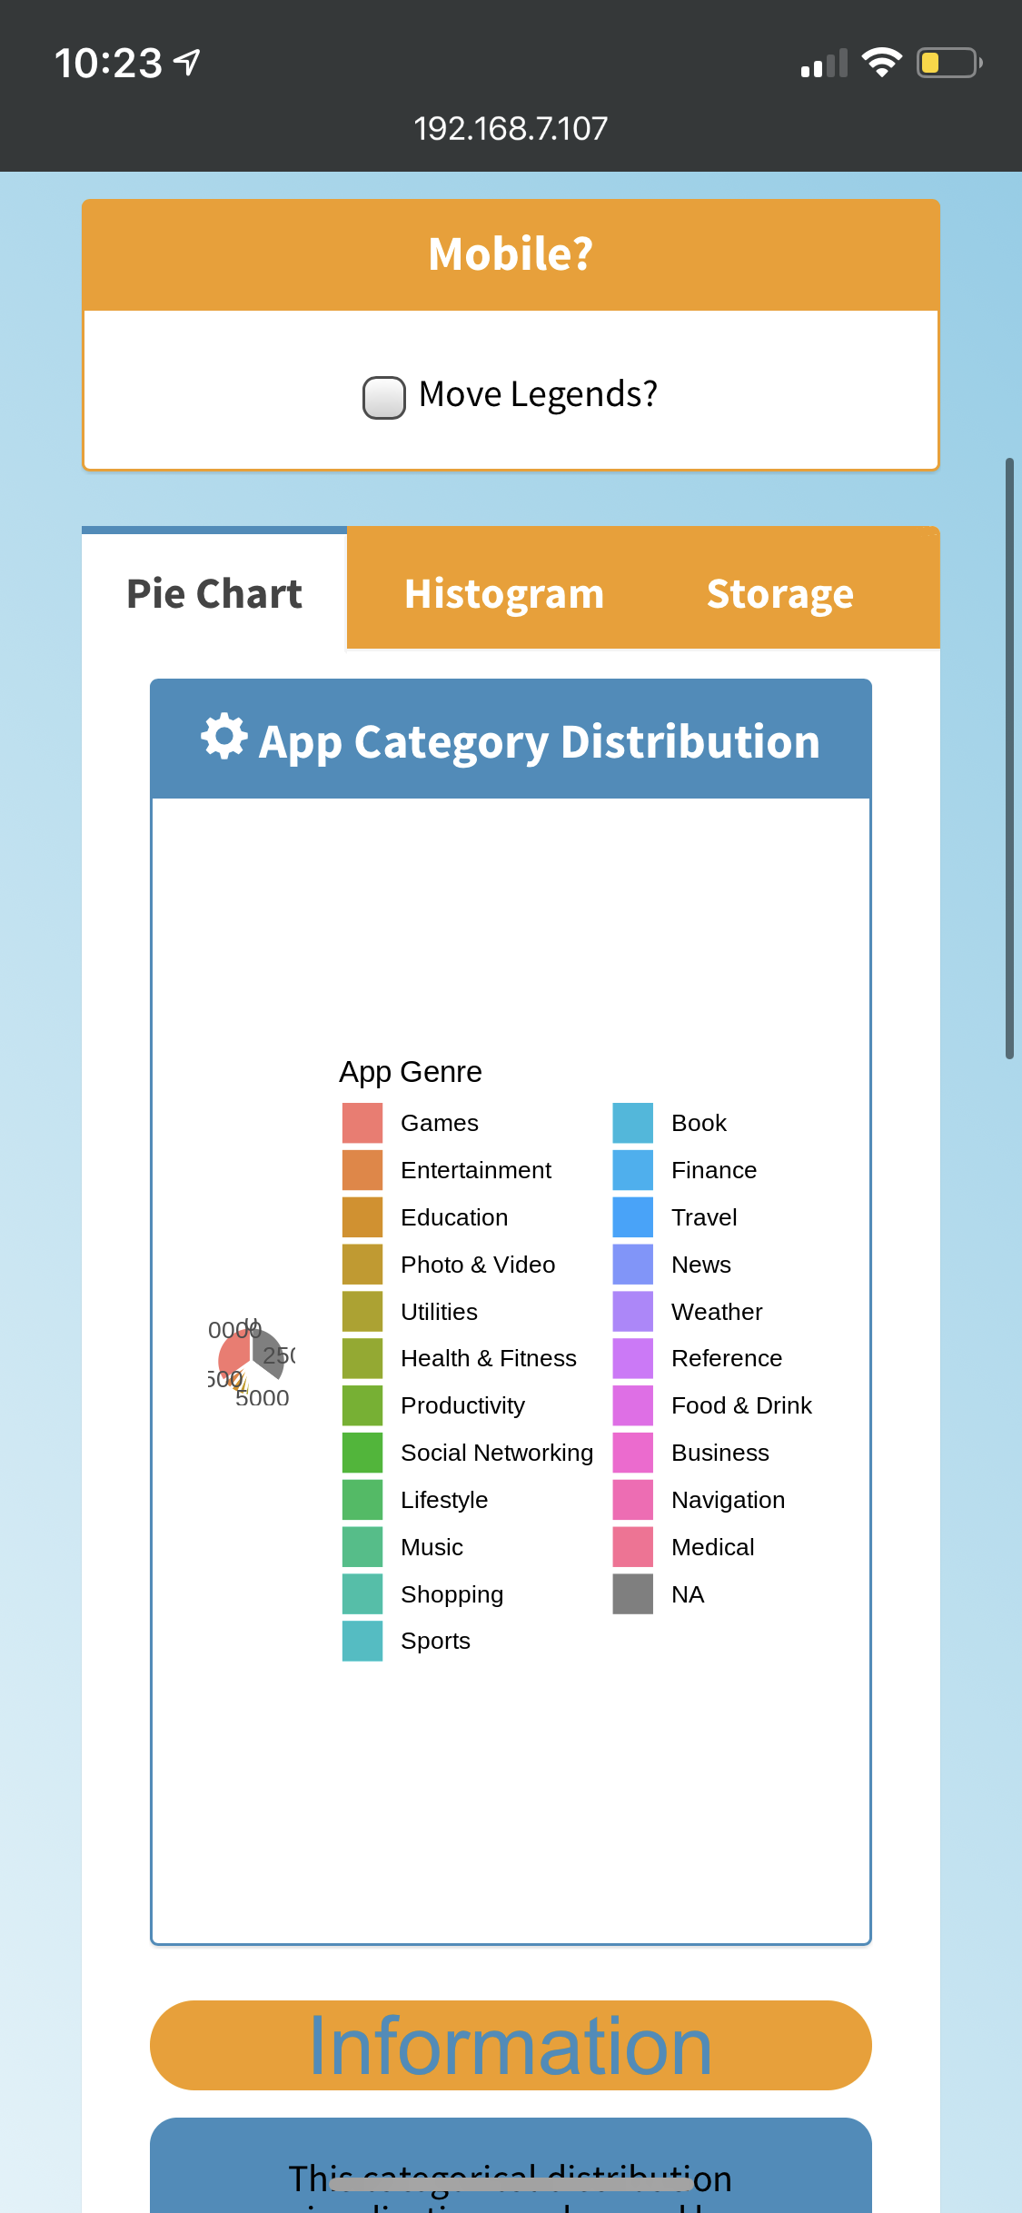
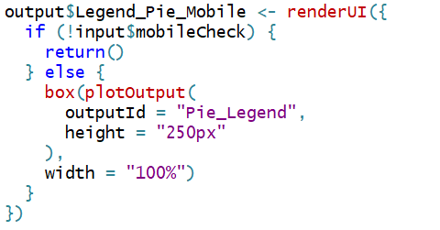

This helps us find interesting problems…
Solution >
Such as incorrect plot scaling.
But the fix leads us into two more shiny tips:
renderUI (on the fly) based on conditions
Toggle a new plot to be rendered based on mobile checkbox toggle.
Said plot only contains the legend. (cowplot library required.)
Problem >

Slide 15

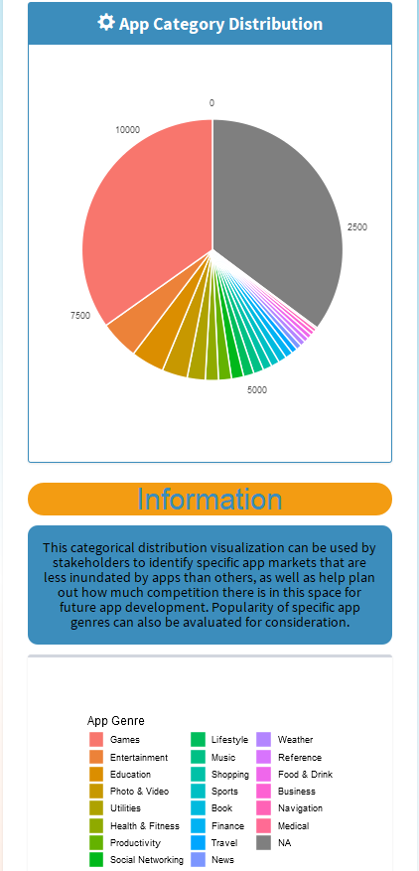
VS.

Slide 16
Smaller tips
Showing and hiding plots.
Taglists to plot multiple UI elements.
Plot caching
Pivot table and scrollability.
Highlighting information using KPI boxes.
[[ShinyWidgets]]?
Maintaining a color theme.

Slide 17
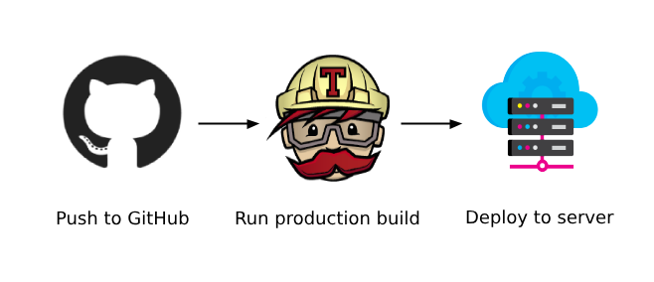

Travis CI (Continuous Deployment and Integration)
Basic requirements:
YAML
Deploy script
Environmental Variables
Before starting, make sure to hook up your GitHub account with your Travis CI account and your shinyapps.io account.
https://travis-ci.org

Slide 18
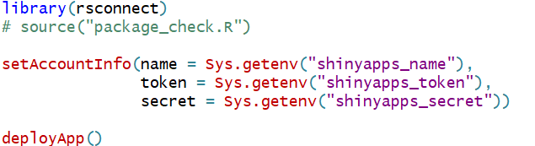
Deploy script (deploy.R)
Doesn’t have to be much more than
Note the commented-out package_check.R file.
These packages will be installed based on the YAML config file.
That’s shown next.

Slide 19
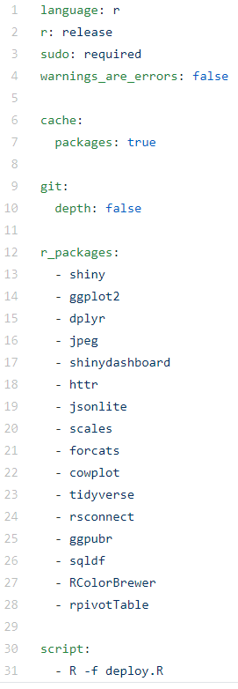
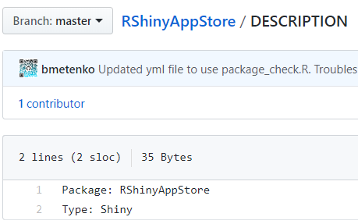
.travis.yml file
Simple file specifying to Travis-CI what to install.
R version and package versions can be specified.
Last entry in the list is the deploy script to upload and re-deploy the app.
Another Requirement:
A DESCRIPTION file:

Slide 20
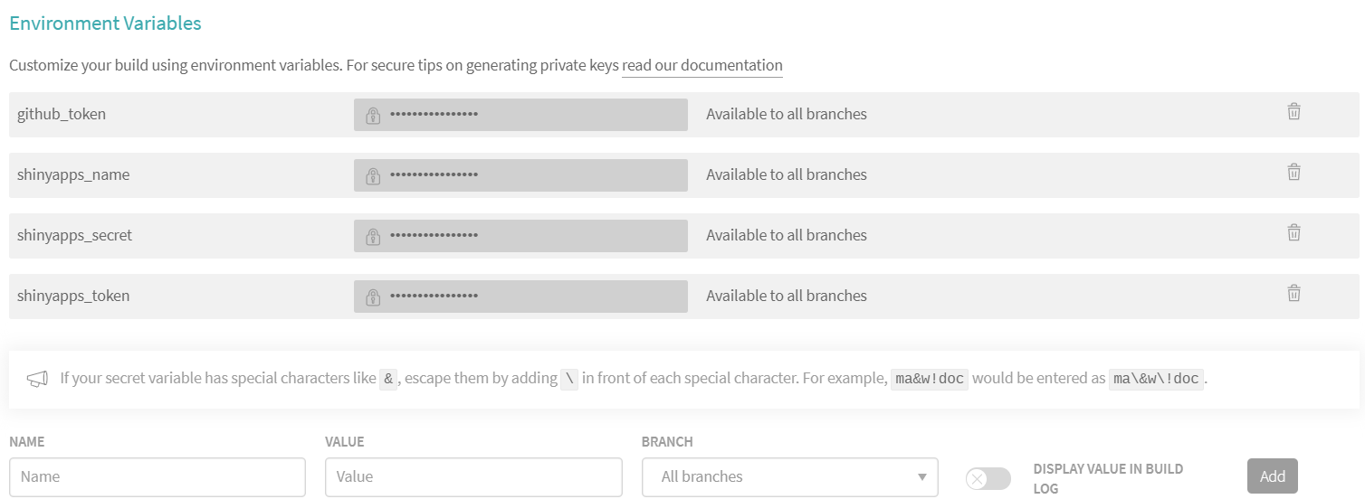
Environmental Variables
You want to keep these private, otherwise anyone can publish anything to your account on shinyapps.io:
Found and editable on Travis CI settings of your repo.

Slide 21

Environmental Variables
You want to keep these private, otherwise anyone can publish anything to your account on shinyapps.io:
Found and editable on Travis CI settings of your repo.
Tokens to add in can are listed here:
https://www.shinyapps.io/admin/#/tokens
(Not shown here for privacy reasons but refer to the previous slide and the deploy script after clicking show and show secret on this webpage.)

Slide 22

Questions?

