Slide 1
R Shiny Tips and Tricks: An App Store Project Demo
Author: Bohdan Metenko Thursday, August 15th, 2019 < > 6:00pm | PhillyR Meetup Hosted by Slalom Consulting, 100 N 18th St #2000, Philadelphia, PA

Slide 2
Talk Outline
Intro to Shiny
App Overview
CSS styling and options.
Maintaining a color theme.
Hover and gradients.
Mobile considerations and splitting up plots.
Showing and hiding plots.
Taglists to plot multiple UI elements.
Plot caching.
Pivot table and scrollability.
Highlighting information using KPI boxes.
[[ShinyWidgets]]
Travis CI and requirements. (Contininuous Deployment and Integration.)

Slide 4
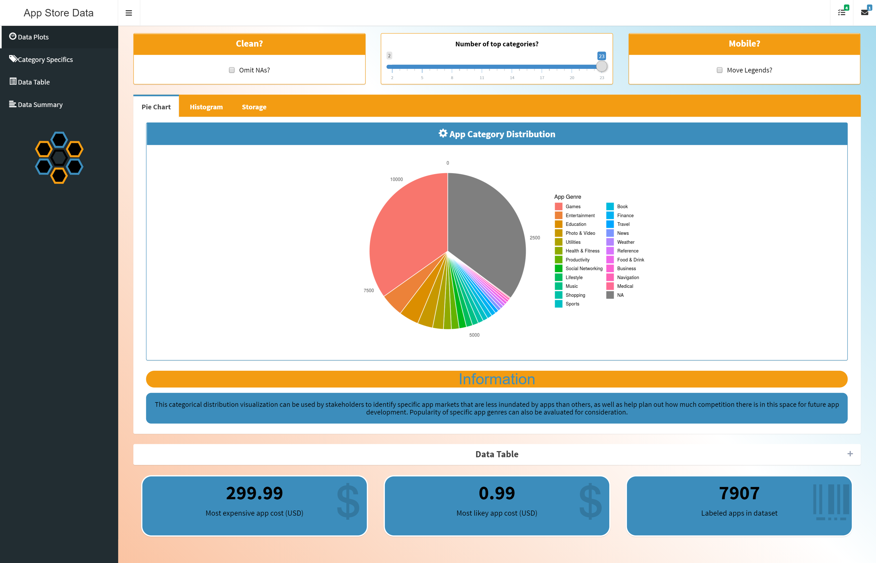
Current App State
Code available at
https://www.github.com/bmetenko/RShinyAppStore
(Note: please run package_check.R before running the app from RStudio on your machine.)
A Live version is published on
https://bmetenko.shinyapps.io/RShinyAppStore/
(Limited to the Free tier, so please everyone don’t jump on there at once.)
Purpose: Visualization and Presentation of
Apple App Store Data from 2017
(App Sizes, App Ratings, App Genre)

Slide 5
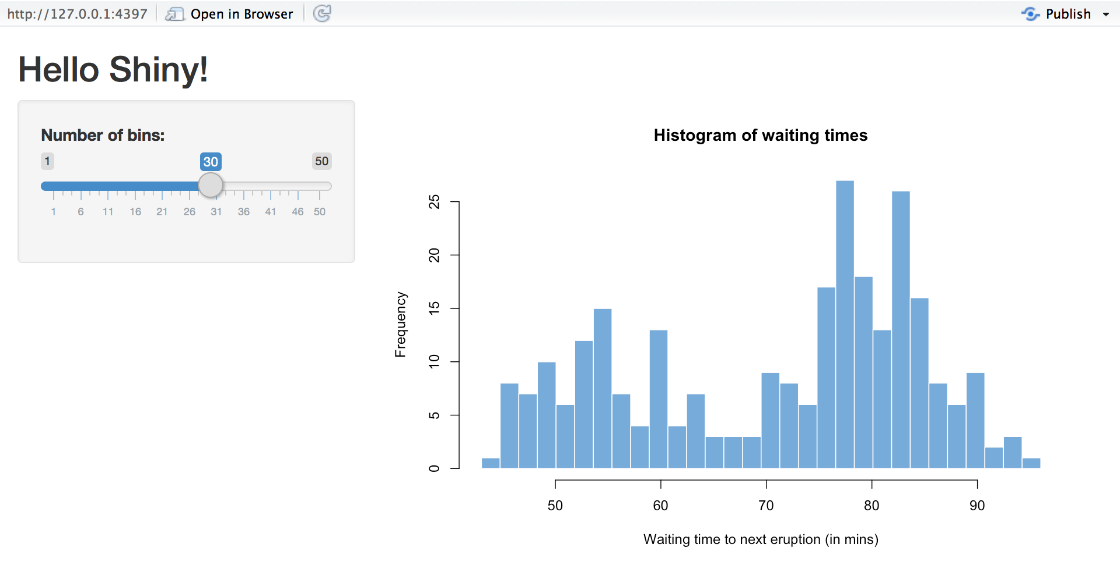
Tips and Tricks #1 | CSS styling
Normal Shiny is plain.
Overriding CSS can change that.
Helps you change colors, add hover over effects, create background gradients and the like.

Slide 6
Tips and Tricks #1 | CSS styling
In Practice:
Multiple choices for CSS:
Inside specific elements of the app
Example picture of code. (EPOC)
In the header element of your main app body.
EPOC
Personal and seperate stylesheet and reference.
EPOC
External Specialized Stylesheet
EPOC – Tailwind CSS

Slide 7
Tips and Tricks #1 | CSS styling
In Practice:
Multiple choices for CSS:
Inside specific elements of the app
Example picture of code. (EPOC)
In the header element of your main app body.
EPOC
Personal and seperate stylesheet and reference.
EPOC
External Specialized Stylesheet
EPOC – Tailwind CSS

Slide 8
Tips and Tricks #1 | CSS styling
In Practice:
Multiple choices for CSS:
Inside specific elements of the app
Example picture of code. (EPOC)
In the header element of your main app body.
EPOC
Personal and seperate stylesheet and reference.
EPOC
External Specialized Stylesheet
EPOC – Tailwind CSS

Slide 9
Tips and Tricks #1 | CSS styling
In Practice:
Multiple choices for CSS:
Inside specific elements of the app
Example picture of code. (EPOC)
In the header element of your main app body.
EPOC
Personal and seperate stylesheet and reference.
EPOC
External Specialized Stylesheet
EPOC – Tailwind CSS

