Slide 1


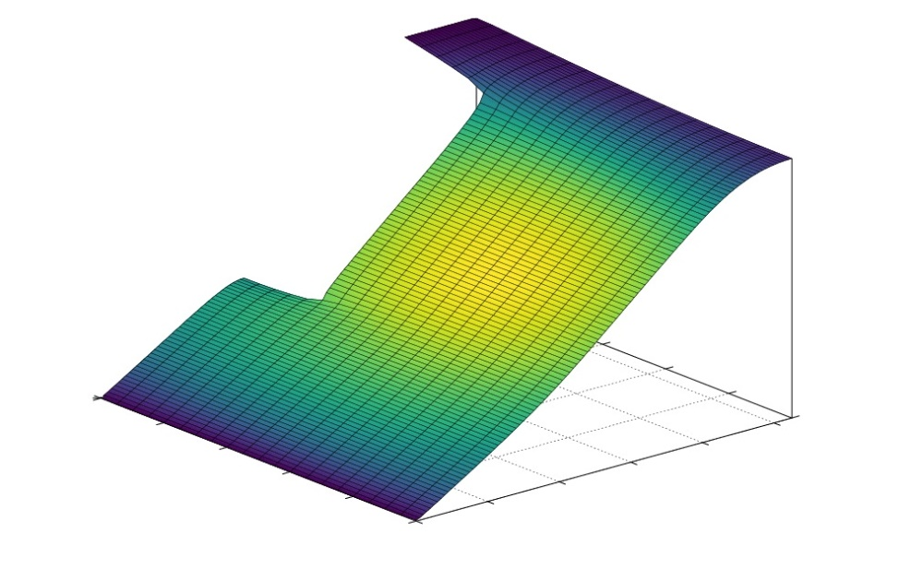
Case Study in Scientific Computing
By Brady, Georgia and Markus

Slide 2
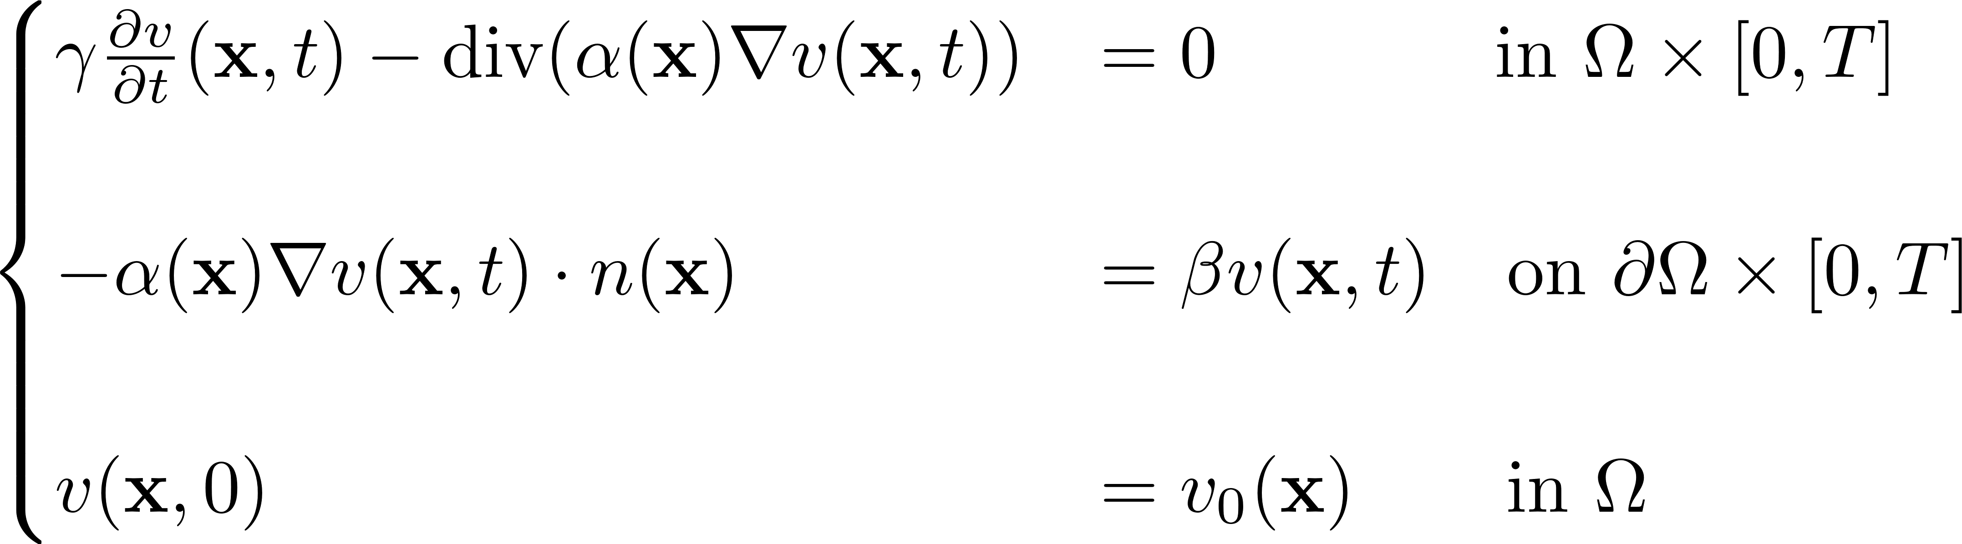
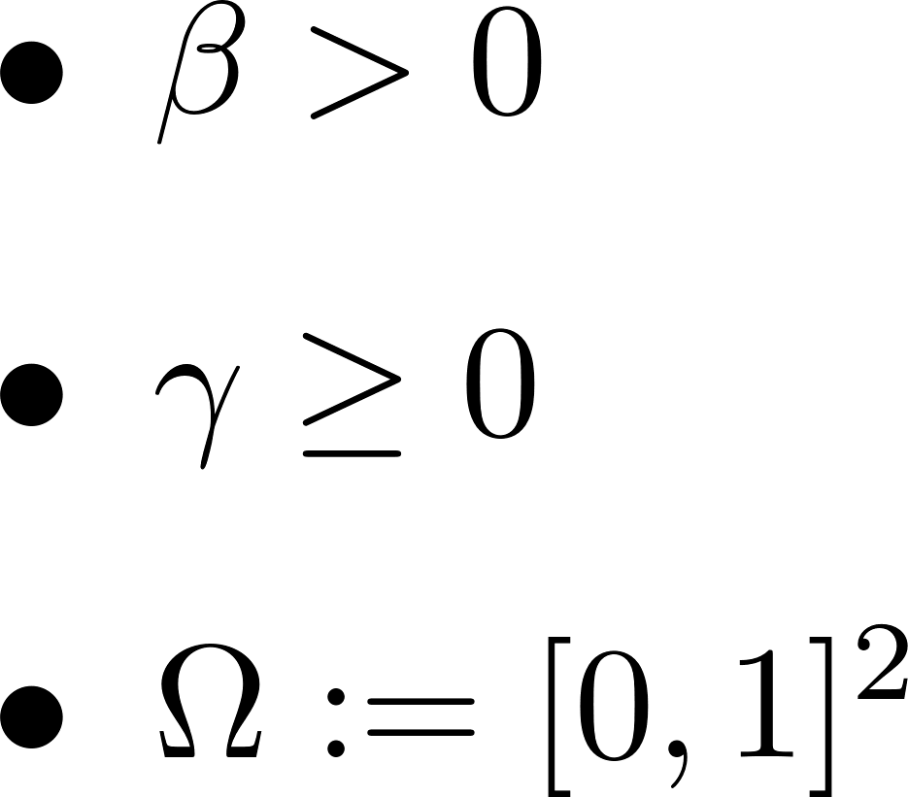
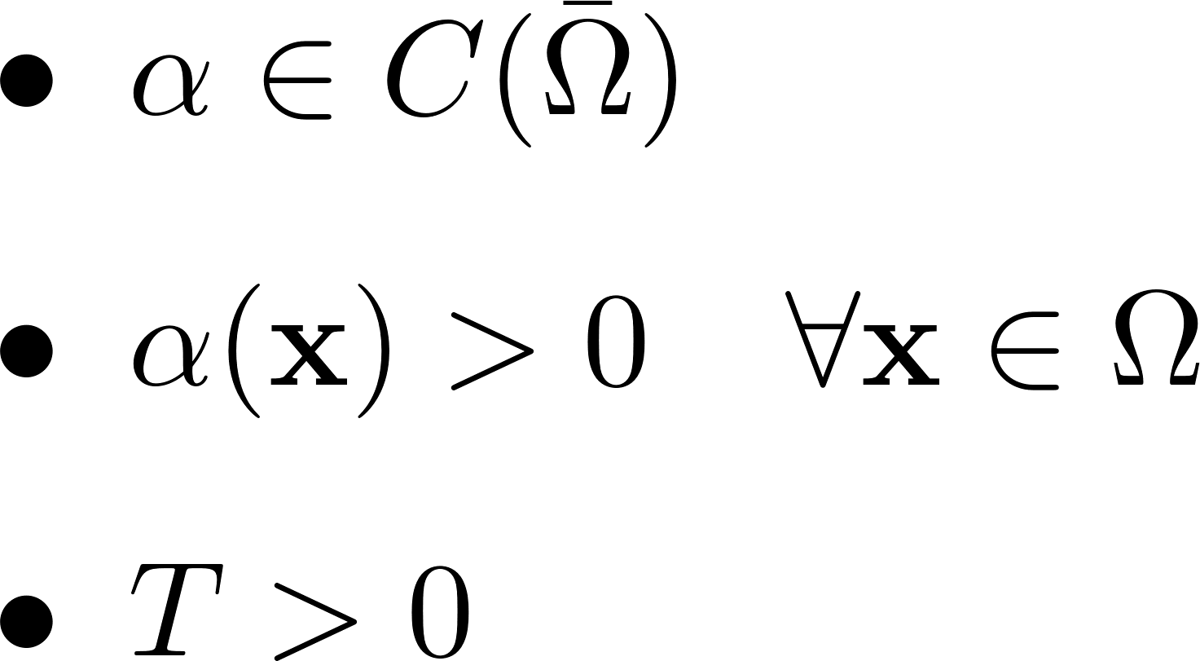
Problem 1
University of Oxford
Mathematical Institute
EPSRC Centre for Doctoral Training in Industrially Focused Mathematical Modelling

Slide 3





Numerical Method for Problem 1
University of Oxford
Mathematical Institute
EPSRC Centre for Doctoral Training in Industrially Focused Mathematical Modelling

Slide 4
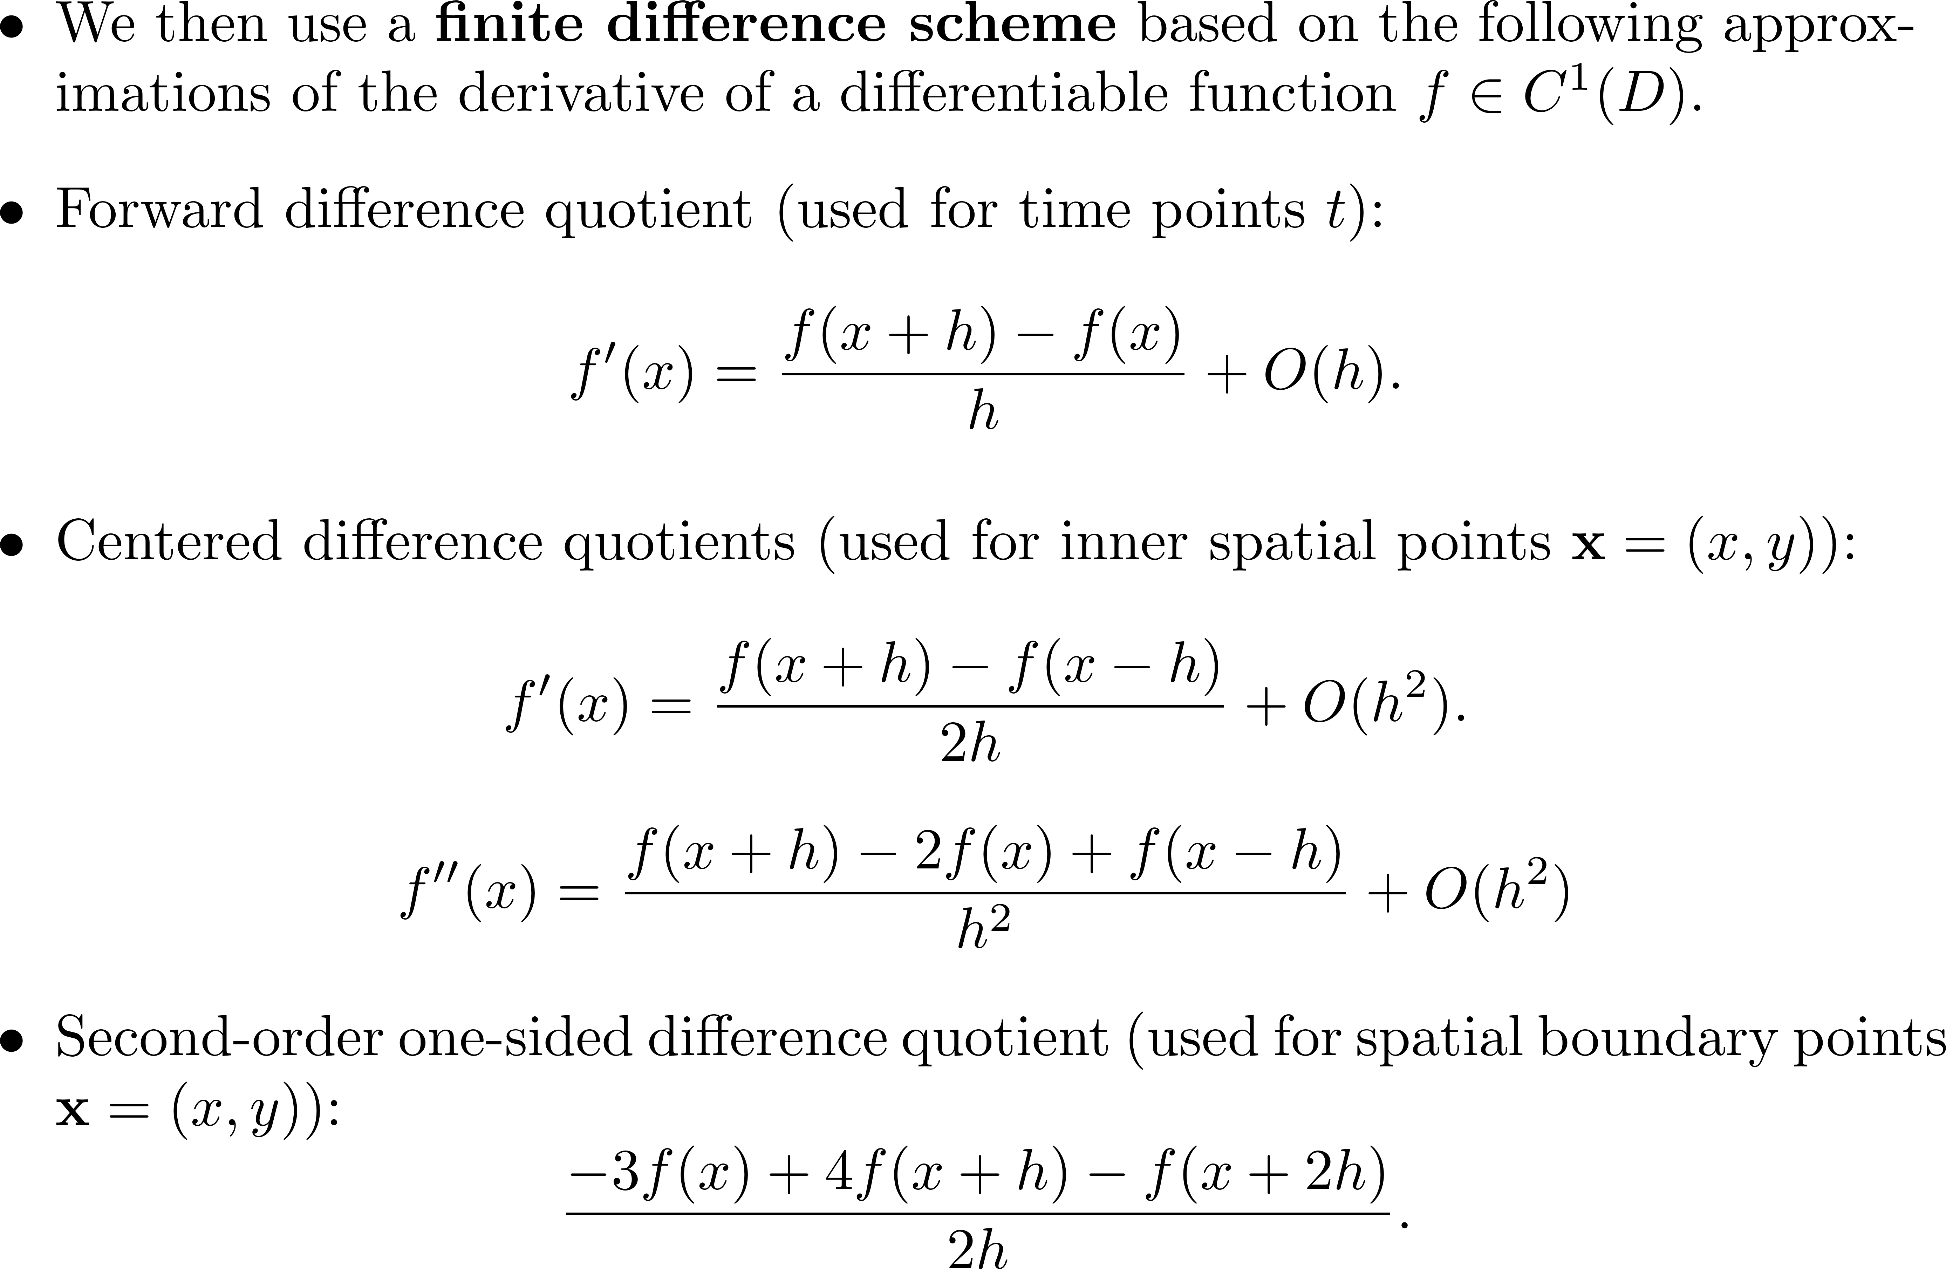
Numerical Method for Problem 1
University of Oxford
Mathematical Institute
EPSRC Centre for Doctoral Training in Industrially Focused Mathematical Modelling

Slide 5
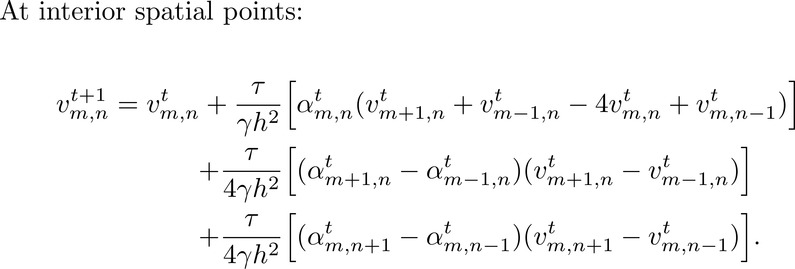
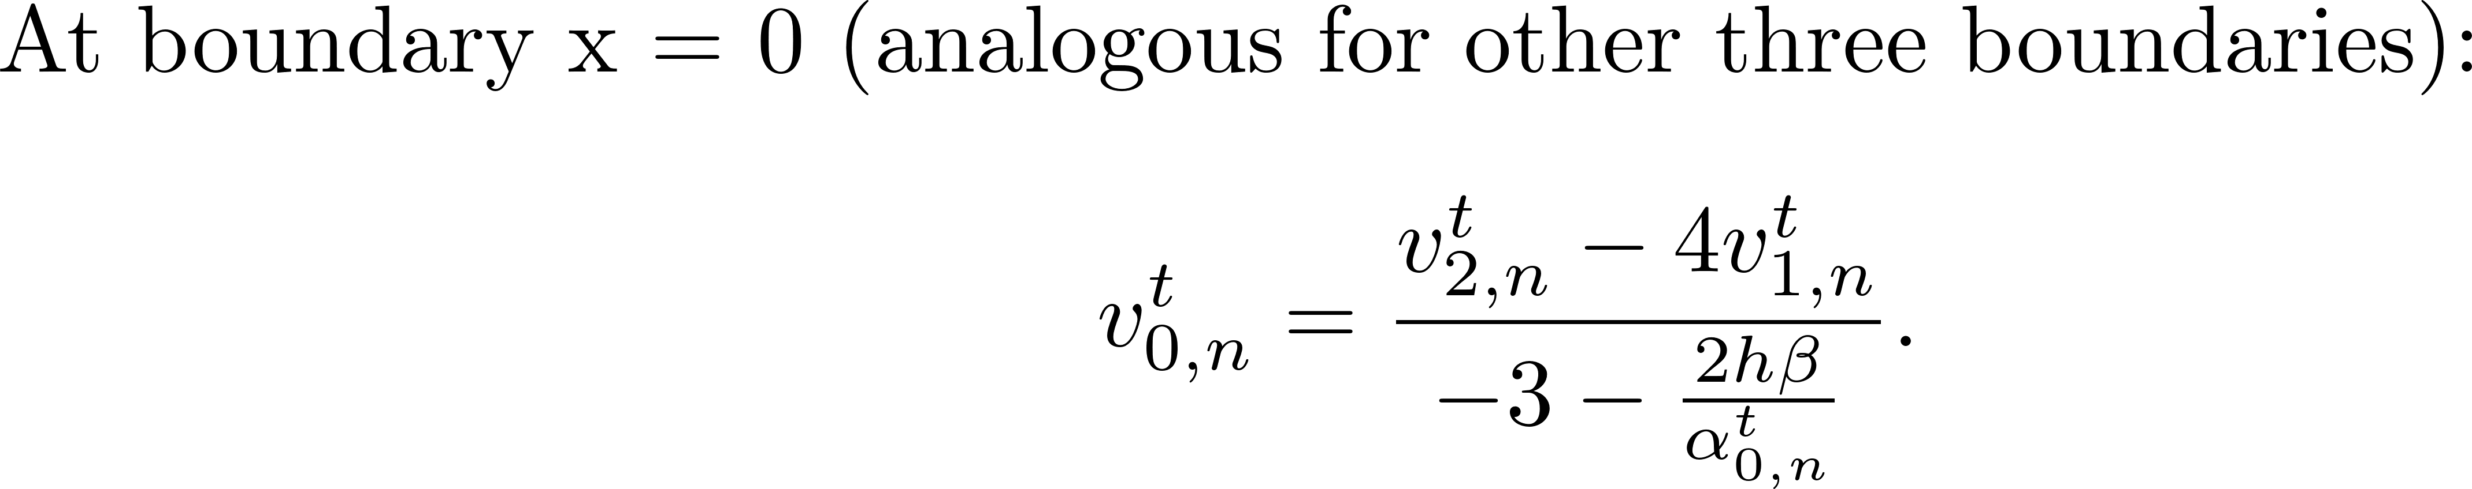
Derived Finite Difference Scheme
University of Oxford
Mathematical Institute
EPSRC Centre for Doctoral Training in Industrially Focused Mathematical Modelling

Slide 6
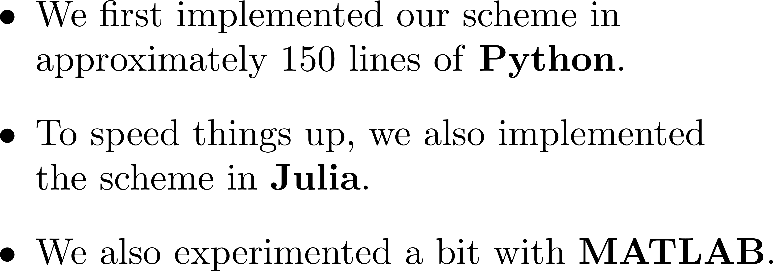
Implementation
University of Oxford
Mathematical Institute
EPSRC Centre for Doctoral Training in Industrially Focused Mathematical Modelling

Slide 7
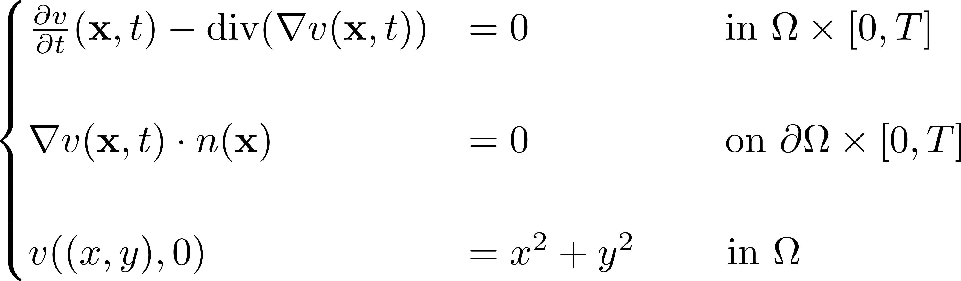
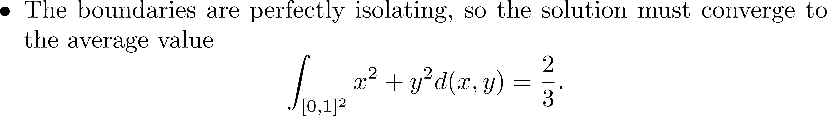
Test to Validate Implementation
University of Oxford
Mathematical Institute
EPSRC Centre for Doctoral Training in Industrially Focused Mathematical Modelling

