Slide 1

FOOD WASTE & SUSTAINABILITY
The Real Cost of What We Throw Away
A closer look at the food we waste, and how we can fix it
Name: ________________ · Course: ________________ · Date: __________
Notes:
Hi, my name is ___. My topic for this project is food waste, and how it connects to sustainability. Food waste is one of those problems that sits quietly in the background, but once you look at the numbers it turns out to be a big deal for our economy, the environment, and the people around us. Over the next few minutes I'll cover what food waste actually is, why it matters, and some realistic ways we can cut it down.

Slide 2

What Is Food Waste?
Food waste is any food that was grown or made for people to eat, but ends up thrown out instead. Experts usually split the problem into two parts: Food loss happens early, on farms and in factories, when crops spoil or get damaged before they reach us. Food waste happens later, at grocery stores, restaurants, and in our own kitchens, when good food gets tossed.
1/3
of all food made worldwide is never eaten
30–40%
of the U.S. food supply is thrown out each year
Why it counts as sustainability: wasting food wastes everything used to make it, the water, land, fuel, and money, while people who need that food go without.
Notes:
So what counts as food waste? It's any food that was grown or made for people to eat but ends up thrown out instead. Experts usually split it into two parts. Food loss happens early, on farms and in factories, when crops spoil or get damaged before they reach us. Food waste happens later, at stores, restaurants, and in our own kitchens. Globally, about a third of all food is never eaten. In the U.S. it's even higher, somewhere between 30 and 40 percent of everything we produce.

Slide 3





Where Does It Happen?
Food is lost and wasted at every step, from the farm all the way to your plate.
Farms
Processing
Stores
Restaurants
Homes
Homes are the #1 source of food waste in the U.S. Roughly 40–50% of it happens after food reaches us.
Why so much at home? We tend to over-buy at the store, get confused by “sell by” and “best by” dates and toss food that is still fine, and cook bigger portions than we actually eat. Because this waste is so close to us, it is also some of the easiest to prevent.
Notes:
Food gets wasted at every step of the chain. Some is lost on farms and during processing. Stores toss food that looks less than perfect or passes a sell-by date, and restaurants over-prepare. But in the U.S., the single biggest source is our own homes. We buy more than we can use, we get confused by date labels, and we serve portions that are too big. The good news is that because so much waste happens at the consumer end, a lot of it is within our control.

Slide 4




Why It Matters: The Impacts
On People
On the Environment
On Wildlife
• Higher costs. Wasted food costs the average U.S. family of four about $1,500 a year. • Hunger nearby. About 34 million Americans go hungry while edible food is thrown out.
• More emissions. Food in landfills gives off methane and drives 8–10% of global greenhouse gases. • Wasted resources. It burns up water, land, and fuel used to grow food no one eats.
• Lost habitat. Clearing land for food we never eat destroys homes for wildlife. • Polluted water. Fertilizer runoff creates ocean “dead zones” where fish cannot survive.
The Three E's: these impacts hit the Economy (money and resources), the Environment (emissions and habitat), and Equity (people going hungry) all at the same time.
Notes:
Food waste hurts in three directions, which lines up with the three E's of sustainability. For people, it costs the average family of four around 1,500 dollars a year, and it feels unfair when 34 million Americans don't have enough to eat while good food gets thrown out. For the environment, food rotting in landfills releases methane, a strong greenhouse gas, and all the water and land used to grow that food is wasted too. And for wildlife, clearing land destroys habitat, while fertilizer runoff pollutes rivers and creates dead zones in the ocean.

Slide 5




Solutions at Every Level
Individual
Local & National
Global
• Shop smart. Make a meal plan and a list so you only buy what you will use. • Store & reuse. Keep food fresh, eat leftovers, and treat “best by” as quality, not safety.
• Curbside composting. Cities can collect scraps and turn them into soil, not landfill. • Donation laws & labels. Rules and clear dates help stores send extra food to food banks.
• Better storage. Fund refrigeration and transport so food does not spoil in transit. • Shared goals. Back the UN target to cut food waste in half by 2030.
The takeaway: no single fix solves this. Real progress needs action from all of us, our leaders, and the world together.
Notes:
The encouraging part is that we already know how to fix a lot of this, at every level. As individuals, we can plan meals, shop with a list, store food properly, and stop treating best-by dates as hard deadlines. At the local and national level, cities can offer curbside composting, and governments can pass donation laws and clearer labeling so stores send extra food to food banks. And globally, wealthier countries can help fund better storage and transport, and support shared goals like the UN's target to cut food waste in half by 2030.

Slide 6
Rating the Top 3 on the Three E's
My three highest-impact solutions, weighed against Environment, Economy, and Equity.
Top Solution
Environment
Economy
Equity
Donation laws to rescue surplus food
HIGH Keeps edible food out of landfills and cuts methane.
MED Costs money to move and store, but tax breaks help donors.
HIGH Feeds people facing hunger right away.
Curbside & community composting
HIGH Cuts landfill methane and rebuilds healthy soil.
MED Startup and pickup costs, but creates jobs and compost.
MED Greens neighborhoods, but does not feed people directly.
Smart shopping & clear date labels
HIGH Stops waste at the source, where most of it starts.
HIGH Costs little and saves families money.
MED Helps households save, but reaches people unevenly.
HIGH = strong benefit MED = some trade-offs
Notes:
To figure out which solutions are worth pushing hardest, I rated my top three against the three E's. Rescuing and donating surplus food scores high for the environment and for equity, since it feeds people directly, but it costs money to move and store. Composting is strong for the environment and creates jobs, but it doesn't feed anyone directly. Smart shopping and clearer labels might be the best all-around option. It stops waste at the source, it's cheap, and it saves families money, though it reaches people unevenly.

Slide 7
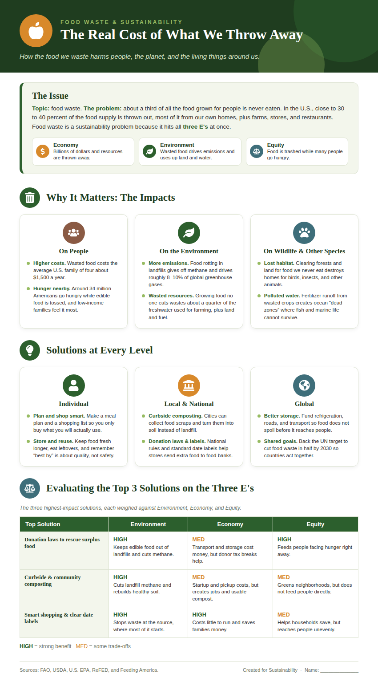
The Full Picture
Everything on one page:
• The problem and its link to the Three E's. • Impacts on people, the environment, and wildlife. • Solutions at the individual, local, and global levels. • An evaluation of the top three solutions.
Big takeaway: food waste is something we all touch every day, which means we all have a part in the fix.
Notes:
I pulled all of this together into a one-page infographic. It lays out the problem, the impacts on people, the environment, and wildlife, the solutions at each level, and the same evaluation table. The big takeaway is that food waste is a problem we all touch every day, which also means we all have a part in the solution. Small changes at home add up quickly when millions of people make them.

Slide 8

What We Can Do
Simple habits and smart policies that add up fast
Plan meals and shop with a list, buy only what you will use.
Store food well and eat leftovers, don't fear “best by” dates.
Compost food scraps instead of sending them to the trash.
Support food donation laws and curbside composting programs.
Waste a little less, and we save money, cut emissions, protect habitats, and help feed our neighbors, all at once.
Sources: FAO, USDA, U.S. EPA, ReFED, and Feeding America.
Notes:
So to wrap up, food waste is a sustainability problem hiding in plain sight, but it's also one of the most fixable. Plan your meals, save your leftovers, compost what you can, and support policies that move extra food to people who need it. If we each waste a little less, we save money, cut emissions, protect habitats, and help feed our neighbors, all at once. Thanks for listening, and I'm happy to take any questions.

