Slide 1
BIODIVERSITY in the NATIONAL PARK system
Data Analysis by bmgonzales

Slide 2
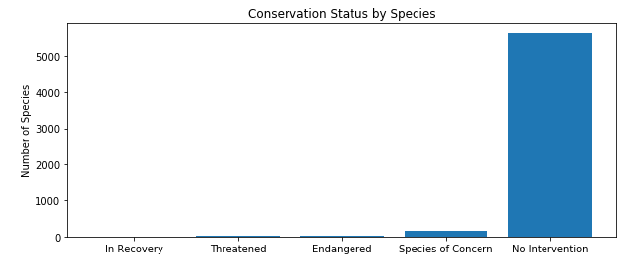
Study of Species at National Parks
While most observed species currently require no intervention, certain categories of species are more likely than others to become endangered.
Category | Species Studied | Percent Protected
Mammal | 214 | 17.76%
Bird | 521 | 15.16%
Amphibian | 80 | 8.75%
Fish | 127 | 8.66%
Reptile | 79 | 6.33%
Nonvascular Plant | 333 | 1.50%
Vascular Plant | 4470 | 1.03%

Slide 3
Significance of Endangered Status
Mammal :: Bird
Mammal :: Reptile
Not Significant
pval = 0.45
Significant
pval = 0.02
Protected | Not Protected | Protected | Not Protected
38 | 176 | 79 | 442
Protected | Not Protected | Protected | Not Protected
38 | 176 | 5 | 74
Recommendation: The difference in likelihood of endangered status between mammals and reptiles is significant, while the difference between mammals and birds is not significant. Given that these species have a similar likelihood of becoming endangered, birds may benefit from similar conservation efforts received by mammals.

Slide 4
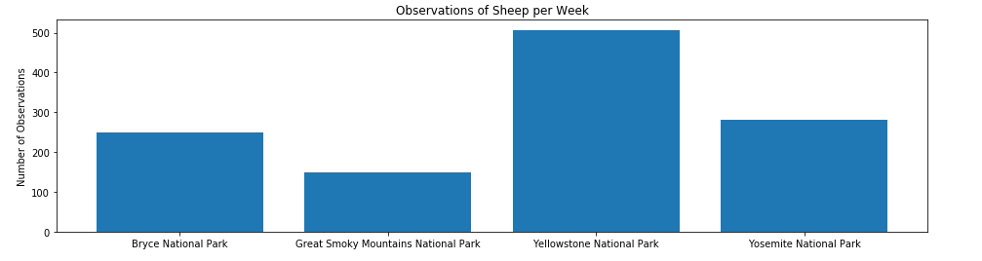
National Parks Sheep Observations
15% of sheep at Bryce National Park have Foot and Mouth Disease.
Sheep Species | Conservation Status | Number of Observations
Domestic Sheep | No Intervention | 542
Bighorn Sheep | Species of Concern | 493
Sierra Nevada Bighorn Sheep | Endangered | 153

Slide 5
Foot and Mouth Disease Study
Determining Necessary Sample Size
Calculations
Baseline Conversion Rate | 15%
Minimum Detectable Effect | 33%
Statistical Significance | 90%
Sample Size | 520
The study will require 2.08 weeks of observation at Bryce National Park and 1.03 weeks of observation at Yellowstone National Park.

