Slide 1

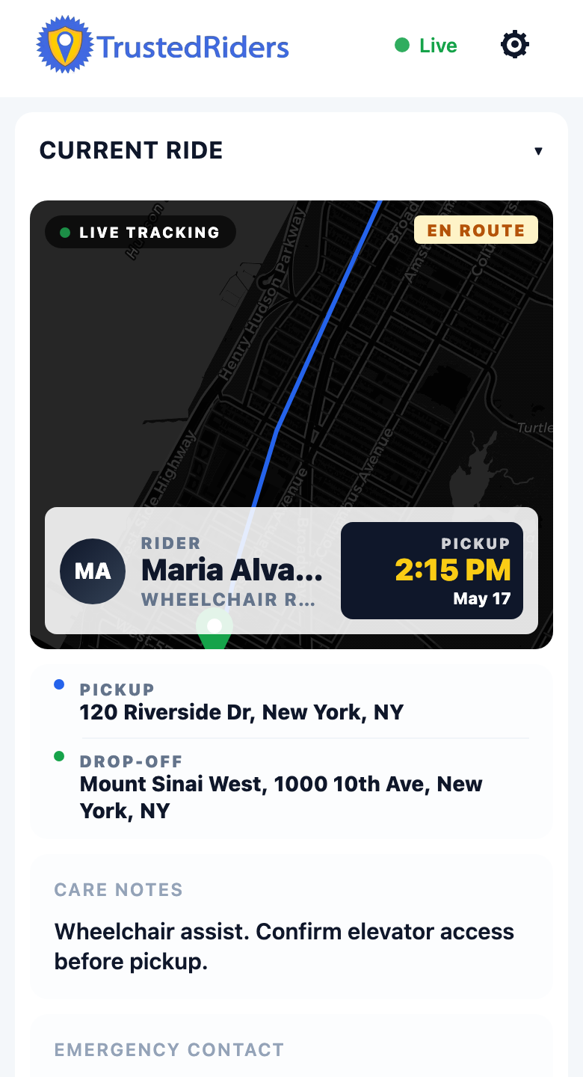
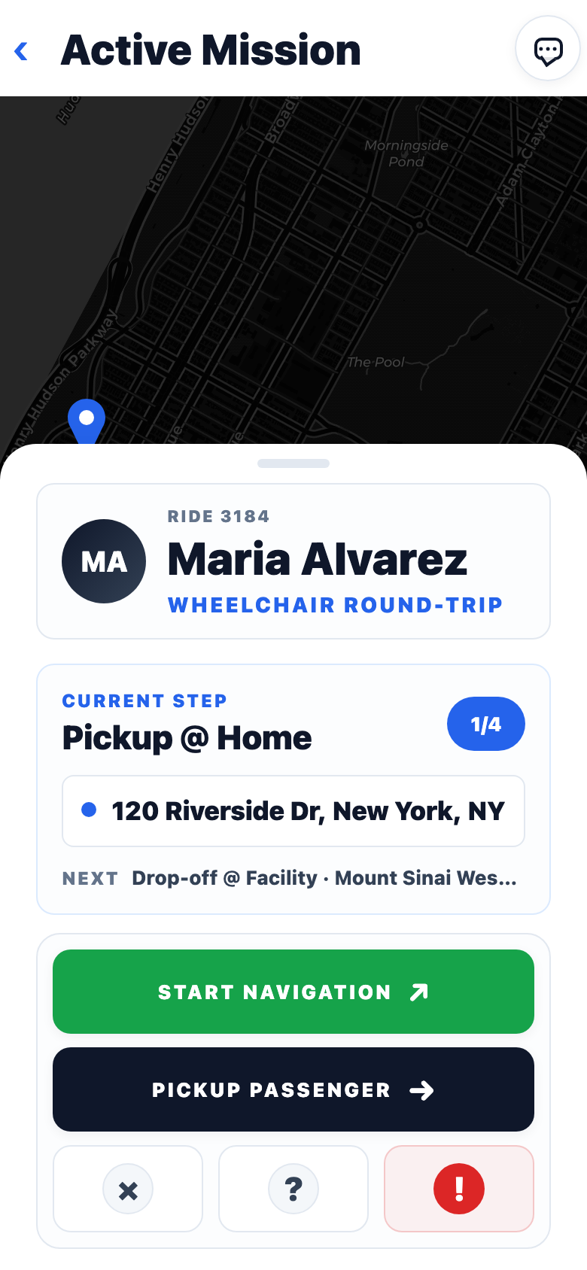
MOBILE PROTOTYPE STATUS
The driver app is demoable, but not yet production complete.
Expo / React Native mobile app focused on authenticated drivers, live rides, mission execution, location sharing, and backend integration with Suresh's Fleet API.
DEMOABLE NOW
BACKEND GAPS
UI CLEANUP
TrustedRiders mobile Expo app demo | local demo API used for screenshot data
01

Slide 2
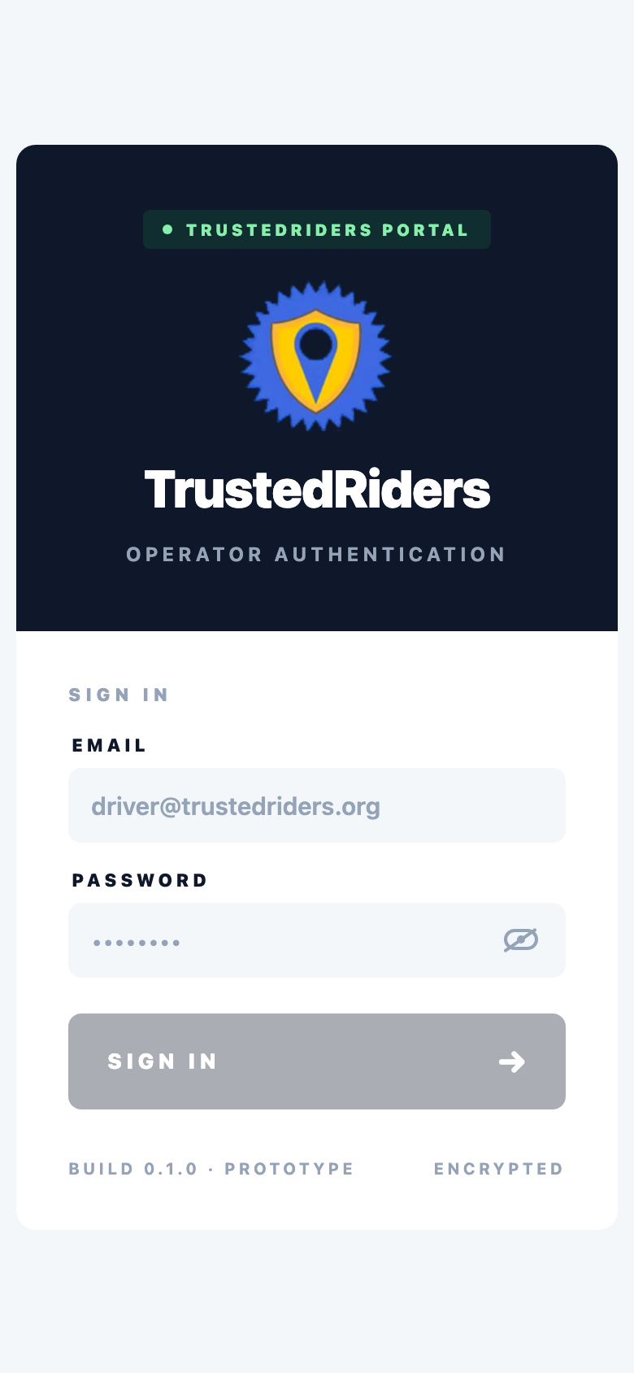
CURRENT CAPABILITY
What works today
The mobile app now has the core driver loop visible in one place: sign in, see the current ride, review trip context, launch the mission, and share live location.
Backend-authenticated entry
Login posts to the Fleet API, persists JWT state, and gates the app behind the driver session.
Ride polling and enrichment
The app reads ride lists plus per-ride detail payloads for coordinates, addresses, notes, and metadata.
Live operations surface
Current ride, scheduled rides, pending requests, status notices, and location indicator are wired into the driver shell.
TrustedRiders mobile Expo app demo | screenshots captured from local demo API, May 17 2026
02

Slide 3
HOME SCREEN PROOF
Current ride view is the strongest demo moment.
The driver lands on a glanceable command surface: status, map context, pickup time, rider identity, pickup/drop-off, care notes, emergency contact, and live location state.
What it proves
1. Ride payload normalization is feeding real UI.
2. Route coordinates can draw a map path.
3. The app now feels like an operations tool, not a static prototype.
Needs cleanup: the dev build reports a nested <button> warning on this screen.
TrustedRiders mobile Expo app demo | screenshots captured from local demo API, May 17 2026
03

Slide 4
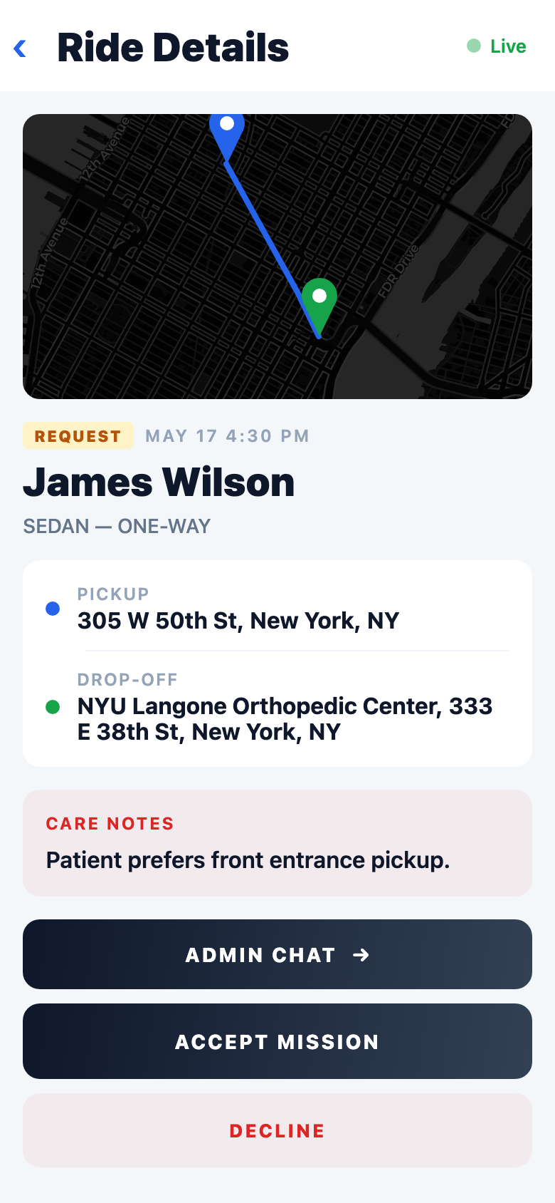
RIDE REQUEST
Pending rides are reviewable, actionable, and map-backed.
This is the handoff point between dispatch assignment and driver acceptance. It is ready for a demo of intended workflow, while the accept/decline backend contract still needs production hardening.
Done
Route preview, rider details, pickup/drop-off, care notes, and decision controls render cleanly.
Still needed
Backend-owned accept/decline endpoint behavior and status reconciliation need to be completed and verified against live data.
TrustedRiders mobile Expo app demo | screenshots captured from local demo API, May 17 2026
04

Slide 5
MISSION MODE
Active mission flow is in place.
The mission screen gives the driver a map-first workflow with staged progress, navigation launch, passenger action, support/help, emergency escalation, and background location tracking hooks.
Driver guidance
Four-step mission model tracks pickup, facility arrival, return pickup, and arrival home.
Backend telemetry
Mission screen sets active ride context for foreground and background location pings.
Remaining risk
Status transitions need live backend confirmation and error recovery, especially after app backgrounding.
TrustedRiders mobile Expo app demo | screenshots captured from local demo API, May 17 2026
05

Slide 6
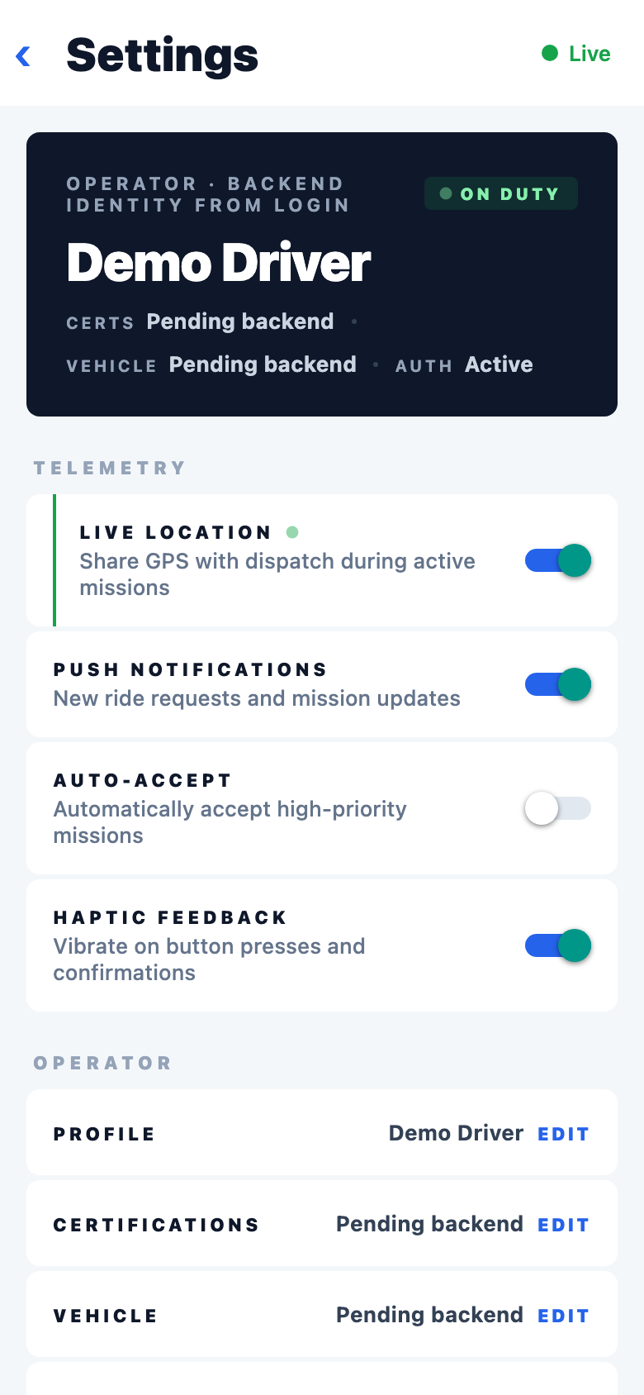
DRIVER OPERATIONS
Settings shows the production readiness line.
The settings screen is valuable in the demo because it makes the remaining backend ownership explicit instead of hiding placeholder state.
Operational toggles
Live location, push notification intent, auto-accept, and haptics settings are represented.
Backend-dependent identity
Certifications and vehicle fields are still marked pending because /api/me is not deployed yet.
Demo framing
Use this slide to explain what is product-complete versus what still needs live backend data.
TrustedRiders mobile Expo app demo | screenshots captured from local demo API, May 17 2026
06

Slide 7
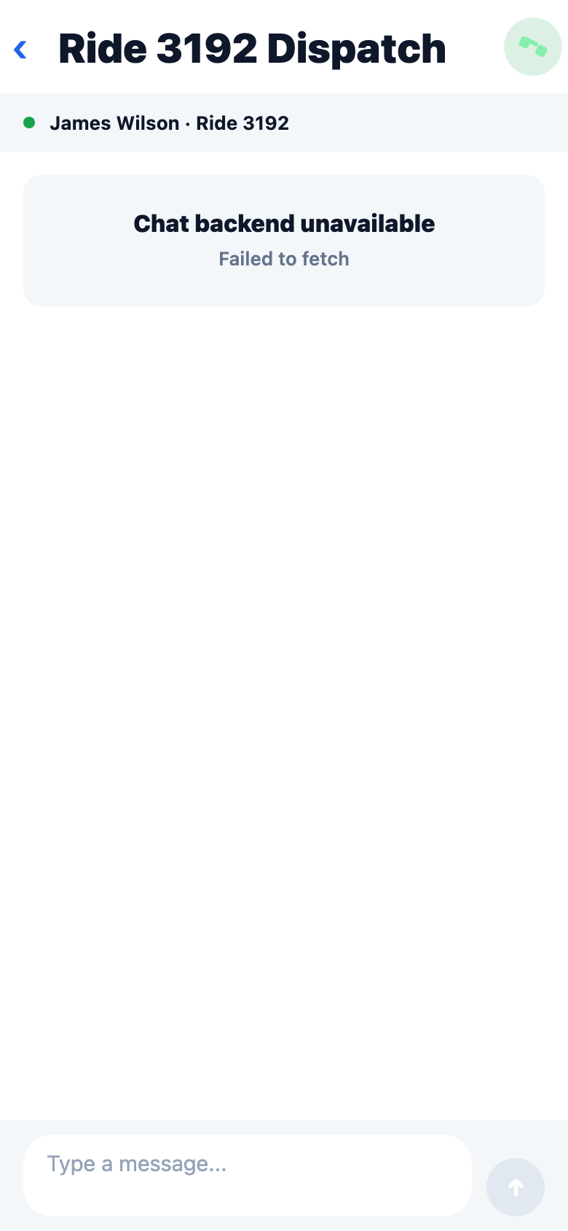
OPEN WORK
The gaps are mostly integration endpoints and hardening.
Admin-driver chat
The UI route exists, but live chat backend is unavailable in the current mobile demo path.
Push registration
POST /api/register-push-token is documented as not deployed on the live backend.
Driver profile
GET /api/me is still needed to replace settings/profile placeholders.
Production polish
Resolve nested button warning, validation/error states, and TestFlight permission copy before a broader pilot.
TrustedRiders mobile Expo app demo | screenshots captured from local demo API, May 17 2026
07

Slide 8
RECOMMENDED DEMO NARRATIVE
Show the app as a working driver loop with a clear backend punch list.
The deck should lead with confidence, then be specific about what remains. That creates trust: the app is real enough to demo, and the open work is tractable.
Demo auth, current ride, ride request, and mission flow
Mobile app
DONE
Wire deployed accept/decline, push token, chat, and /api/me
Backend
BLOCKED
Fix nested button warning and final permission/error states
Mobile app
NEXT
Suggested live demo order: sign in → current ride → ride request detail → active mission → settings → remaining backend work.
TrustedRiders mobile Expo app demo | screenshots captured from local demo API, May 17 2026
08

