Slide 1


Slide 2
What is ILift?
ILift is the perfect management tool for any gym and it’s members.

Slide 3
Motivation
In an era where we question if our jobs will be replaced by A.I. a lot of gyms still do not possess a friendly portal for client management.

Slide 4


Slide 5
Features:
management for training rooms, users, trainers, courses etc.
feedback for courses and trainers
user and administrator mode
friendly interface

Slide 6

Clean Presentation
Intuitive User Experience
Great Design
Responsiveness

Slide 7


Slide 8
Our team:
Bodea Nicolae - Software Engineer - Full stack
Bocioc Titus - Software Engineer - Back end
Codrin Strimbei - Database Manager
Carausu Catrinel - Front end developer
Alexa Sabina - Front end developer
Bica Denisa - Front end developer
Mihai Alexandru Badila - Software Engineer - Back end
Baciu Cristian - Designer and Dev-ops

Slide 9


Slide 10
Technologies
Front-end: React
Back-end: PHP,MySQL
Working Methodology: Agile - Scrumban framework
Arhitecture: REST

Slide 11


Slide 12
Unit testing - Nicu and Codrin have developed a front end page where the status of all running tests can be seen.
Manual testing - After each service method was implemented it was tested manually using Postman.
Integration testing - each front end service was tested to be able to communicate with the REST service

Slide 13
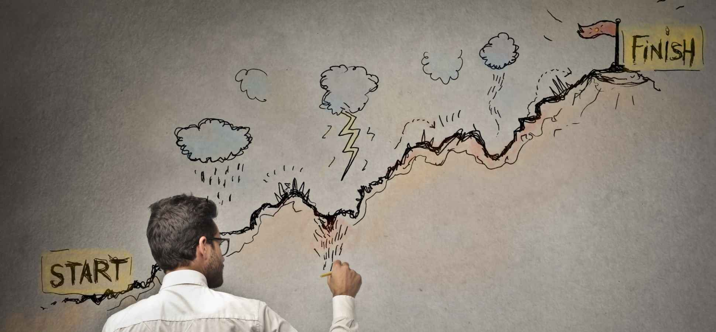

Slide 14
How it went?
We had the opportunity to work with the Agile methodology and develop a REST service using php and a front end application using React. Our team managed to develop a suitable application for any gym.

Slide 15


Slide 16
Challenges:
Choosing a backend technology
Creating services for backend in React
Learning technologies as none of us has worked with them before

Slide 17
Solutions:
Determination
Teamwork
Communication

Slide 18


Slide 19
Monetization
each gym will receive a personalized application which will be designed based on their requests
the gym will be taxed based on how much change is required to the application(for this there will be a list of prices)

