Slide 1
UK Biobank & PLINK Tool
User Guide
Jongung Song
BMIL

Slide 2
Materials
UK Biobank
What is UK Biobank?
A large-scale biobank research project in the UK aimed at disease prevention and health promotion
Collecting data from 500,000 UK adults (aged 40-69) between 2006 and 2010
Multimodal cohort study including Genomics, Clinical, Lifestyle, Health Records, and Imaging data
Available to public and private research organizations, used in over 1,500 research projects worldwide
Scale & Impact
Number of participants: 500,000+ participants
Data size: 15 PB (petabytes) or more

Slide 3
Materials
UK Biobank
Types of Data in UK Biobank
Genomic Data
SNP Array: Approximately 96M
Whole Exome Sequencing (WES): Provides data out of 500,000 individuals
Whole Genome Sequencing (WGS): Currently available to select researchers
Clinical & Lifestyle Data
Body measurements (Biometrics): Height, weight, blood pressure, etc
Blood & Urine Tests: Blood sugar, lipid levels, proteinuria, etc.
Lifestyle Data: Dietary habits, smoking, drinking, exercise habits, etc
Health Records: Hospital visits, prescription medication, death and cancer registries, etc.
Imaging Data
MRI and ultrasound imaging (brain, heart, abdomen, etc)
Environmental & Additional Data
Socioeconomic Data

Slide 4
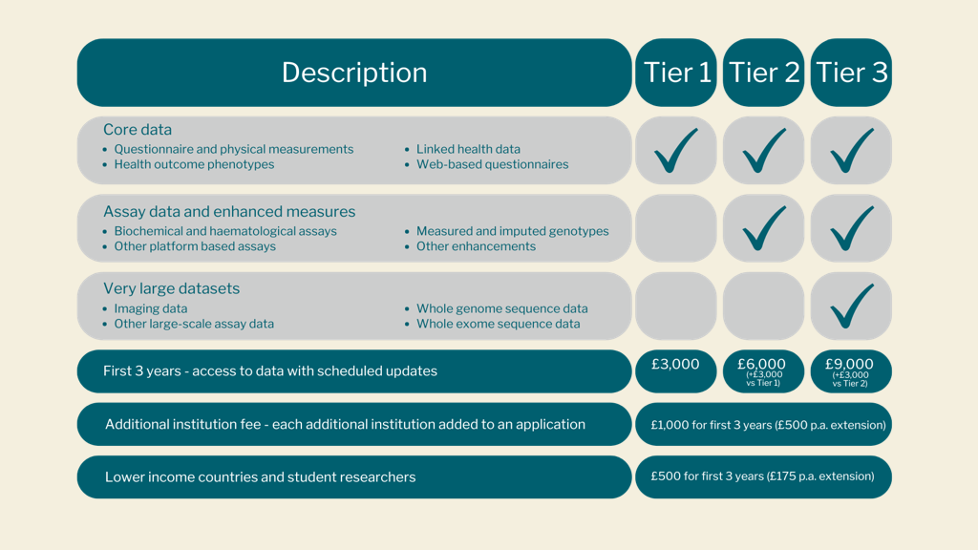
Materials
UK Biobank

Slide 5
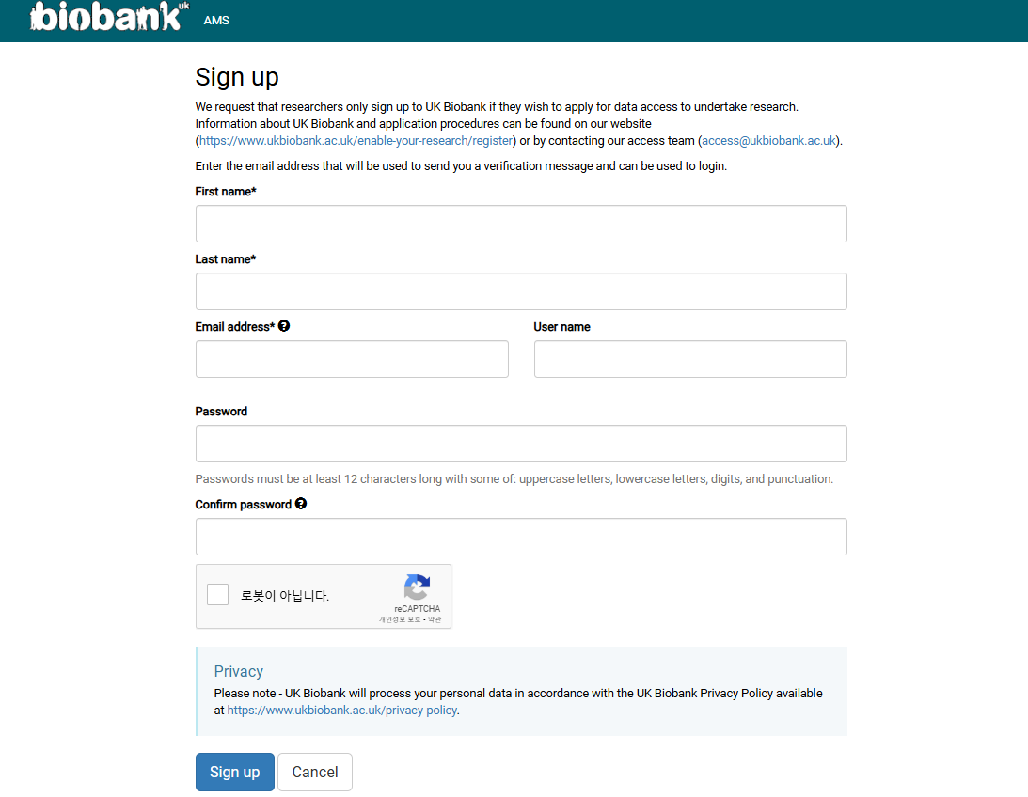
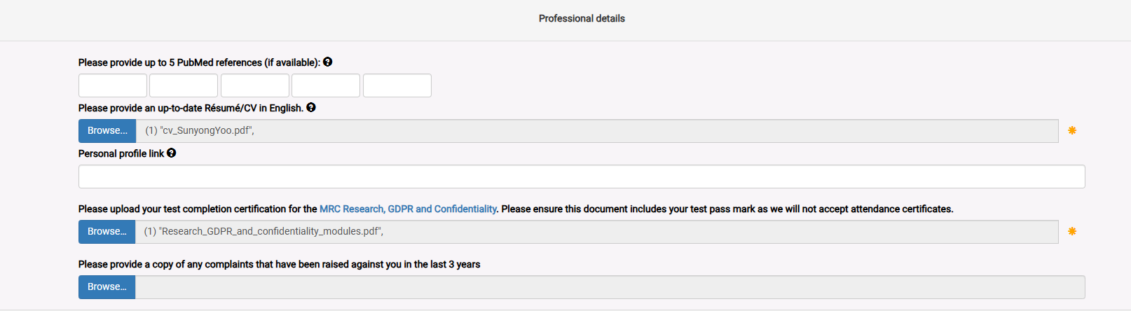
Materials
How to use UKB

Slide 6
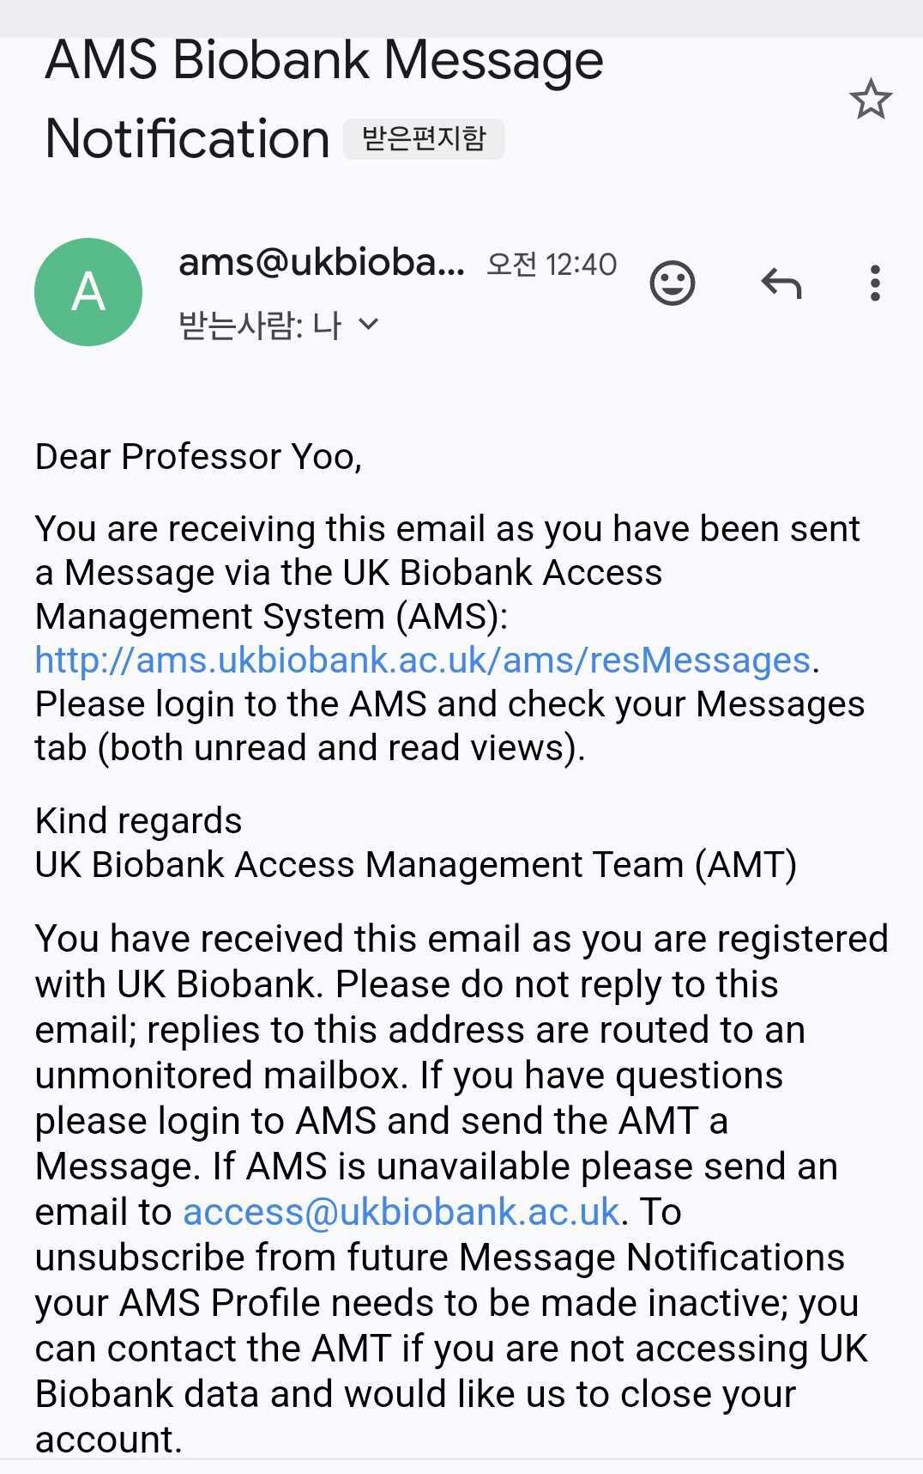
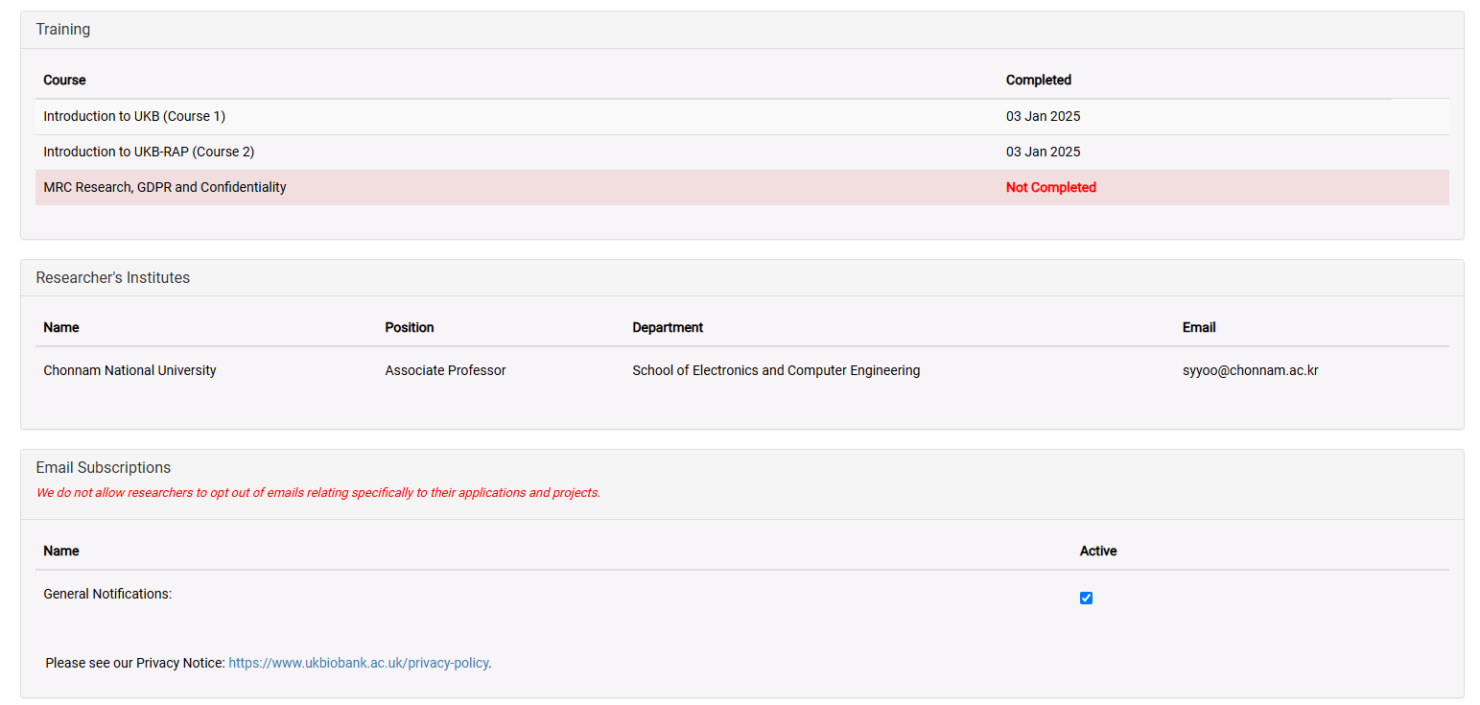
Materials
How to use UKB

Slide 7
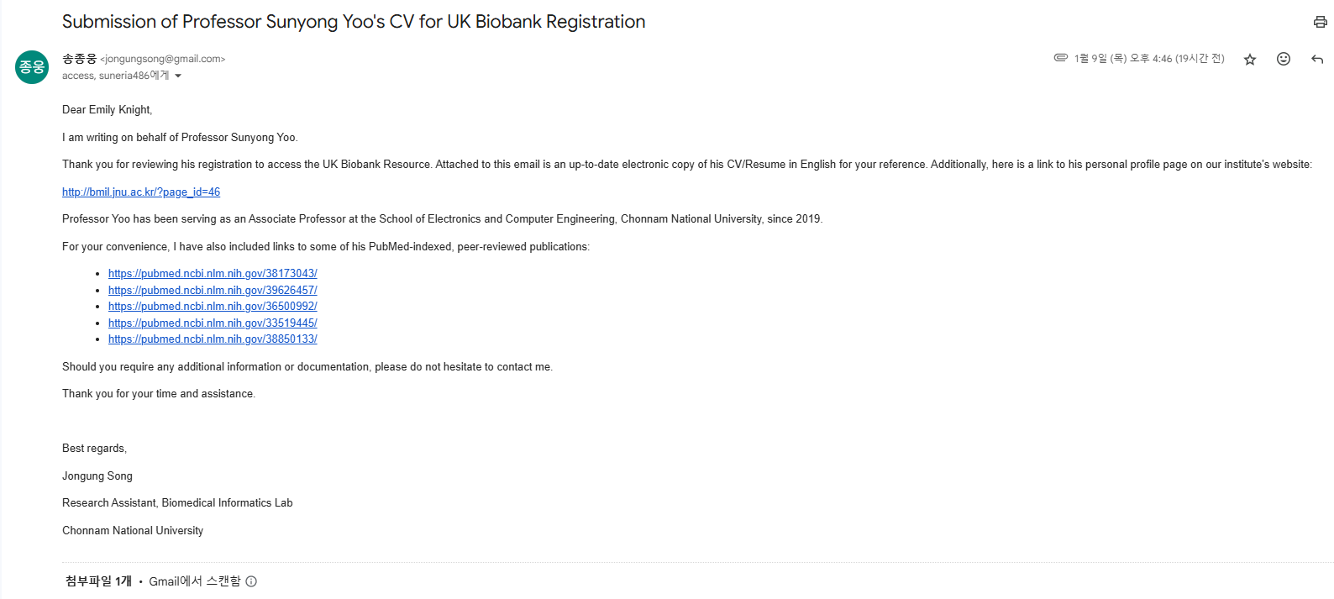
Materials
How to use UKB

Slide 8
Materials
How to use UKB
Application Submission
Once registered with UK Biobank, log in and submit an Application Draft
During this step, selecting the appropriate data tier (Tier 1, Tier 2, Tier 3)
The UK Biobank ethics and access review process will then be initiated
Review and Approval
After submission, UK Biobank may request modifications or additional details
Once approved, the MTA agreement is finalized, and the Data Access Fee is paid
Data Access and Download Process
After approval, select the Data Category in the UKBB Access Management System
UK Biobank will then authorize the bult data download and send a download key via email
Download the dataset, then proceed with decryption and decompression before use

Slide 9
Methods
PLINK: A Tool for Whole-Genome Association Analysis
What is PLINK?
PLINK is an open-source tool for genome-wide association studies (GWAS) and population-based genetic analysis
It is widely used for quality control (QC), association testing, population stratification, and genetic data formatting
It supports multiple file formats, including VCF, BED, BIM, and PED
Key Features of PLINK
Genotype Data Processing: Converts raw genotype data (e.g., VCF) into PLINK formats (.bed, .bim, .fam)
Quality Control (QC) Procedures: Includes filtering based on minor allele frequency(MAF), Hardy-Weinberg equilibrium (HWE), and genotype missingness
GWAS Analysis: Performs single-marker association tests for case-control and quantitative traits
Population Stratification: Principal component analysis (PCA) to correct for population structure

Slide 10
Methods
PLINK: A Tool for Whole-Genome Association Analysis
PLINK Input & Output Formats
Input Files
VCF (.vcf): Variant Call Format (raw sequencing data)
BED/BIM/FAM (.bed, .bim, .fam): Binary format for efficient storage
BED (Binary Pedigree)
BIM (Binary Map)
FAM (Family)
Output Files
Association Results (.assoc, .assoc.linear, .assoc.adjusted): GWAS p-values and effect sizes
QC Filtered Data (.bed, .bim, .fam): Processed genotype data

Slide 11
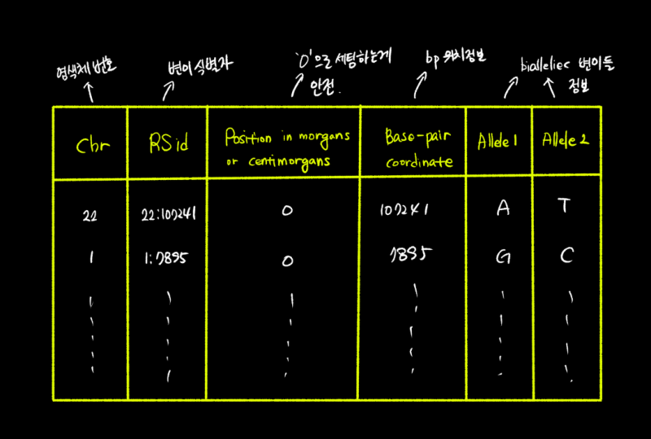
Methods
PLINK: A Tool for Whole-Genome Association Analysis
BED
PLINK’s core data file, which stores SNP genotype information in a binary format
Each individual’s genotype is stored as 0 (homozygous allele, Homozygous Reference), 1 (heterozygous, Hegerozygous), 2(homozygous variant, Homozygous Alternative)
BED files cannot be used alone without .bim and .fam
BIM
A file containing SNP (genetic variant) information, which stores the location and alleles of each variant

Slide 12
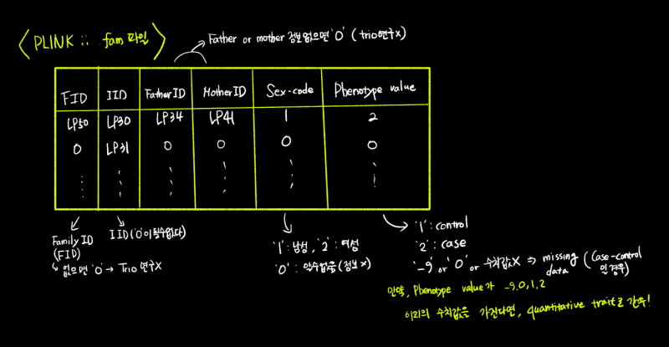
Methods
PLINK: A Tool for Whole-Genome Association Analysis
FAM
Contains information about each object (Sample), including phenotype data
Used to determine each object’s information and whether it has a disease

Slide 13
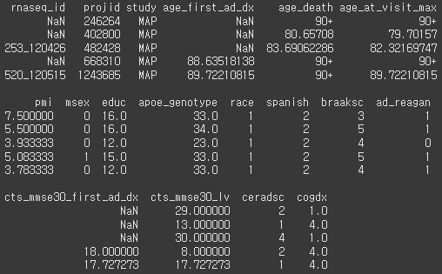
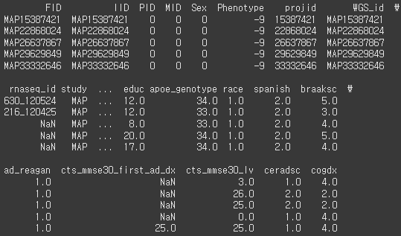
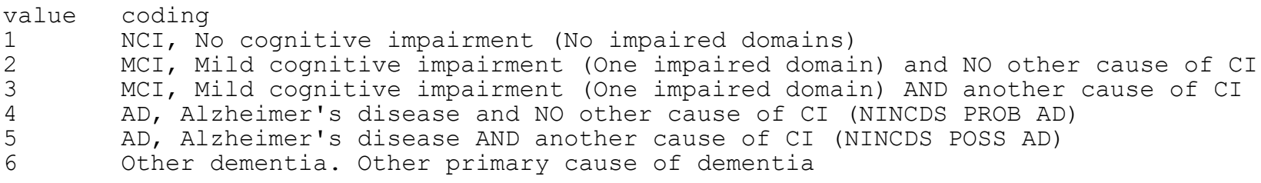
Methods
PLINK: A Tool for Whole-Genome Association Analysis
Analyze FAM files and clinical data integration

Slide 14
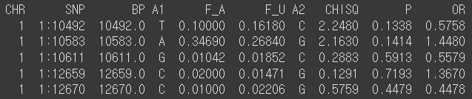
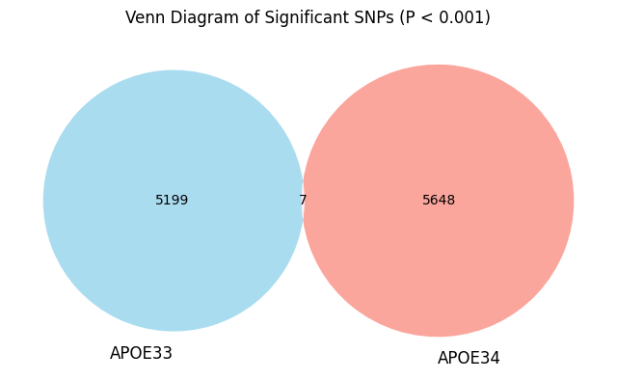
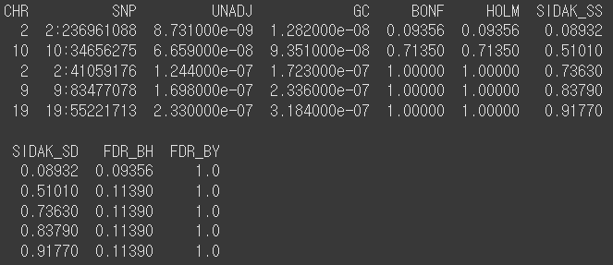
Methods
PLINK: A Tool for Whole-Genome Association Analysis
GWAS Results
Assoc
Assoc.adjusted

Slide 15
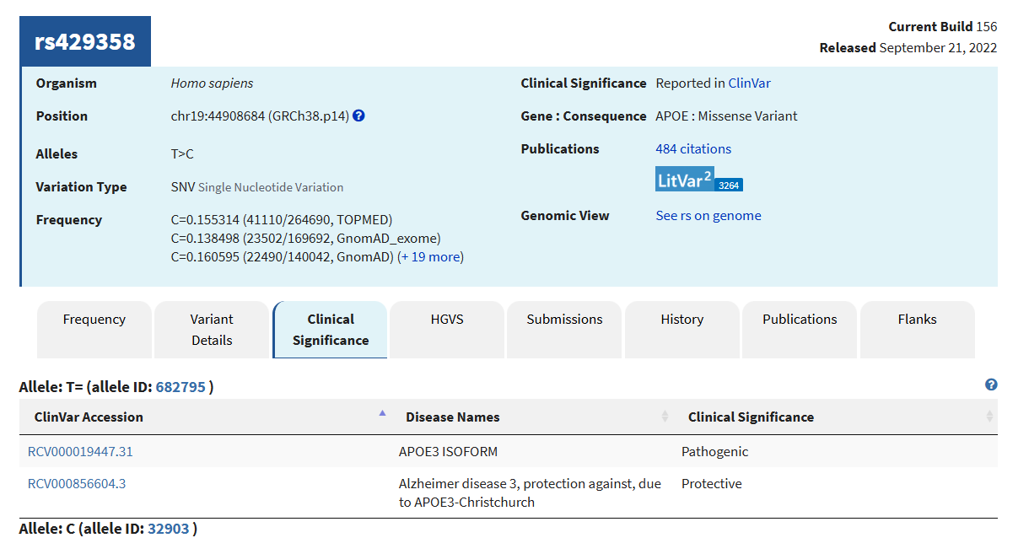
Methods
PLINK: A Tool for Whole-Genome Association Analysis
GWAS Results

