Slide 1



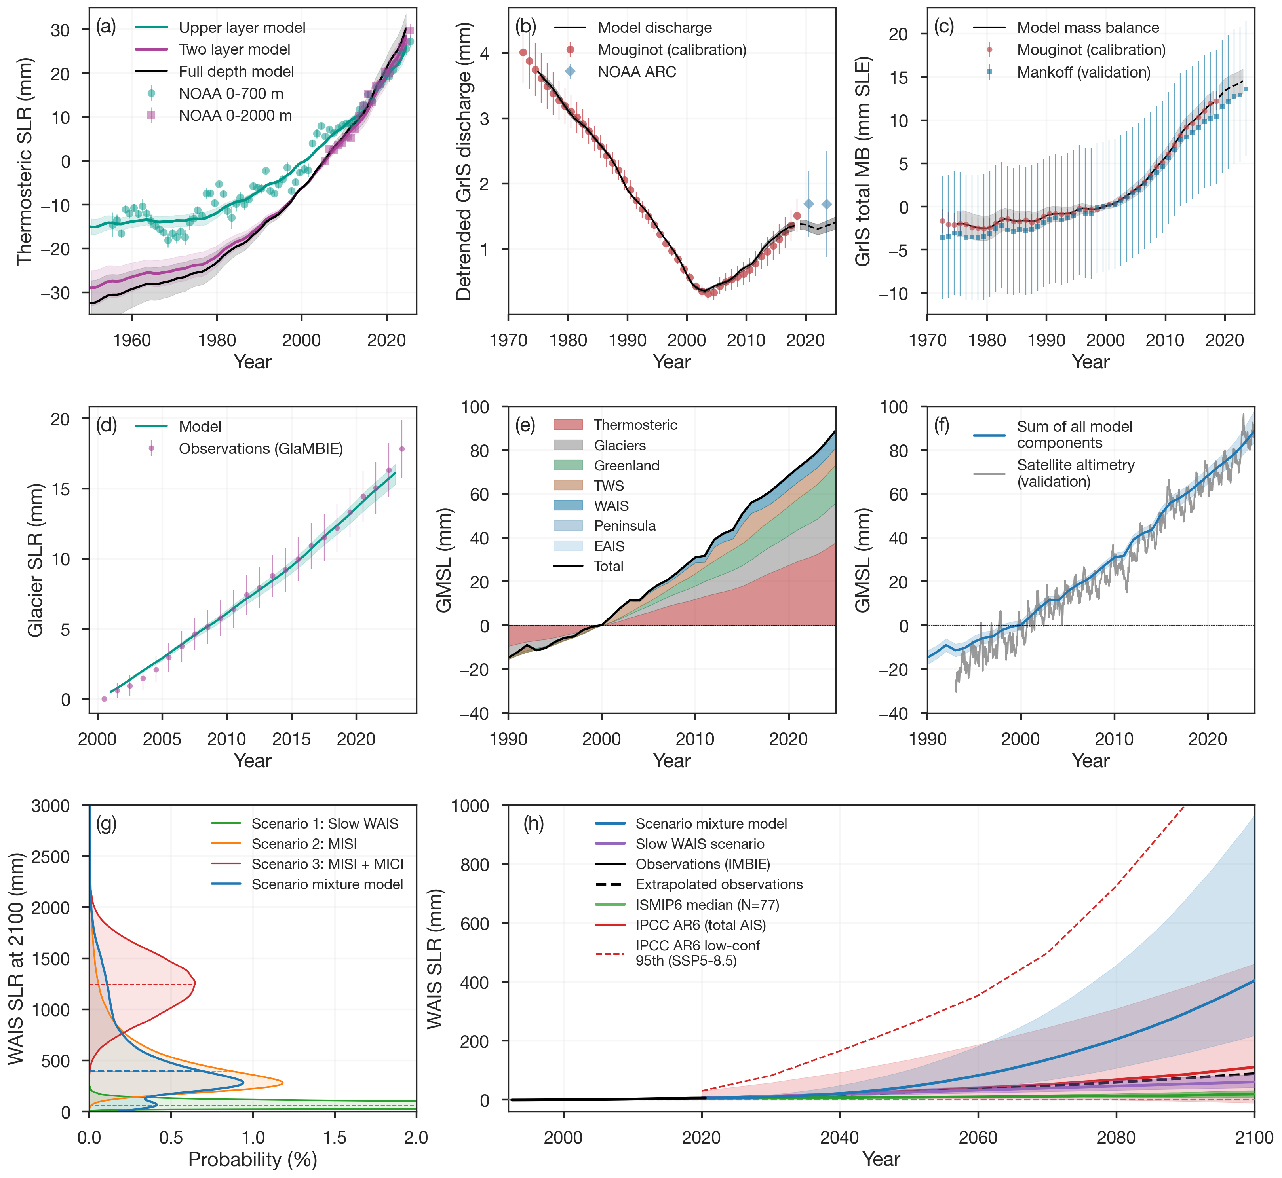
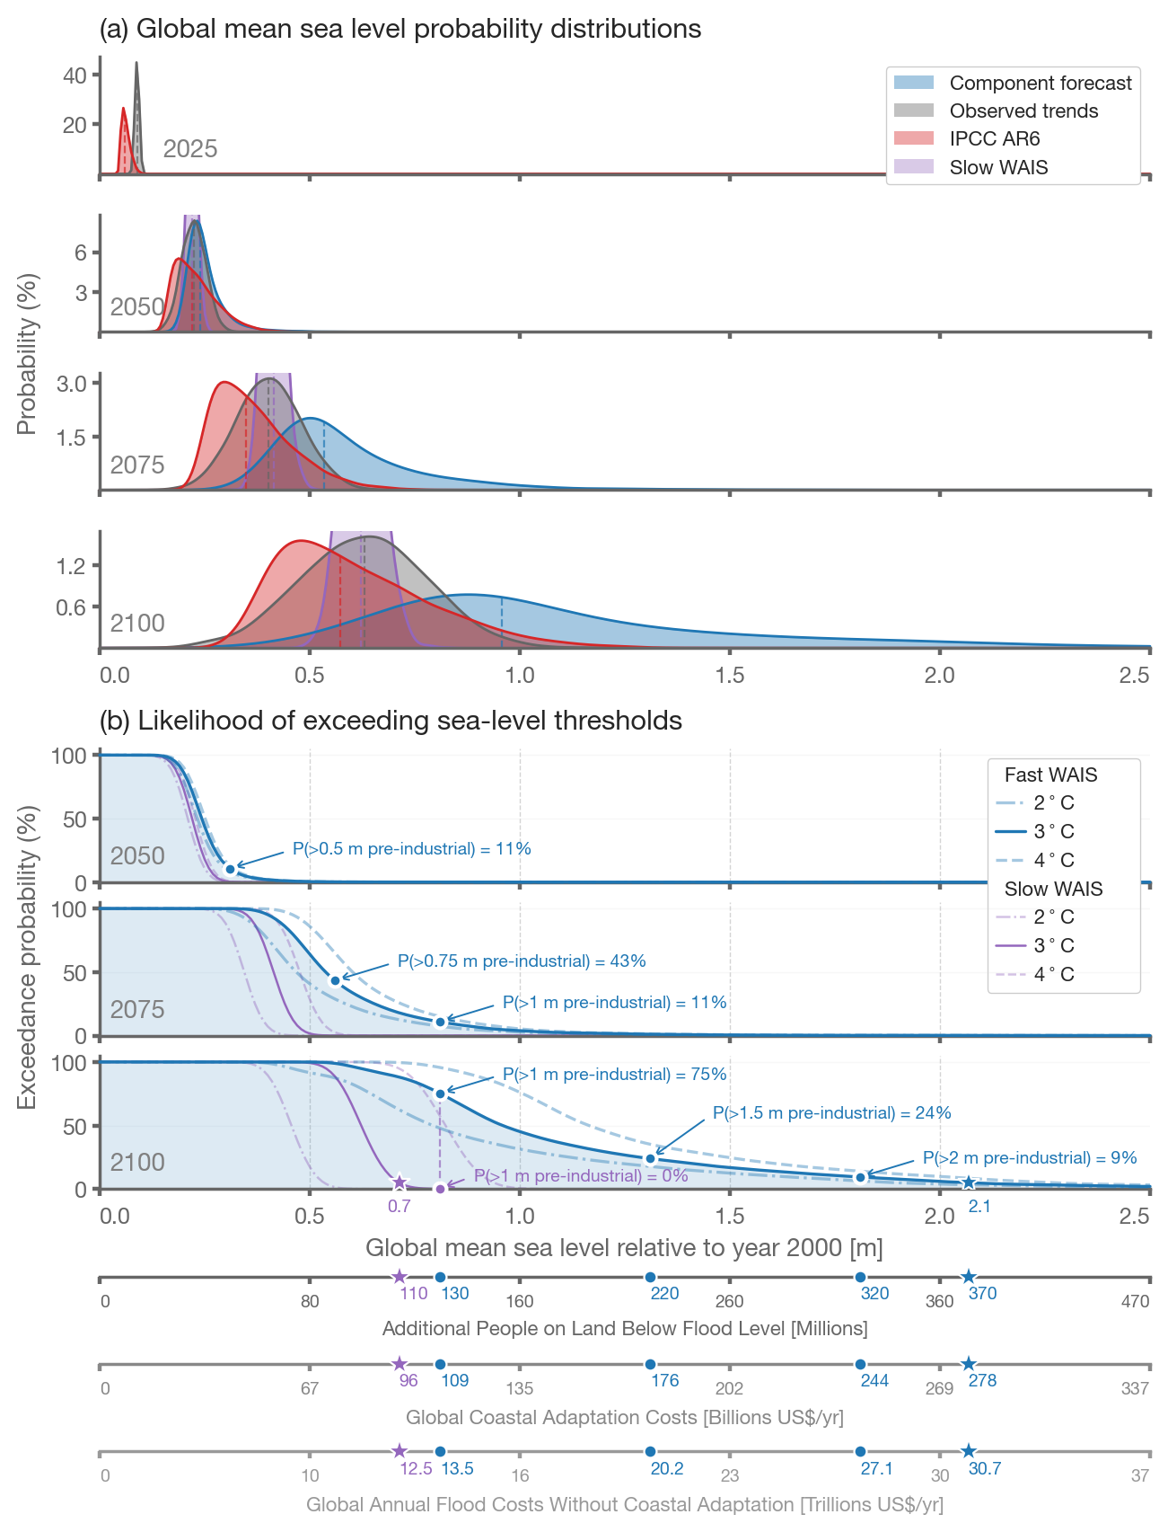
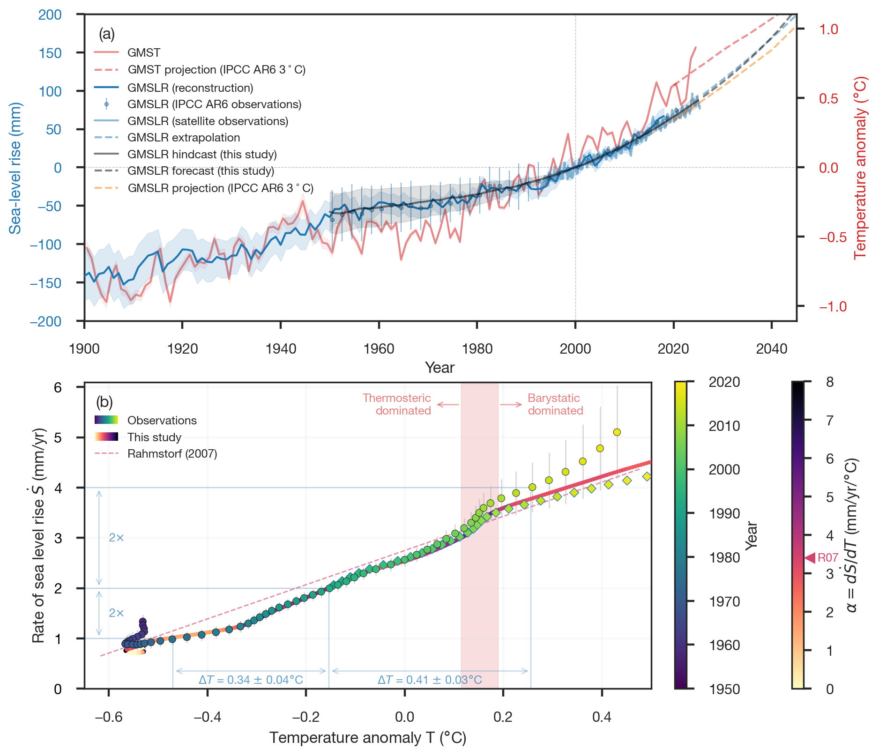
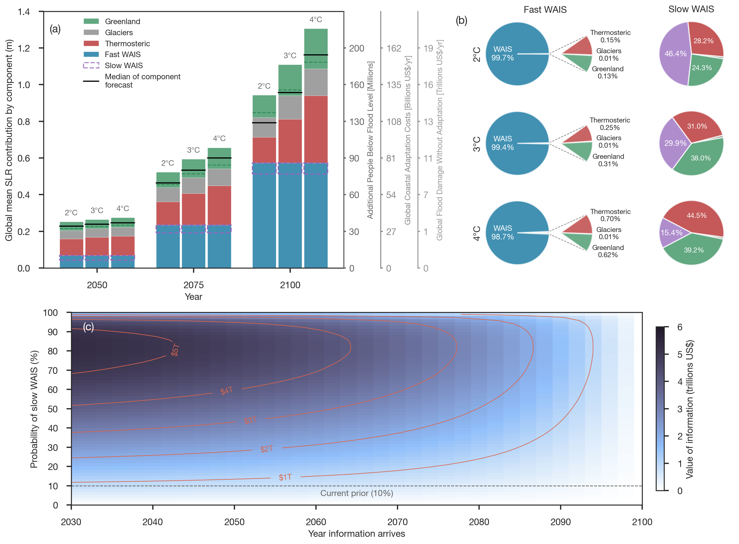
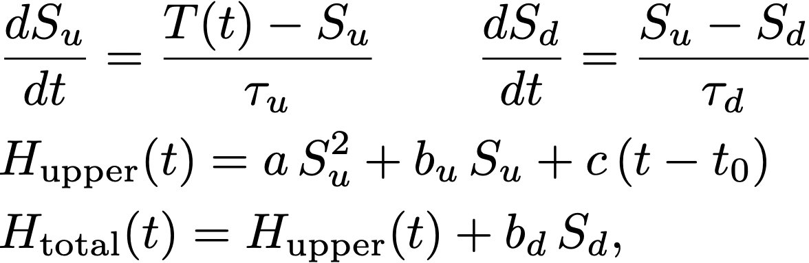
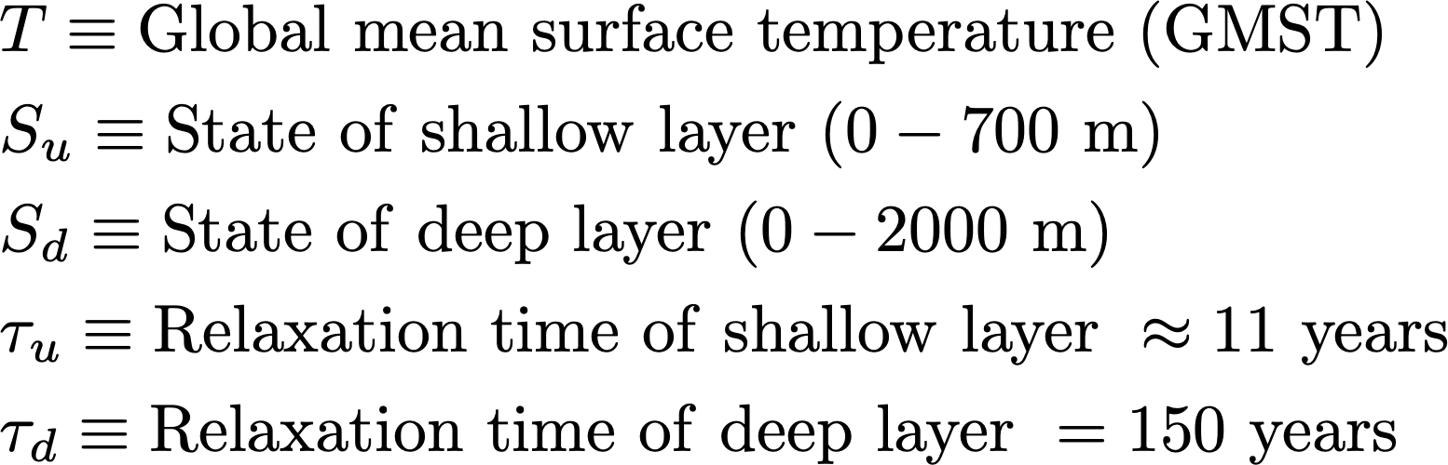
Partitioning predictable and deeply uncertain components of 21st century sea-level rise
Brent Minchew^{1,2}, Colin Meyer^{2,3}, Tobias Tiecke², Brian White², and Andi Gros²
Abstract
We construct a data-driven global mean sea-level (GMSL) forecast model by calibrating reduced physical models for individual sea-level contributors against decades-long independent observational records.
When forced with observed surface temperatures, the calibrated components sum to match observed GMSL within error back to 1950.
Our forecasts show a 73% probability of GMSLR exceeding 1 meter (pre-industrial), and 10% of exceeding 2 meters, by the end of the century.
The dynamics of West Antarctic glaciers account for >90% of the forecast uncertainty.
Reveals orthogonal dimensions of sea-level risk: emissions reduction decreases median projections related to the predictable, temperature-sensitive components, but leaves the WAIS-driven, high-risk tail of the distribution largely unchanged.
(Note: SSP1-2.6, SSP2-4.5, SSP3-7.0 map to 2 ℃ , 3 ℃, 4 ℃)
Model components (only showing most relevant)
Forecasts
Global data and model performance
Key takeaways:
Hindcast results of our model closely match independent observations in (a) GMSL time-series and (b) GMSL rate and temperature anomaly
Forecasts track observed trends in the first decade
Ocean thermal expansion (thermosteric): Modeled as a two-layer energy balance, each with a variable state, relaxation time, and sensitivities.
Greenland glacier discharge: Modeled as an ocean-driven delay model forced by EN4 ocean temperatures in the peripheral waters surrounding Greenland.
Greenland surface mass balance (SMB): Calibrated with regional climate models due to a lack of sufficient data coverage
West Antarctic Ice Sheet (WAIS) represented by a probabilistic scenario-mixture model that accounts for the broad range of possible mass loss rates from the scientific literature.
`Slow WAIS’: Ice sheet continues to lose mass at the current rate and acceleration
`Fast WAIS’: Internal feedbacks (primarily MISI) accelerate mass loss. These are taken to independent of emission scenarios.
Variance decomposition
Internal dynamical feedbacks in WAIS make variances of all other sea-level contributors negligible
Take-aways
Virtually all uncertainty is in West Antarctica
Other sea level contributors are predictable
Orthogonal risks:
Cutting emissions reduces the predictable, temperature-sensitive components
WAIS contribution is largely insensitive to emission reductions
Most valuable question: How fast will WAIS lose mass?

