Slide 1


TCL Technical Seminar 2019/05/16 Kalman Filters Benjamin Ionescu

Slide 2
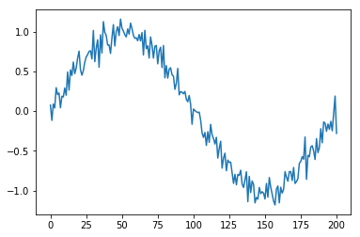
Goal: filter a basic noisy signal
X-axis: np.linspace(-np.pi, np.pi, 201)
Y-axis: np.sin(x_axis) + noise
1
Notes:
13

Slide 3
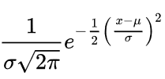
What did I use for noise?
Gaussian noise.
Noise = sigma*np.random.randn(201) + mu
Reason: Optimizing MSE provides best estimate – iff noise is Gaussian [Ref. 1, page 2]
2
Notes:
13

Slide 4

Process + Measurement model
‘x’ is the true value we want to estimate, because we cannot measure it
‘w’ is “associated white noise with known covariance”
‘z’ is what we measure
‘v’ is “associated measurement error”
‘H’ is “noiseless connection between state vector and measurement vector”
‘Phi’ is the state transition matrix
3
Notes:
13

Slide 5
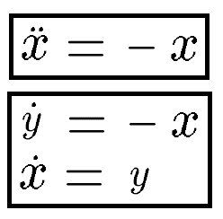
What is phi?
Convert to state space [Ref. 2, page 20]
Next slide shows matrix representation
4
Notes:
13

Slide 6
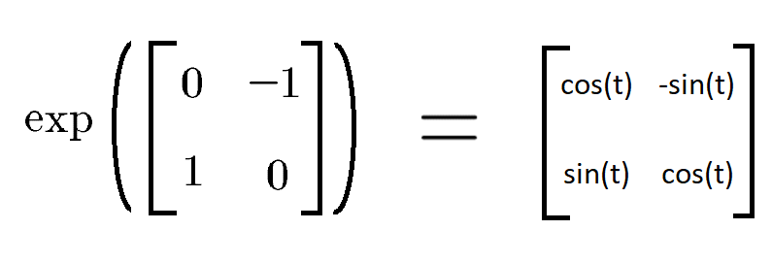
What is phi?
According to [2], Phi from equation (1) is given by the exponential
Actually dt, not t [Ref. 2, page 21]
5
Notes:
13

Slide 7
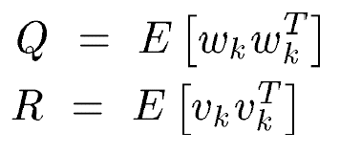
What is H? New challengers: Q? R?
The ‘H’ matrix from equation (2) is identity.
That leaves ‘w’ and ‘v’. But we don’t need them directly – we just need their matrices [Ref. 1, page 3]:
Process noise variance
Observation noise variance
6
Notes:
13

Slide 8
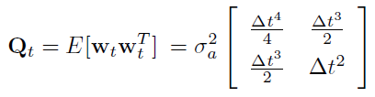
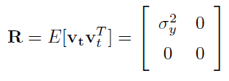
What are Q, R?
Stolen from [Ref. 2, page 24], [Ref. 2, page 25]
Consistent Q, R notation [Ref. 2, page 22]
7
Notes:
13

Slide 9
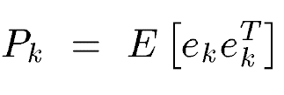
How to use this model here?
Now we have Phi, H, Q, R. Last matrix missing is a “P_0” matrix, representing initial error:
I was not sure what to use, so I just put identity. We also need an initial estimate – so I just used x_0 = [1 0]
8
Notes:
13

Slide 10
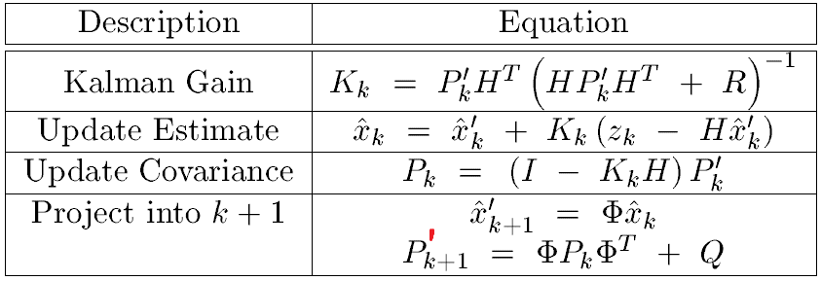
How to use this model here?
Skipping the derivation, we now just follow this scheme [Ref. 1, page 6].
9
Notes:
13

Slide 11
How to use this model here?
But, the problem I have, is that the result is noisy:
10
Notes:
13

Slide 12
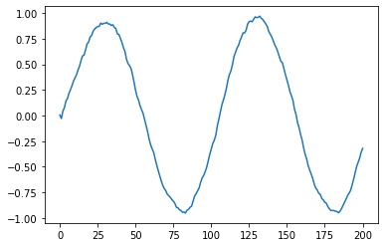
Edit: new result successful
The mistake was that Q and R must be diagonal
11
Notes:
13

Slide 13
References
[1] Lacey, Tony. "Tutorial: The Kalman Filter." Georgia Institute of Technology (1998).
[2] Unknown author, “The Kalman Filter.” Cornell University (2006)
12

Slide 14
감사합니다 Thank you

