Slide 1


TCL Technical Seminar 2019/05/16 Kalman Filters Benjamin Ionescu

Slide 2
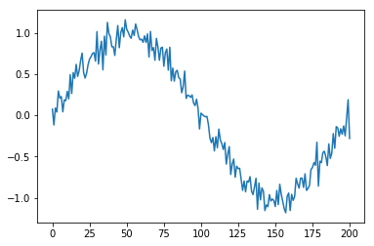
Goal: filter a basic noisy signal
X-axis: np.linspace(-np.pi, np.pi, 201)
Y-axis: np.sin(x_axis) + noise
1
Notes:
<number>

Slide 3
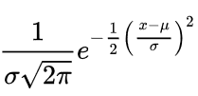
What did I use for noise?
Gaussian noise.
Noise = sigma*np.random.randn(201) + mu
Reason: Optimizing MSE provides best estimate – iff noise is Gaussian [Ref. 1, page 2]
2
Notes:
<number>

Slide 4
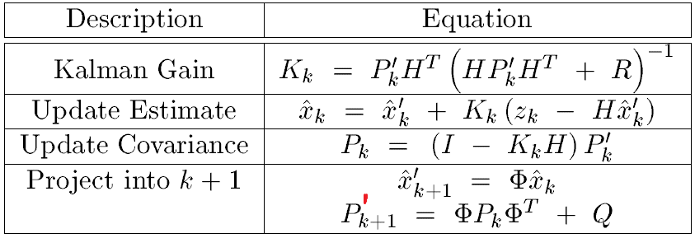
The Kalman Filter Algorithm
To run this algorithm [Ref. 1, page 6], we need to define: H, R, P, x, z, Q and Φ
3
Notes:
<number>

Slide 5

Process + Measurement model
‘x’ is the true value we want to estimate, because we cannot measure it
‘w’ is “associated white noise with known covariance”
‘z’ is what we measure – just the value of the noisy signal
‘v’ is “associated measurement error”
‘H’ is “noiseless connection between state vector and measurement vector”
‘Phi’ is the state transition matrix
Defined: H, R, P, x, z, Q and Φ
4
Notes:
<number>

Slide 6
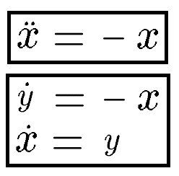
What is phi?
Convert to state space [Ref. 2, page 20]
Next slide shows matrix representation
Defined: H, R, P, x, z, Q and Φ
5
Notes:
<number>

Slide 7
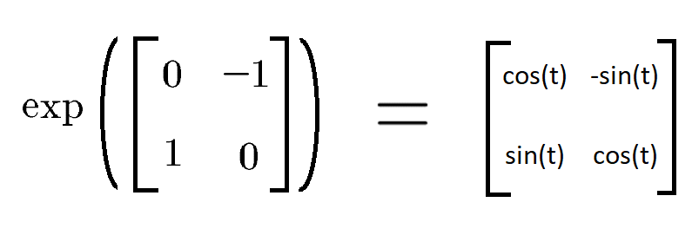
What is phi?
According to [2], Phi from equation (1) is given by the exponential
Actually dt, not t [Ref. 2, page 21]
Defined: H, R, P, x, z, Q and Φ
6
Notes:
<number>

Slide 8
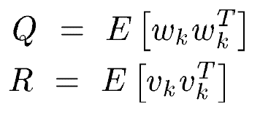
What is H?
The ‘H’ matrix from equation (2) is identity.
That leaves ‘w’ and ‘v’. But we don’t need them directly – we just need their matrices [Ref. 1, page 3]:
Process noise variance
Observation noise variance
Defined: H, R, P, x, z, Q and Φ
7
Notes:
<number>

Slide 9
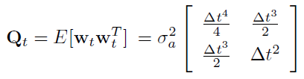
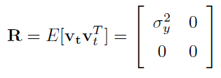
What are Q, R?
Stolen from [Ref. 2, page 24], [Ref. 2, page 25]
Consistent Q, R notation [Ref. 2, page 22]
Defined: H, R, P, x, z, Q and Φ
8
Notes:
<number>

Slide 10
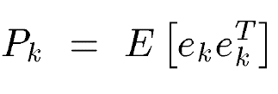
What are x, P?
Now we have Phi, H, Q, R. Last matrix missing is a “P_0” matrix, representing initial error:
I was not sure what to use, so I just put identity. We also need an initial estimate – so I just used x_0 = [1 0]
Defined: H, R, P, x, z, Q and Φ
9
Notes:
<number>

Slide 11
Everything is defined
Skipping the derivation, we now just follow this scheme [Ref. 1, page 6].
10
Notes:
<number>

Slide 12
Incorrect definition somewhere?
But, the problem I have, is that the result is noisy:
11
Notes:
<number>

Slide 13
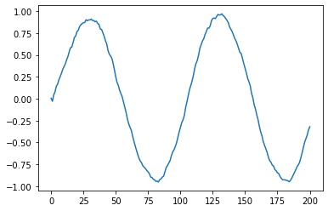
Edit: new result successful
The mistake was that Q and R must be diagonal
12
Notes:
<number>

Slide 14
References
[1] Lacey, Tony. "Tutorial: The Kalman Filter." Georgia Institute of Technology (1998).
[2] Unknown author, “The Kalman Filter.” Cornell University (2006)
13

Slide 15
감사합니다 Thank you

