Slide 1
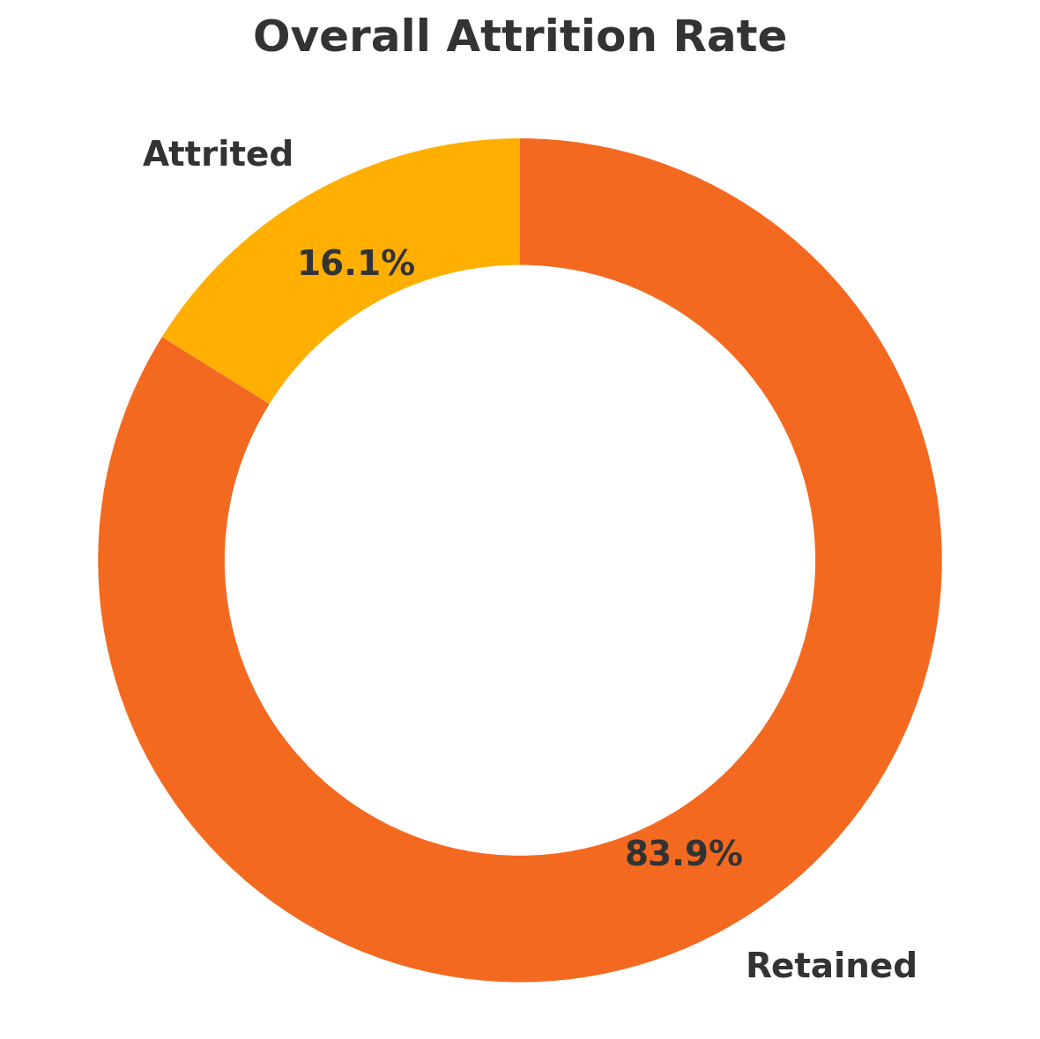
Attrition Insights at a Glance
Education Level Bachelors and Master’s Degree holders form the the highest majority of leavers
Work Experience and Tenure Risk Peak exits occur among the younger working professionals
Department Hotspots R&D and Sales have the highest churn, followed by HR
Demographic Trends Single, male, and 28-37 year olds form the majority of leavers
Overtime Impact 54% exit rate for employees working overtime vs. 46% for those who don’t

Slide 2
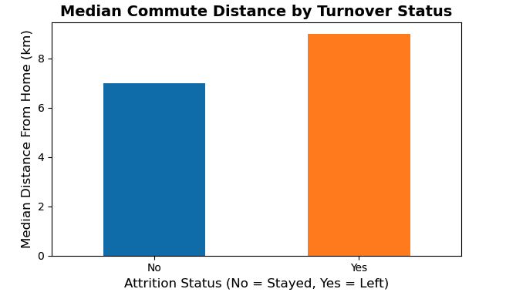
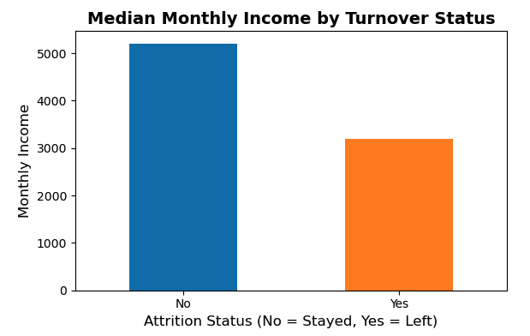
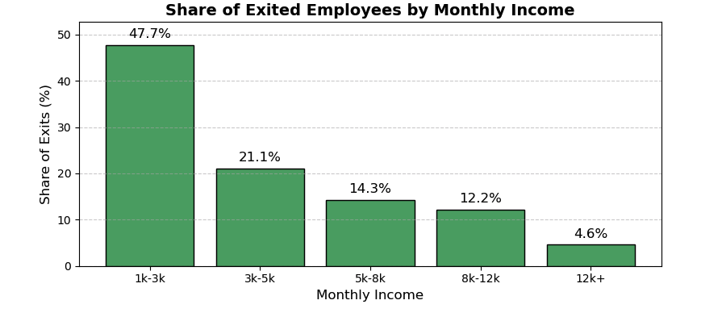
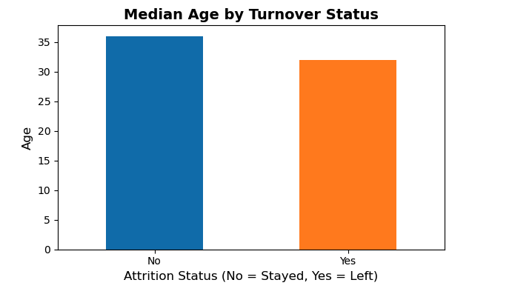
Attrition Insights at a Glance

Slide 3
Top 5 Key Drivers of Attrition
For deeper analysis, a tree-based model fitment was performed, which in turn identified the top five key drivers of Attrition.
Competitive Pay (12.8 %) Higher salaries are the strongest retention lever.
Employee Age (10.0 %) Older staff members are more likely to stay.
Overall Experience (8.9 %) More total working years reduces exit risk.
Commute Length (7.8 %) Longer drives push people closer to quitting.
Tenure at Company (7.6 %) The longer someone’s been here, the less likely they’ll leave.
Notes:
Salary carries the greatest weight in our model, so it’s the most important factor when it comes to why people leave.
To drive retention, start by reviewing the pay levels, then focus on supporting early-career employees, easing commutes, and celebrating tenure.

Slide 4
Further Action Plan
Compensation and Benefits • Review salary structures and employee benefits to ensure that they are in accordance with the industry standards in order to reduce attrition
Enhance Work–Life & Commute Support • Introduce flexible scheduling, remote-work options, and transit stipends for employees facing long commutes or low W-L balance scores.
Strengthen Early-Career Retention • Implement structured onboarding, mentoring, and career-development programs to reduce first-year exits in high-risk groups (R&D, Sales, singles 18–24).
Measure & Govern • Build a live dashboard tracking turnover, satisfaction, commute, and tenure metrics. • Assign an HR partner per department and hold quarterly review meetings to monitor progress and adjust tactics.

Slide 5
Appendix

